Slide 1


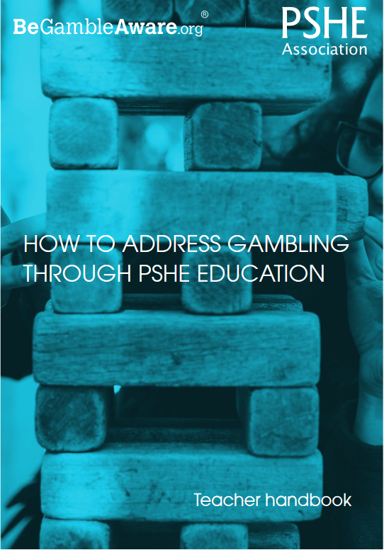
Teacher
slide
Exploring risk
KS2
Ensure you read the guidance before teaching the lesson
© PSHE Association & Gamble Aware, 2020

Slide 2
Using this PowerPoint
Teacher
slide
The slides in this presentation are divided into two sections:
Teacher slides (blue) – provide key information regarding lesson preparation
Pupil slides (white) – provide a visual focus point for pupils during the lesson and delivery notes for teachers about the activities. Click ‘notes’ to view these.
Ensure that you select ‘Use Presenter View’ under the ‘Slide Show’ tab – this will allow you to preview the teaching notes on your monitor while the main presentation is displayed on a screen/smartboard.

Slide 3
Context
Teacher
slide
This KS2 lesson focuses on pupils’ understanding and assessment of risk, and how to manage when risk arises. It enables pupils to talk about what is meant by risk and develop strategies for dealing with it. It provides a suitable starting point prior to exploring different types of risk in more detail, for example in relation to drug, alcohol and tobacco education or gambling education.
A follow-up lesson exploring risk in relation to gambling is provided for pupils in Year 5/6. This lesson is not designed to be taught in isolation and should form part of a planned, developmental programme for PSHE education. Timings provided are approximate – teachers are expected to adapt delivery according to the needs of their pupils and their previous learning on risk.

Slide 4

Teacher
slide
Learning objective
To learn about risk in everyday situations
Learning outcomes
Pupils will be able to:
assess how risky different everyday activities are
describe how important it is to ‘stop and think’ before taking a risk
explain what makes a risk worth taking and what makes it too risky

Slide 5
Preparing to teach
Teacher
slide
Climate for learning
Make sure you have read the accompanying teacher guidance notes before teaching this lesson – for guidance on establishing ground rules, the limits of
confidentiality, communication and handling questions effectively.
Resources required
Box/envelope for anonymous questions
Paper
Resource 1: Risky activities
Resource 2: Risk scenarios
Resource 3: Risk reflection sheet
      Duration
      This has been designed to be taught as a sixty minute PSHE education lesson
60

Slide 6
Lesson summary
Teacher
slide
Activity | Description | Timing
1. Baseline assessment | Discuss what is meant by risk, types of risks and what makes something more or less risky | 5-10 MINS
2. Risk continuum | Pupils draw an example of a risky activity then place them on a risk continuum - class feedback and discuss | 15 MINS
3. Paired discussion | Pupils discuss why people take risks | 5 MINS
4. In the moment | Class discuss how a character could manage a situation involving risk | 10 MINS
5. Risk scenarios | Pairs of pupils assess levels of risk in different situations, potential consequences and suggest how to minimise the risk | 15 MINS
6. Endpoint assessment | Pupils complete a self-evaluation sheet about their learning on risk | 5 MINS
7. Extension activity | Pupils create a cartoon strip using the ‘in the moment’ scenario as stimulus, provide advice and depict a positive outcome | -
© PSHE Association 2018

Slide 7
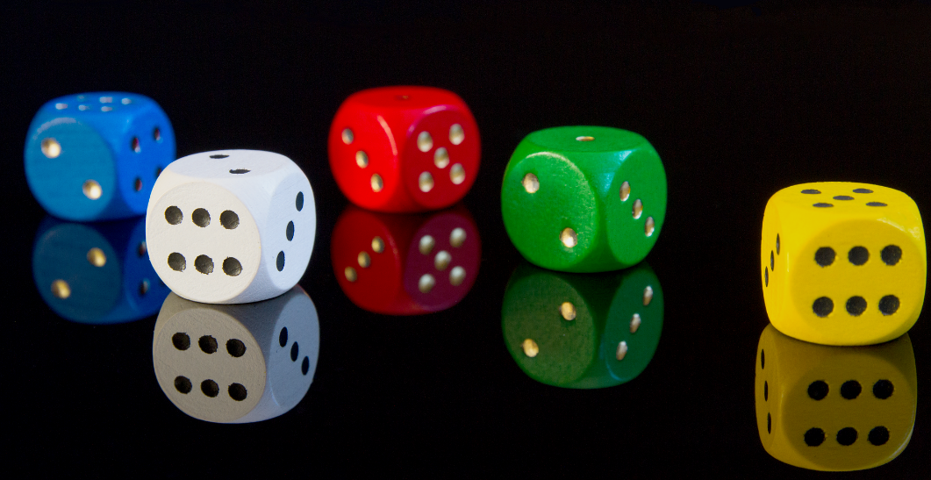
Exploring risk

Slide 8

Ground rules
[Add your class rules here]
Notes:
Teacher Notes
Use this slide to display your class agreement / ground rules for PSHE education lessons. See Accompanying Teacher Guidance Notes (separate document).

Slide 9


Risk: What’s our starting point?
Discuss as a class:
What is meant by risk?
What kinds of things are risky?
What makes something more or less risky?
Notes:
Teacher Notes - Baseline assessment (10 mins)
Use this activity to gain a sense of pupils’ understanding of the concept of risk and those they are familiar with.
Discuss, as a class what is meant by risk. What kinds of things are risky?
Discuss what makes something more or less risky?
Example definition of risk: Risk is the possibility of taking an action when we cannot always predict what will happen and when there is the potential of losing something of value. Most things people do carry some risk, but some activities are much riskier than others.
(Adapted from Wikipedia definition of ‘risk’)
Draw out that high-risk activities are likely to include:
possible loss to life, health or other serious loss (e.g. financial, environmental)
a high chance of a negative outcome (not being successful)
Pupils may or may not include gambling-related risk - if gambling is included in the pupils’ awareness, it may indicate an increased likelihood that pupils would benefit from Lesson 2 as a progression from this lesson.

Slide 10

      We are learning about risk
      We will be able to:
  assess how risky different everyday situations are
  describe how important it is to ‘stop and think’ before taking a risk
  explain what makes a risky worth taking and what makes it too risky
Notes:
Teacher Notes – Learning objective and outcomes
Introduce the learning objectives and outcomes

Slide 11

Work in groups to rank the activities from lower to higher risk
Risk continuum
Draw a risky activity…
Higher risk
Medium risk
Lower risk
Notes:
Teacher Notes – Risk continuum (10 mins)
Working in groups, each pupil draws a risky activity, then as a group - rank them on a line of continuum (lower risk, medium risk, higher risk).
If you want to use or add in other examples for the pupils to consider, see: Resource 1: risky activities
Take feedback, making a class version of the risk continuum on the whiteboard or flipchart, choosing some of the example activities and asking pupils to explain and justify where they would place the activity on the line of continuum.
Support: Use a simple continuum: lower risk – higher risk
Challenge: Use a more complex continuum: lowest risk, lower risk, medium risk, higher risk, highest risk. Pupils explain what else would affect the level of risk (e.g. the person taking the risk – their age or capability level) or other details relating to the activity.

Slide 12

Why do people take risks?
Discuss…
Why might someone want to take the risk?
Notes:
Teacher Notes – Paired discussion (5 mins)
Choose one of the examples from the previous activity, pairs discuss why someone might take or want to take the risk – what might encourage them? Discuss that with risk, can sometimes come gain.
Pupils might say: to have fun, because it’s exciting, to get or win something, because their friends are doing it, it will help them or they can’t live without it, because they feel confident, it’s a low risk activity anyway

Slide 13

Why do people take risks?
Jamie is skateboarding with a group of friends. They dare Jamie to do a skateboard trick on the road. Jamie does it, thinking it will be fun, without thinking of the risks.
Discuss…
Why doesn’t Jamie think about the risks?
What could Jamie have done in this moment instead?
Notes:
Teacher Notes – In the moment (15 mins)
Read the following scenario to the class:
Jamie is skateboarding with a group of friends. They dare Jamie to do a skateboard trick on the road. Jamie does it, thinking it will be fun, without thinking of the risks.
Pupils discuss:
Why doesn’t Jamie think about the risks?
What could Jamie have done in this moment instead?

Slide 14
‘I’m not risking doing a I’m not risking doing a trick like that on the road, no!
like that!’
Exit strategies
Jamie could:
You must be joking – I’ve only just recovered from the last trick I tried!
Quickly assess the situation and say no…
Give an alternative option…
Providing a reason to leave the situation…
Use humour…
Ask for advice…
I’ll do the trick but not on the road – let’s go to the skate park.
‘I’m not sure, I might just check with (trusted adult e.g. parent/teacher) first.
‘Actually, I need to Actually, I need to get to the shop before it shuts.
shuts.’
Notes:
Teacher Notes – In the moment (15 mins)
What could Jamie have done in this moment instead?
Discuss how important it is to ‘stop and think’ before taking a risk but that people can find this difficult when they are caught up in the excitement of the moment, they are with others who are encouraging them, they may want peer approval (to be liked, accepted, show off their skills).
Discuss different exit-strategies that can help to ‘buy time’ to stop and think or walk away from potentially unsafe situations such as:
Quickly assessing the situation and saying no… ‘I’m not risking doing a trick like that on the road, no!’
Giving an alternative option… ‘I’ll do the trick but not on the road – let’s go to the skate park.’
Making an excuse… ‘Actually, I need to get to the shop before it shuts.’
Using humour… ‘You must be joking – I’ve only just recovered from the last trick I tried!’
Asking for advice… ‘I’m not sure, I might just check with (trusted adult e.g. parent/teacher) first.’

Slide 15
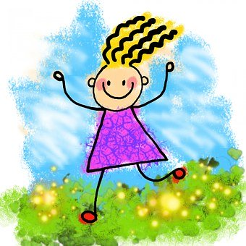
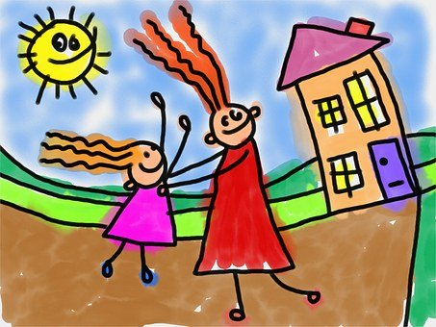
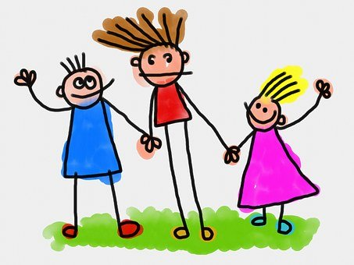
Assessing risk
The level of risk in any situation depends on:
The person
Where it is happening
Who else is there
Notes:
Teacher Notes – Risky scenarios (15 mins)
Display scenarios from Resource 2: risk scenarios. Teachers should select the scenarios they think are relevant and appropriate for their class.
Explain that risk assessment also depends on:
The person (e.g. their age, capability, whether they can afford to take the risk)
Who else is there (if they can help or how taking the risk will affect them)
Where it is happening – the place or situation
Plus…
Whether the risk-factor can be reduced
Whether taking the risk is likely to pay off

Slide 16
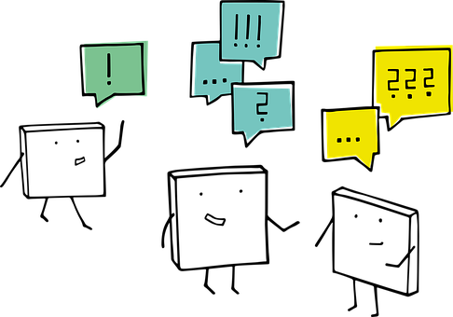
Risky scenarios
Work in pairs, read the scenario and consider:
What are the potential dangers or consequences of taking the risk?
How risky is the situation? Why?
Is it worth them taking the risk?
Notes:
Teacher Notes – Risky scenarios (15 mins) cont’d…
Pupils work in pairs to read the scenarios and consider the questions:

Slide 17
Risky scenarios
  The possible dangers or consequences of taking this risk are __________.
It is high / medium / low risk because _______________________________.
  OPTION 1: Yes, they should take this risk.
  OPTION 2: Yes, they should take the risk but only if… (are there things that would make this activity lower risk?)
  OPTION 3: No, they should not take the risk, this activity is too risky because…
Notes:
Teacher Notes – Risky scenarios (15 mins) cont’d…
Display scenarios from Resource 2: risk scenarios. Teachers should select the scenarios they think are relevant and appropriate for their class.
Explain that risk assessment also depends on:
The person (e.g. their age, capability, whether they can afford to take the risk)
Who else is there (if they can help or how taking the risk will affect them)
Where it is happening – the place or situation
Plus…
Whether the risk-factor can be reduced
Whether taking the risk is likely to pay off
Pupils work in pairs to read the scenarios and consider the questions:
What are the potential dangers or consequences of taking the risk?
________ or _________ or ___________
How risky is the situation? Why?
The situation is high / medium / low risk because…
Is it worth them taking the risk?
Yes, they should take this risk.
Yes, but only if… (are there things that would make this activity lower risk?)
No, this activity is too risky because…
What should the person/people in the scenario do?
It is important that…
Compare pupils’ ideas and responses from some of the examples. Reiterate the importance of pupils checking risky situations with adults.
Support: Instead of the above questions, pupils identify two dangers or consequences of each example and one suggestion of what the characters could do in the situation to reduce risk.
Challenge: Extend pupils’ thinking by asking them to place each example of on a scale of risk from 1-10 (1 is low risk, 10 is high risk) and whether this would change if actions to mitigate the risk were taken.

Slide 18


Risk: Where are we now?
Answer these 3 questions for yourself…
Before this lesson, I felt…
This lesson about risk has made me think about…
Before taking a risk people should…
Notes:
Teacher Notes – End-point assessment (5 mins)
Individually, pupils reflect on their learning about risk using Resource 3: reflections on risk sheet (or recording their responses to the following three questions in their workbooks).
Before this lesson, I felt…
This lesson about risk has made me think about…
Before taking a risk people should…

Slide 19
More activities
Cartoon strip
Create a cartoon strip about Jamie and the skateboard trick… up to the point where Jamie is about to do the dare.
Add speech and thought bubbles for the characters. Include yourself (or another character) giving Jamie advice about what to do.
Notes:
Teacher Notes – Extension activities
Pupils create a cartoon strip of the In the moment scenario up to (but not beyond) the point where Jamie is about to take the dare. Pupils add speech and thought bubbles for the characters and include themselves (or another character if they prefer) giving Jamie advice about what to do. They should ensure they include a positive outcome to the situation.

