Slide 1


Ensure you read the guidance before teaching the lesson
Teacher
slide
Primary Extremism lessons
Lesson 4
Year 5/6: Extremism

Slide 2
Teacher
slide
Using this PowerPoint
The slides in this presentation are divided into two sections:
Teacher slides (purple) – provide key information regarding lesson preparation
Pupil slides (white) – provide a visual focus point for pupils during the lesson and delivery notes for teachers about the activities. Click ‘notes’ to view these.
Ensure that you select ‘Use Presenter View’ under the ‘Slide Show’ tab – this will allow you to preview the teaching notes on your monitor while the main presentation is displayed on a screen/smartboard.
© PSHE Association 2019

Slide 3



Challenge and support
Teacher
slide
The lesson includes suggestions for challenge and support activities, to help you differentiate appropriately for your class.
Challenge activities deepen and extend the learning for those who need more challenge or who finish the activity quickly.
Support activities are adapted to be more accessible for those who need it.
Look for the logo on the pupil slides. See delivery notes for details of the activities.
Support
Challenge
© PSHE Association 2019

Slide 4
Context
Teacher
slide
This is the fourth of a series of four lessons written for primary aged pupils with this particular lesson aimed at upper KS2.
This lesson aims to consider the various ways in which people may be influenced by those around them, how this can sometimes be in a negative way and the impact it can have on their attitudes and behaviours. The lesson also helps pupils recognise times when they or their friends might be more vulnerable to external influences and how this can increase their susceptibility to prejudiced or extremist views.
Each lesson is intended to be delivered to different year groups and therefore should be placed within a suitable context to ensure it is part of a developmental, age-appropriate PSHE education programme.
© PSHE Association 2019

Slide 5



      Learning objective
About how attitudes and opinions can sometimes be influenced by being exposed to prejudiced or extremist views
About how to resist and challenge these viewpoints
Teacher
slide
      Learning outcomes
Pupils will be able to:
Describe some of the ways in which people may be influenced by others (positively and negatively)
Explain what is meant by someone having prejudiced or extremist views
Identify some different ways to manage negative influences
Describe where, when and how to seek support for self and others
© PSHE Association 2019

Slide 6




Preparing to teach
      Climate for learning
It is possible that during this lesson a pupil may express biased or prejudiced views. If this happens, challenge the attitudes rather than the person, and remind pupils that attitudes which are prejudiced against or stereotype other people are unacceptable in school. Consider whether you need to report the views to the Designated Safeguarding Lead (DSL).
Before teaching these lessons, please ensure that you read the accompanying teacher guidance for advice on establishing ground rules, the limits of confidentiality, handling questions, and additional advice relating to teaching sensitive issues.
      Resources required
A box or envelope for anonymous questions
Flipchart paper and pens
Pens and pencils
Resource 1: Zones of influence
Resource 2: Dilemmas
Resource 3: Think, feel, do
Resource 3a: Think, feel, do (support)
Resource 3b: Choices and outcomes (challenge)
      Further guidance
      Members of the PSHE Association can access our website for further guidance www.pshe-association.org.uk
      Duration
      This lesson has been designed to be taught as a 60 minute PSHE education lesson.
60
© PSHE Association 2019

Slide 7
Lesson summary
Teacher
slide
Activity | Description | Timing
Baseline assessment | Pupils brainstorm people and things that might influence someone’s attitudes and behaviour | 10 MINS
2. Different kinds of influence | Pupils write about the different influences in their lives | 10 MINS
3. Negative influences | Pupils consider what ‘prejudice’ and ‘extremism’ mean | 10 MINS
4. Dilemmas: managing negative influences | Pupils work in groups to consider how to manage negative influences in given scenarios | 15 MINS
5. Class discussions: What to do in tough times? | Pupils talk about alternative courses of action | 5 MINS
6. Plenary | Pupils discuss networks of support for when they are worried or afraid for themselves or others | 5 MINS
7. Endpoint assessment | Pupils revisit the baseline activity to record their new learning | 5 MINS
8. Extension (optional) | Pupils create a mini advice booklet on ways of supporting people who feel excluded
© PSHE Association 2019
© PSHE Asciation 2018 7.

Slide 8

Lesson 4:
Extremism

Slide 9

Ground rules
[Add your class rules here]
Notes:
Teacher Notes
Use this slide to display your class agreement / ground rules for PSHE education lessons. See Accompanying Teacher Guidance Notes (separate document).

Slide 10

      We are learning about how negative stereotypes can influence behaviours and attitudes towards different groups of people
      We will be able to:
  Identify examples of different types of stereotyping
  Describe how stereotypes can be unfair and unhelpful
  Recognise how stereotyping may have a negative effect on someone’s behaviour, aspirations and feelings about themselves
  Identify positive actions to challenge stereotyping
Notes:
Teacher Notes – Learning objective and outcomes
Introduce the learning objectives and outcomes, explain to the class that today they will be learning about how attitudes, opinions and views can be influenced

Slide 11




Starting point
Draw an outline of a person in the middle of your paper.
Around this person mind map all the people or things that might influence their beliefs, attitudes or behaviour.
Notes:
Teacher guidance 10 mins:
In small groups, ask pupils to draw an outline of a person in the middle of a large sheet of paper and around the outside mind-map all the people or things that might influence a person’s beliefs, attitudes or behaviour. Share feedback. Ideas might include family members, friends, teachers, celebrities, advertising, television, online content, newspapers, politicians, religious leaders/religious beliefs.

Slide 12
Different kinds of influence
Draw or write the people or things that influence you.
Next to each person or thing, write how it influences you.
Notes:
Teacher guidance 10 mins:
Ask pupils to now think about the people and things that influence them. Using Resource 1: Zones of influence ask them to draw or write about who these may be (they might be similar to the list above or they may have some different ideas).
Next to each person or thing, ask them to list the different ways in which they are influenced (e.g. Mum encourages me to hand in my homework on time, my brother dares me to jump off the highest diving board in the swimming pool, my best friend makes me happy by telling me funny jokes).
Compare and share responses. Are they always influenced in a positive way? Can the people and things they have listed sometimes influence them in a less helpful way?

Slide 13


What does the word prejudice mean?
What does the word extremism or extremist mean?
Let’s agree on a definition for the word prejudice and add it to our working wall.
How might someone holding extreme views affect or influence others?
Let’s agree on a definition for this word and add it to our working wall too.
Notes:
Teacher guidance 10 mins:
In small groups, ask pupils to discuss what they think prejudice means.
Take feedback then share this definition of prejudice:
‘An unfair and unreasonable opinion or feeling, especially when formed without enough thought or knowledge’ [Cambridge English Dictionary].
Using this and their ideas from the discussion, agree a class definition of prejudice.
Write the agreed definition on a class working wall on ‘Prejudice’ and keep it on display throughout the lesson.
Now ask them in their groups to discuss what they think extremism, or holding extremist views mean.
Ask them to feedback some of their ideas to the rest of the class.
Share the following definitions:
Extremism: The fact of someone having beliefs that most people think are unreasonable and unacceptable [Cambridge English Dictionary]
Extremist: A person who holds extreme political or religious views, especially one who advocates illegal, violent, or other extreme action. [Oxforddictionnaries.com]
Again, agree a shared definition to add to the working wall.
How might someone holding extreme views affect or influence others?
Explain to the class that people can hold extreme (very strong) views or beliefs about things like animal rights, the environment, religion, or how the country should be run. Many people who share very strong views or beliefs do not act upon them.
However, a very small minority of people hold views which are far beyond what most people think of as acceptable, are offensive and not in line with the values the vast majority of people share (in this country often referred to as British values); that expressing such views can be illegal and that sometimes people use manipulation, persuasion, or violence to try to influence others to take on their views.

Slide 14


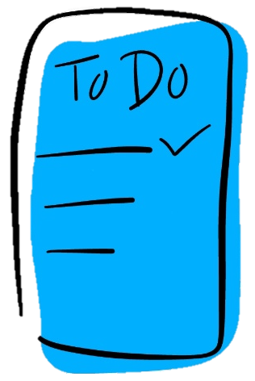
Dilemmas
Sometimes people feel lonely or unhappy. They might be more open to being influenced during these times.
Read your group’s dilemma.
What might the person be thinking?
How might the person feel?
What could the person do?
Can you identify any stereotypes, prejudice or extremist thinking?
Notes:
Teacher guidance 15 mins:
Explain that there may be times in people’s lives when they feel lonely, excluded, or unhappy, or they might feel a bit uncertain about the way their life is going or unsure about what to do next. In turn, this might then make them more open to being influenced in a negative way by someone else’s views or opinions.
Using Resource 2: Dilemmas, allocate each group one of the scenarios.
Pupils read the scenario then consider, discuss and, using Resource 3: Think, feel, do, record their thinking about:
• How the person may be feeling — how would they describe their emotions?
• What might the person be thinking?
• What could the person do in order to manage the situation? What choices are they faced with? From whom or where could they get help and support?
Pupils feedback their ideas and opinions with the rest of the class about how the situations could be managed.
Discuss as a class: Can they identify either stereotypical, prejudiced or extremist thinking in any of the scenarios?
Support: Pupils draw a circle around the ideas that they agree with or add their own ideas on Resource 3a: Think, feel, do (support)
Challenge: Pupils identify the different choices that the person could make to manage the situation, the likely outcomes that might result and any evidence of possible stereotypical, prejudiced or extremist thinking on Resource 3b: Choices and outcomes.

Slide 15
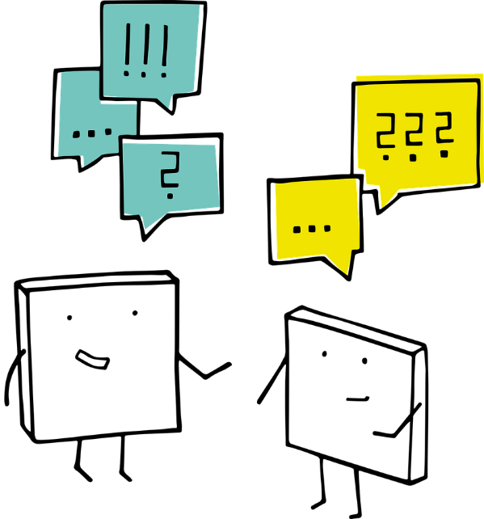
What to do in tough times?
In your group, decide what else the character you discussed could do to manage their situation.
What might be the impact of them thinking or acting this way for their future lives?
Who could help or provide support for them?
What could happen if they didn’t get help?
What could they do next?
Notes:
Teacher guidance 5 mins:
Back in their groups, ask pupils to discuss all the alternatives that they thought of that would help the person to manage the situation.
What might be the impact of them thinking or acting this way for their future lives?
Who could help or provide support for the characters?
What could happen if they didn’t get help?
What could the characters do next?
Make sure these, or similar strategies are drawn out in the discussion:
• Taz: could stop hanging out with this group; could speak to Mum, or another trusted adult; could find other places to go for a while – a different park, sports centre, friend’s house.
• Arden: could leave the online forum; could speak to a parent, teacher or other trusted adult; could show the content to a trusted adult. #
• Ash: could tell the friend that this would be against the law and would get them into a lot of trouble; could say that the animals could come to more harm outside the farm; could suggest other ways of helping animals, e.g. campaigning or fund-raising on behalf of animals, that would be legal and safe; could speak afterwards to a parent, teacher or other trusted adult.
• Zigger: could check the facts by speaking to Mum about why she lost her job; talk about their worries and feelings about Mum losing her job with Mum, a teacher, or another trusted adult.

Slide 16

Your support network
There may be times you feel lonely or angry about the things going on in your life, but there are always trusted people you can talk to.
Think quietly about the people who can support you.
It might help to look at your Zones of Influence sheet again.
Think about, or circle, who you could help you if you are worried or afraid.
Notes:
Teacher guidance 5 mins (slide 16-17)
Reiterate that although there may be times when they feel lonely or angry about the things going on in their lives, there are always trusted people they can talk to and who can offer support and advice.
Adopting prejudiced or extreme views about people or situations will not help and can be dangerous.
Ask pupils to think quietly about their support network of people and to look again at their Zones of influence sheet and either think to themselves, or circle whom they trust and know could help them when they are worried or afraid.
Ask them also to consider whom they could talk to if they were worried about a friend or somebody else. Remind them about the adults in school whom they can go to for help and also about children’s websites/ helplines such as Childline www.childine.org.uk 0800 1111 and www.childline.org.uk/get-support/ to speak to a counsellor online.
There are also sections on the Think u Know website www.thinkuknow.co.uk/ for pupils (8-10) or (11-13) where they can access support and help regarding online extremist behaviours by clicking the CEOP button.

Slide 17



Support
If you were worried about a friend, or somebody else, you could talk to a trusted adult in school.
You could also get help from Childline
by calling 0800 1111
or visiting www.childline.org.uk/get-support/
There are also sections on the Think u Know website where you can get support
by visiting www.thinkuknow.co.uk/
If you see extremist behaviour online then you can report this using the CEOP button.
Notes:
Teacher guidance 5 mins (slide 16-17)
Reiterate that although there may be times when they feel lonely or angry about the things going on in their lives, there are always trusted people they can talk to and who can offer support and advice.
Adopting prejudiced or extreme views about people or situations will not help and can be dangerous.
Ask pupils to think quietly about their support network of people and to look again at their Zones of influence sheet and either think to themselves, or circle whom they trust and know could help them when they are worried or afraid.
Ask them also to consider whom they could talk to if they were worried about a friend or somebody else. Remind them about the adults in school whom they can go to for help and also about children’s websites/ helplines such as Childline www.childine.org.uk 0800 1111 and www.childline.org.uk/get-support/ to speak to a counsellor online.
There are also sections on the Think u Know website www.thinkuknow.co.uk/ for pupils (8-10) or (11-13) where they can access support and help regarding online extremist behaviours by clicking the CEOP button.

Slide 18


Where are we now?
Go back to the first activity in which you wrote what you already knew about what influences a person’s attitudes or behaviour.
In a different colour pen or pencil, write down anything you want to change or add.
Notes:
Teacher Notes – End-point assessment (5 mins)
Ask pupils to revisit their group baseline activity about who and what might influence a person’s attitudes or behaviour and add any new learning in a different coloured pen.

Slide 19

More activities
Create a mini advice booklet about the signs to look out for if someone is being left out or excluded in class.
Include actions that could be taken to support other pupils who may be going through unhappy times.
You could share this or present it to the class.
Notes:
Teacher Notes – Extension activities
These activities can be included if you have additional time in the lesson or afterwards, to challenge pupils who need to be stretched or for pupils who demonstrate a particular interest in this topic.

