Slide 1


Ensure you read the guidance before teaching the lesson
Teacher
slide
Primary Extremism lessons
Lesson 1
Years 1/2: Sameness and difference
© PSHE Association 2019

Slide 2
Teacher
slide
Using this PowerPoint
The slides in this presentation are divided into two sections:
Teacher slides (purple) – provide key information regarding lesson preparation
Pupil slides (white) – provide a visual focus point for pupils during the lesson and delivery notes for teachers about the activities. Click ‘notes’ to view these.
Ensure that you select ‘Use Presenter View’ under the ‘Slide Show’ tab – this will allow you to preview the teaching notes on your monitor while the main presentation is displayed on a screen/smartboard.
© PSHE Association 2019

Slide 3



Challenge and support
Teacher
slide
The lesson includes suggestions for challenge and support activities, to help you differentiate appropriately for your class.
Challenge activities deepen and extend the learning for those who need more challenge or who finish the activity quickly.
Support activities are adapted to be more accessible for those who need it.
Look for the logo on the pupil slides. See delivery notes for details of the activities.
Support
Challenge
© PSHE Association 2019

Slide 4
Context
Teacher
slide
This is the first of a series of four lessons written for primary aged pupils with this particular lesson aimed at KS1.
This lesson aims to enable pupils to recognise some of the similarities and differences they share with others and to reinforce that this is part of everyday life and relationships. Recognising that they have much more in common with others than their differences, will help pupils to develop attributes which make them less susceptible to prejudiced or extremist narratives.
Each lesson is intended to be delivered to different year groups and therefore should be placed within a suitable context to ensure it is part of a developmental, age-appropriate PSHE education programme.
© PSHE Association 2019

Slide 5



      Learning objective
About the ways in which they are the same and different to others and that there is a great deal they share in common
Teacher
slide
      Learning outcomes
Pupils will be able to:
Identify special things about them that make them who they are
Describe similarities and differences between themselves and others and the things they have in common
Recognise how they are all equal despite any differences they may have
© PSHE Association 2019

Slide 6




Preparing to teach
      Resources required
A box or envelope for anonymous questions
Flipchart paper and pens
Pens and pencils
Resource 1: Group graffiti wall images
Resource 2: Wonderful me
Resource 3: Differences
Story book: Giraffes can’t dance by Giles
Andreae; Elmer by David McKee; Rainbow Fish by Marcus Pfister
      Climate for learning
Make sure you have read the accompanying teacher guidance notes before teaching this lesson – for guidance on establishing ground rules, the limits of
confidentiality, communication and handling questions effectively.
      Duration
      This lesson has been designed to be taught as a 60 minute PSHE education lesson.
      Further guidance
      Members of the PSHE Association can access our website for further guidance www.pshe-association.org.uk
60
© PSHE Association 2019

Slide 7
Lesson summary
Teacher
slide
Activity | Description | Timing
Baseline assessment | Pupils draw or write on their group graffiti wall things that are the same or different about two characters | 10 MINS
2. Similarities and differences | Pupils identify some similarities and differences between children of their age | 5-10 MINS
3. Paired discussion | Pupils identify ways in which they are different/same as another pupil | 5-10 MINS
4. Story telling | Pupils listen to ‘Giraffes can’t dance’ and consider the reaction of the other animals to the giraffe because he was different | 15-20 MINS
5. Plenary/signposting support | Pupils identify who to tell if someone is being unkind to them because of a difference | 5 MINS
6. Endpoint assessment | Pupils return to baseline assessment and add to or amend it in light of their new learning | 5-10 MINS
7. Extension (optional) | Pupils interview two adults in school about differences and similarities
© PSHE Association 2019

Slide 8

Lesson 1:
Same/different

Slide 9

Ground rules
[Add your class rules here]
Notes:
Teacher Notes
Use this slide to display your class agreement / ground rules for PSHE education lessons. See Accompanying Teacher Guidance Notes (separate document).

Slide 10


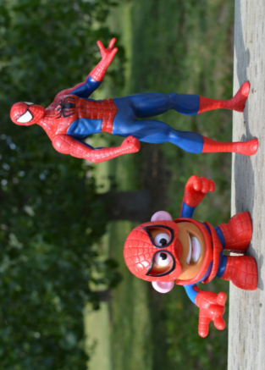
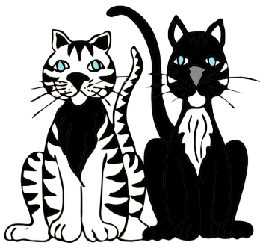

Starting point lesson slide
Draw or write all the ways that the characters look similar
Draw or write all the ways that the characters look different
Are there any other ways that the characters could be similar or different?
Notes:
Teacher Notes - Baseline assessment (10 mins)
Provide each table group with an image of two similar characters (examples could be: Simba and Nala, Zig and Zag, Bert and Ernie, Dr Chris and Dr X and Peppa Pig and George). See Resource 1: Group graffiti wall images. On a large piece of paper (A1) ask pupils to draw or write all the ways that the characters look similar. Next, write or draw ways that the characters look different. Are there any other ways that the characters could be similar or different?
It is important that pupils complete this activity individually. Do not guide or prompt their answers. When finished, collect in their papers. Explain you will revisit this work at the end of the lesson. Look through pupils’ ideas to elicit an understanding of what pupils already know about what being similar or different means.

Slide 11

      We are learning ways in which we are the same and different
      We will be able to:
  Identify special things about us that make us who we are
  Describe similarities and differences between ourselves and others and the things we have in common
  Recognise how we are all equal despite our differences
Notes:
Teacher Notes – Learning objective and outcomes
Introduce the learning objectives and outcomes, explaining that this lesson will explore the ways in which we are all the same and the ways in which we are different.

Slide 12

Ways in which we are same?
?
Which feelings might we have every day?
Ways in which we are different?
Notes:
Teacher notes – 5 - 10 mins
Following on from the baseline activity, ask pupils to write or draw the different ways that children of their age can be the same and can be different. If necessary, support pupils with keywords from the vocabulary section on lesson plan. Remind the class that children can also be the same and different in ways we cannot see (e.g. live in different places, enjoy doing different things outside of school, follow different religions, support different football teams).
Teaching point: Explain that we all have things about us that are the same as other people but we also have things about us that make us different to others.

Slide 13





How are you the same or different to someone else in the class?
At the weekend, I like to …
I like to eat…
I don’t like …
I like to play …
My favourite subject is…
© PSHE Association 2019
Notes:
Similarities and differences: 5 - 10mins
Using the Resource 1:Wonderful Me ask pupils to draw or write some of the similarities and differences they share with someone else in the class.
There will be lots of things about them that are the same as other people (that they share in common) and there will also be things that are different and that this is the same in the wider world.
Ask pupils to think about and share the similarities and differences that they couldn’t ‘see’ but still existed. Remind pupils that we find out about some of these by what people say and do rather than how they look. Reiterate that despite similarities and differences, everyone is still of equal importance.
Teacher note: Remind the class to be sensitive about the feelings of others when they do this kind of ‘sharing’ and to check that it is ok with the other person for it to be shared with the rest of the class. It may also be helpful to reinforce the appropriate class ground rule.
Support:
Pupils respond on Resource 3: What is the same and what is different? By putting a tick next to similarities and a cross next to differences that they can see on the picture of two children.
Challenge:
Pupils respond on Resource 2: Wonderful Me by drawing or writing about all the similarities and differences that they can think of between them and someone else in the class that can’t be seen.

Slide 14
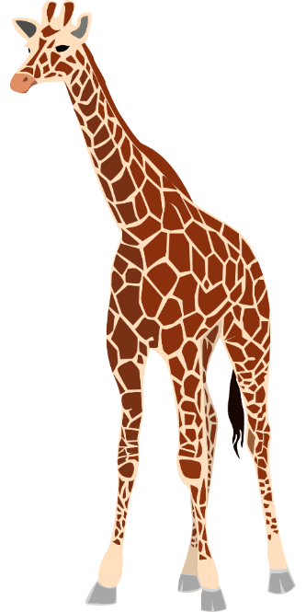
Things that make us different
?
Listen to the story
In what ways is the giraffe different to all the other animals?
How did the reaction of the other animals make the giraffe feel?
Does it matter that the giraffe dances in a different
way?
‘But sometimes when you are different you just need a
different song.’
What do you think that means?
?
?
?
?
?
Notes:
Teacher Notes – Things that make us different 15 – 20 mins
Ask pupils to think of all the different ways that the giraffe is different to all the other animals it meets. How did the reaction of the other animals make the giraffe feel? Does it matter that the giraffe dances in a different way? What was it that made him happy in the end.
Teaching point: reinforce that even though the animals all danced in a different way they were all equally important and that is the same with the class
Alternatively, Elmer by David Mckee or Rainbow Fish by Marcus Pfister could work well using similar questions. If using Elmer, ask the pupils why they think ‘When Elmer rejoined the herd, none of the other elephants noticed him.’?
If using Rainbow Fish, ask the pupils why they think the feelings of Rainbow Fish changed ‘When the water around him filled with glimmering scales, he at last felt at home among the other fish.’

Slide 15
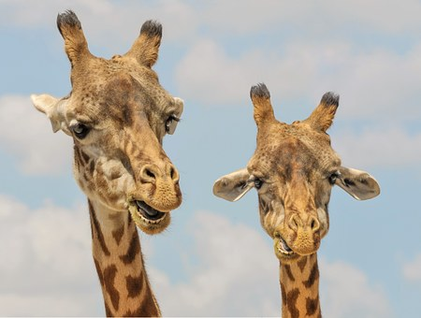

Signposting slide
Who could the giraffe tell, either in school or at home, if someone was making them feel unhappy because of their differences?
Notes:
Teacher Notes – Signposting support – 5 mins
Ask the class to think back to the ‘Giraffes can’t dance’ story or one of the other stories and to identify who the giraffe/Elmer or Rainbow Fish could tell either in school or at home if someone was making them feel unhappy because of their differences.
Remind the class that it is always best to speak to a parent or a trusted adult in school if they are having trouble with any feelings, big or small, or if they are feeling particularly sad, scared or worried about something.

Slide 16


Where are we now?
Go back to the ‘group graffiti wall’ activity
Is there anything you would like to change?
Is there anything you would like to add?
Use a different colour pen or pencil to amend your draw and write and show how your thinking has developed or changed.
Notes:
Teacher Notes – End-point assessment (5 - 10 mins)
Return pupils’ draw and write graffiti wall sheets from the start of the lesson. Ask them to now use a different colour pen / pencil to make any additions or changes they can to their original drawing, as a result of their learning in today’s lesson.
After the lesson, display everyone’s Wonderful Me on the working wall or similar.

Slide 17
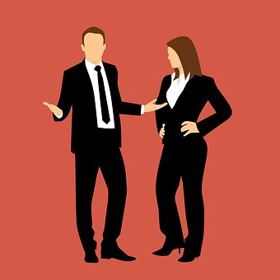
More activities
Interview two grown-ups at school. Ask them about their likes and dislikes.
What things do they share in common that can’t be seen?
Notes:
Teacher Notes – Extension activities
These activities can be included if you have additional time in the lesson or afterwards, to challenge pupils who need to be stretched or for pupils who demonstrate a particular interest in this topic.

