Slide 1



Ensure you read the guidance before teaching the lesson
Teacher
slide
Drug and alcohol education
KS2
Year 5/6 Lesson 4:
Managing risk: drugs and alcohol in the media
© PSHE Association 2020

Slide 2

Using this PowerPoint
Teacher
slide
The slides in this presentation are divided into two sections:
Teacher slides (purple) – provide key information regarding lesson preparation
Pupil slides (white) – provide a visual focus point for pupils during the lesson and delivery notes for teachers about the activities. Click ‘notes’ to view these.
Ensure that you select ‘Use Presenter View’ under the ‘Slide Show’ tab – this will allow you to preview the teaching notes on your monitor while the main presentation is displayed on a screen/smartboard.
© PSHE Association 2020

Slide 3



Challenge and support
Teacher
slide
The lesson includes suggestions for challenge and support activities, to help you differentiate appropriately for your class.
Challenge activities deepen and extend the learning for those who need more challenge or who finish the activity quickly.
Support activities are adapted to be more accessible for those who need it.
Look for the logo on the pupil slides. See delivery notes for details of the activities.
Support
Challenge
© PSHE Association 2020

Slide 4
Context
Teacher
slide
This is the last of four lessons for upper key stage 2 pupils providing age-appropriate drug and alcohol education. This lesson focuses on media messages and influences in relation to smoking/vaping and alcohol use. Pupils learn to identify key messages through analysing media such as adverts and health advice posters. They apply these critical thinking skills to assess the reliability of sources and learn how to access reliable and accurate advice and information about alcohol and tobacco/e-cigarette use.
Neither this, nor any of the other lessons, is designed to be taught in isolation, but should always form part of a planned, developmental PSHE education programme.
© PSHE Association 2020

Slide 5
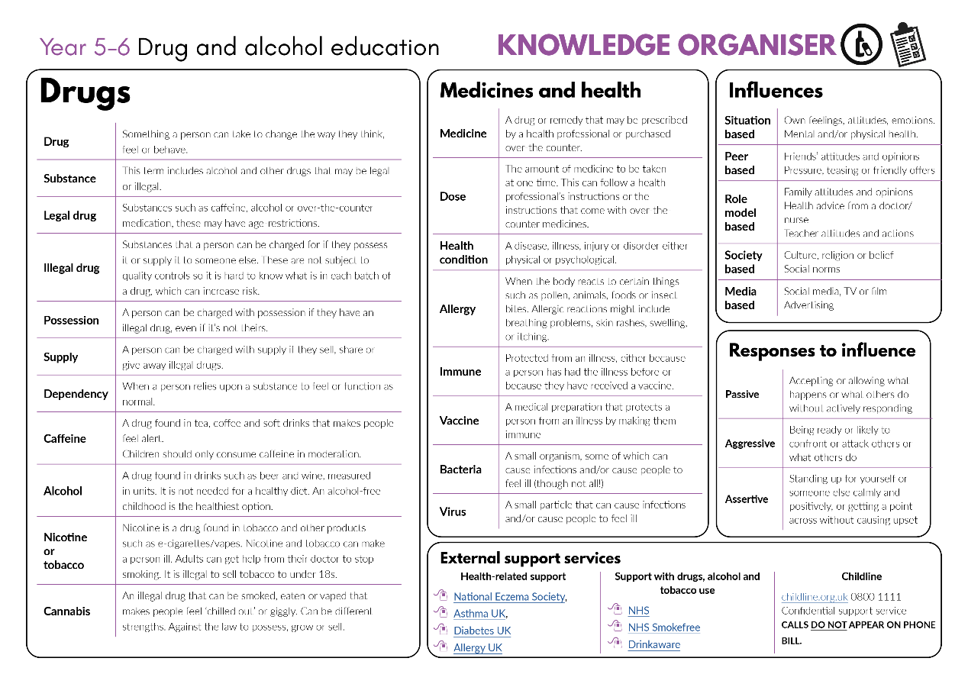


Developing subject knowledge
Teacher
slide
Key information on content related to these lessons can be found in the Year 5-6 Knowledge Organiser.
Advice on safe practice, dispelling common misconceptions, visitors to the classroom and other important information can be found in Teacher Guidance: Drug and alcohol education
Data sources to inform your planning can be found within our document that outlines the approach of these lessons Evidence Base: Drug and alcohol education, along with advice regarding how to talk to young people about addiction, dependency and problematic substance use.
© PSHE Association 2020

Slide 6



Teacher
slide
      Learning objective
To learn that mixed messages about drug use in the media exist and that these can influence opinions and decisions
      Learning outcomes
Pupils will be able to:
  identify mixed messages in the media in relation to smoking/vaping and alcohol
  analyse key messages, suggest who they are targeted at and why
  describe how these messages might affect a person’s thoughts, feelings and actions
  explain what would help a person to make informed decisions about health and where they could find reliable information

Slide 7




Teacher
slide
Preparing to teach
      Climate for learning
Make sure you have read the accompanying teacher guidance notes before teaching this lesson for guidance on establishing ground rules, the limits of confidentiality, communication and handling questions effectively.
      Resources required
Box or envelope for anonymous questions
Resource 1: Mixed message posters A-F [1 set enlarged and displayed per class or 1 set per small group]
Resource 2: Think, feel, do worksheet [1 per pair]
Resource 3: Sources of information cards [1 set per group or 1 set enlarged for whole class use]
      Duration
      This has been designed to be taught as a sixty minute PSHE education lesson
      Further guidance
      Members of the PSHE Association can access our website for further guidance www.pshe-association.org.uk
60

Slide 8
Lesson summary
Teacher slide
Activity | Description | Timing
1. Baseline assessment | To be completed before the lesson. Remind pupils of ground rules. Pupils make a visual or written scenario about an advert/film or TV screenshot about smoking, vaping or alcohol. | 5-15 MINS
2. Introduction | Reinforce ground rules. Pupils identify where they see messages relating to drugs in the media e.g. social media; TV soaps; TV documentaries, advertising, newspapers. | 5 MINS
3. Analysing media messages | Working in small groups, pupils analyse a media excerpt to identify whom it is targeted at and the key messages it is giving | 15 MINS
4. Think, feel, do | Pairs of pupils imagine a young person looking at one of the media excerpts and discuss what it might make them think, feel, do (or want to do). | 15 MINS
5. Accurate information continuum | Pupils rank different sources of information on a line of continuum from least to most reliable. | 10 MINS
6. Plenary / signposting support | Pupils write a message to the young person from the think, feel, do activity – give facts about the drug and where to get accurate information. | 10 MINS
7. End-point assessment | Pupils complete sentences starters to further reflect on and demonstrate their learning for this lesson. | 5-15 MINS
© PSHE Association 2020

Slide 9

Lesson 4
Managing risk: drugs and alcohol in the media

Slide 10

Ground rules
[Add your class rules here]
Notes:
Teacher Notes
Use this slide to display your class agreement / ground rules for PSHE education lessons. See Accompanying Teacher Guidance.
Reinforce ground rules. Point out any that are especially pertinent such as being respectful to each other’s views and opinions, accepting these may be different to our own and recognising that we may have different thoughts or experiences

Slide 11

Think bubble
?
A young person (aged about 13) is looking at an advert, film or TV programme which is about smoking/vaping or alcohol.
Draw or write about what you can see. In a ‘think bubble’ write what they are thinking about this.
Notes:
Teacher Notes – Baseline assessment (5-15 mins)
This activity should be completed before the lesson. This allows time to look through their work and gain a sense of pupils’ current understanding and experiences of media messages. Remind pupils of the ground rules for these lessons before completing the following activity.
Read aloud the following instructions. Individually pupils draw and write their responses on a blank piece of paper.
A young person (aged about 13) is looking at an advert, film or TV programme which is about smoking/vaping or alcohol. Draw or write about what they can see. In a ‘think bubble’ write what they are thinking about this.
Collect these drawings in and use them to identify pupils’ starting points and to inform future teaching.

Slide 12
We are learning that mixed messages about drug use in the media exist and that these can influence opinions and decisions
      We will be able to:
  identify mixed messages in relation to smoking/vaping and alcohol
  analyse key messages, suggest who they are targeted at and why
  describe how these messages might affect a person’s thoughts, feelings and actions
  explain what would help a person to make informed decisions about health and where they could find reliable information
Notes:
Teacher Notes – Learning objective and outcomes
Introduce the learning outcomes.

Slide 13



Messages in the media
Where might a person see or hear messages about drugs in the media?
Notes:
Teacher Notes – Introduction (5 mins)
As a whole class, pupils identify different places where a person might see or hear messages related to drugs in the media. Make a list on the board.
For example: TV soaps, TV documentaries, advertisements, posters, shops, health warning posters, drug packaging, newspapers and magazines, radio, social media
Teacher’s note: This might be any drug for now but later in the lesson the focus will be on smoking/vaping and/or alcohol.

Slide 14
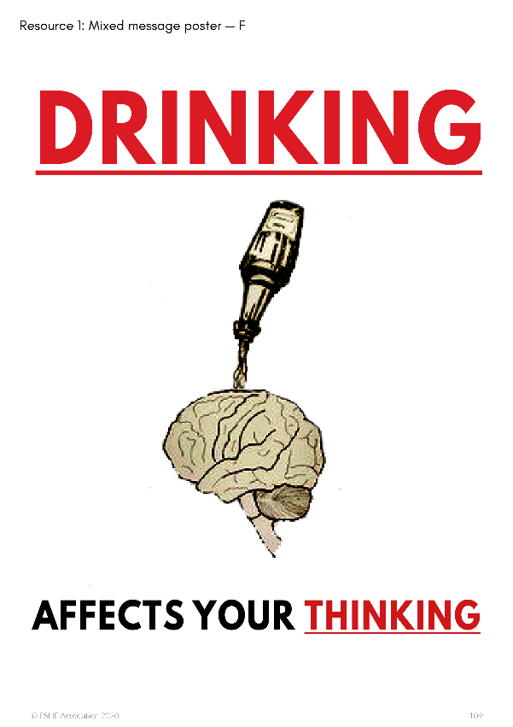


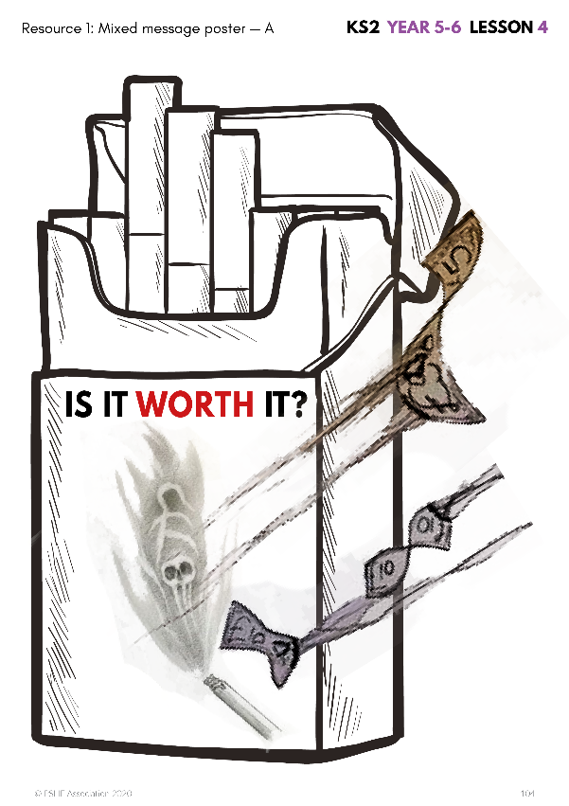
Analysing media messages
Look at the posters with your group and identify the key messages in each one.
Why do you think there are mixed messages about alcohol and smoking in the media?
Notes:
Teacher Notes – Analysing media messages (15 min)
Display around the classroom, or provide each group with copies of, Resource 1: Mixed message posters A-F.
Ask pupils why they think there are mixed messages about smoking/alcohol?
Support: Using each poster from Resource 1: Mixed message posters, pupils identify which are encouraging and which are discouraging people to use the drug (smoke/vape or drink alcohol) and if possible, explain their thinking.
Challenge: Pupils discuss what lifestyle choices these adverts are promoting.

Slide 15

Key messages
Smoking is bad for your health
Smoking could lead to death or fatal diseases
Smoking is a waste of money
Don’t smoke
…?
…?
Notes:
Use the following slide to discuss possible key messages pupils may have suggested for each poster. They may have also suggested additional ideas

Slide 16

Key messages
It’s easy to become addicted (or chained) to smoking
Smoking is a hard habit to break
Don’t smoke
…?
…?
Notes:
Use the following slide to discuss possible key messages pupils may have suggested for each poster. They may have also suggested additional ideas

Slide 17

Key messages
Vape devices are quite interesting gadgets
Lots of different types to choose from
It’s encouraging vaping
…?
…?
Notes:
Use the following slide to discuss possible key messages pupils may have suggested for each poster. They may have also suggested additional ideas

Slide 18

Key messages
Parties always include alcohol
If you drink you’ll have a good time
There are certain times of day to drink
Alcohol is fun
It’s encouraging drinking alcohol
…?
…?
Notes:
Use the following slide to discuss possible key messages pupils may have suggested for each poster. They may have also suggested additional ideas

Slide 19

Key messages
Only men drink beer
Beer is the best drink for men
Men should drink beer
It encourages drinking alcohol
…?
…?
Notes:
Use the following slide to discuss possible key messages pupils may have suggested for each poster. They may have also suggested additional ideas

Slide 20

Key messages
Alcohol will affect your brain badly
Drinking alcohol is unhealthy
Don’t drink alcohol
…?
…?
Notes:
Use the following slide to discuss possible key messages pupils may have suggested for each poster. They may have also suggested additional ideas

Slide 21






Think, feel, do
With your partner, choose one of the posters and imagine a young person looking at it.
Discuss what it might make the young person think, feel or do (or want to do).
Now ‘pair/share’ with another pair who chose the same example as you, do you agree?
Next, do the same with another pair who chose a different example and discuss your responses
Notes:
Teacher Notes – Think, feel, do (15 mins)
Working in pairs, pupils choose one example from Resource 1: Mixed message posters and imagine a young person looking at it. They discuss what it might make the young person think, feel, and do (or want to do).
Pairs complete Resource 2: Think, feel, do worksheet.
Pupils then ‘pair/share’, firstly with another pair who have chosen the same example as them to compare responses and see if they concur, then with a pair who chose a different example and compare responses for similarities and differences.
Bring the class together to feedback and draw some conclusions from their findings.
However, it is important to draw out that actually most young people choose not to use these drugs at all. Highlight some of the following positive social norms:
The number of young people in England (aged 11-15) who smoke regularly (regular means smoking at least one cigarette a week) is very low at 2%
Some people might think that lots of people use e-cigarettes but actually only 2% of young people (aged 11-15) use them
We might think that lots of teenagers drink alcohol, but actually 56% of young people (aged 11-15) say they have never drunk alcohol
Reference: Smoking, drinking and drug use among young people in England 2018 (NHS)

Slide 22
Accurate information continuum
advert on a bus/ train/underground
friend
Which sources of information do you think will give the most reliable and accurate information about drugs?
Organise the cards on a continuum from least to most likely to be reliable and accurate.
parent
teacher/PSHE lesson
TV documentary
www.nhs.uk/live-well
Least likely
Most likely
news story
story in a film/book
Notes:
Teacher Notes – Accurate information continuum (10 mins)
Display Resource 3: Sources of information cards
Explain what they are, how someone could access them and what information they might find out by doing so.
Pupils discuss which will give the most reliable and accurate information, explaining their thinking, then organise the cards on a continuum from least to most likely to be accurate and reliable.
For example: up-to-date health advice should be available on the NHS website; PSHE education lessons teach the facts; a friend may not really know best; an advert on a bus might be trying to persuade someone to buy something and may not give all the information about the product, such as health risks
Teacher’s note: This can be done as a whole class activity or sets of cards given to small groups if preferred.

Slide 23


Reflecting on today’s lesson
Go back to your think, feel, do worksheet and imagine you are giving advice to the young person looking at the media advert.
Write them a message using the sentence starters:
You might think that…
But this might not be reliable because…
Some facts about the effects of smoking/vaping/drinking alcohol are…
Somewhere you could get further information is..
Notes:
Teacher Notes – Plenary/reflecting on today’s lesson/signposting support (10 mins)
Pupils go back to their think, feel, do worksheets (Resource 2) from activity 3 and imagine they are giving advice to the young person looking at the media advert. They can use the sentence starters to write them a message

Slide 24

What has been learnt?
Complete the following sentences:
The lesson has made me think about…
The mixed messages in the media about smoking, vaping and alcohol include…
People should…
I have learned that...
Notes:
Teacher Notes –End-point assessment (5 mins)
Following the lesson, pupils complete all or some of the following sentence starters, writing their comments in their work books as evidence of their learning.

Slide 25




More activities
Design material that accurately informs young people about the risks of smoking/vaping/drinking alcohol.
It could be:
A poster
Film or radio clip
Public health social media message
Notes:
Teacher Notes – Extension activity
Using one of the ‘positive’ social norms statistics as inspiration, pupils design material aimed at accurately informing young people about the risks of smoking/vaping/drinking alcohol. It should avoid using stereotypes, shock or scare tactics and instead aim to be informative and convey correct information. It could take the form of a poster, film/radio clip or Public Health social media message.

