Slide 1



Ensure you read the guidance before teaching the lesson
Teacher
slide
Drug and alcohol education
KS2
Year 5/6 Lesson 2:
Managing risk: legal and illegal drugs
© PSHE Association 2020

Slide 2

Using this PowerPoint
Teacher
slide
The slides in this presentation are divided into two sections:
Teacher slides (purple) – provide key information regarding lesson preparation
Pupil slides (white) – provide a visual focus point for pupils during the lesson and delivery notes for teachers about the activities. Click ‘notes’ to view these.
Ensure that you select ‘Use Presenter View’ under the ‘Slide Show’ tab – this will allow you to preview the teaching notes on your monitor while the main presentation is displayed on a screen/smartboard.
© PSHE Association 2020

Slide 3



Challenge and support
Teacher
slide
The lesson includes suggestions for challenge and support activities, to help you differentiate appropriately for your class.
Challenge activities deepen and extend the learning for those who need more challenge or who finish the activity quickly.
Support activities are adapted to be more accessible for those who need it.
Look for the logo on the pupil slides. See delivery notes for details of the activities.
Support
Challenge
© PSHE Association 2020

Slide 4
Context
Teacher
slide
This is the second of four lessons for upper key stage 2 pupils providing age-appropriate drug and alcohol education. This lesson focuses on legal and illegal drugs, other than medicines, and the associated effects and risks. Pupils also explore how the risk of drug use may vary depending on factors such as the strength of the drug, how much is taken and how often, the person and the situation.
Neither this, nor any of the other lessons, is designed to be taught in isolation, but should always form part of a planned, developmental PSHE education programme.
© PSHE Association 2020

Slide 5
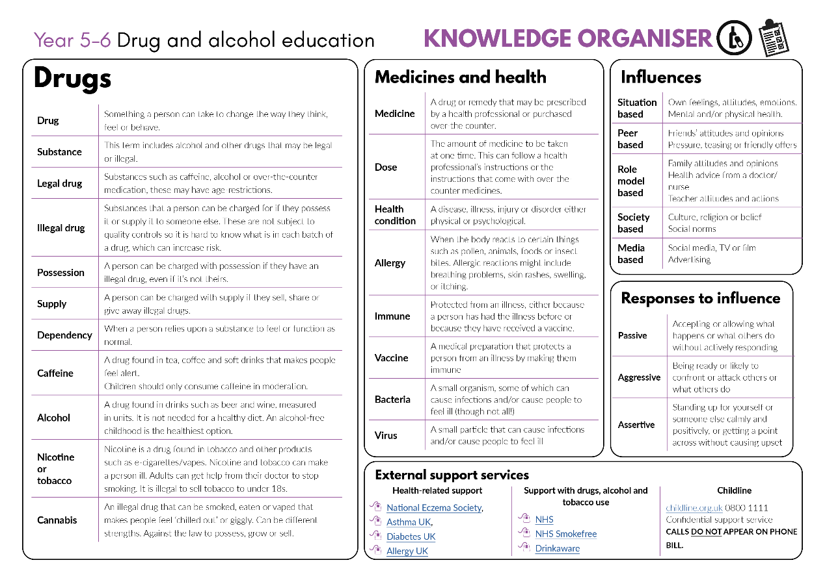


Developing subject knowledge
Teacher
slide
Key information on content related to these lessons can be found in the Year 5-6 Knowledge Organiser.
Advice on safe practice, dispelling common misconceptions, visitors to the classroom and other important information can be found in Teacher Guidance: Drug and alcohol education
Data sources to inform your planning can be found within our document that outlines the approach of these lessons Evidence Review: Effective drug and alcohol education, along with advice regarding how to talk to young people about addiction, dependency and problematic substance use.
© PSHE Association 2020

Slide 6



      Learning objective
To learn about some of the risks and effects of legal and illegal drug use
Teacher
slide
      Learning outcomes
Pupils will be able to:
  explain that there are risks associated with using any type of drug and identify some of the risks and effects of drug use
  recognise that drugs have laws related to them and that some drugs are illegal to own, use or give to others
  analyse the level of risk in different situations, identifying that drugs can affect people in different ways
  explain that for some people drug use can become an unhealthy habit that can be difficult to break but there is support available to help people; where to report any concerns they have

Slide 7




Teacher
slide
Preparing to teach
      Climate for learning
Make sure you have read the accompanying teacher guidance notes before teaching this lesson for guidance on establishing ground rules, the limits of confidentiality, communication and handling questions effectively.
      Resources required
Box or envelope for anonymous questions
Dice [1 per group]
Resource 1: Drugs cards [1 set per class]
Resource 2: Effects and risks cards [1 of each set per group]
Resource 3: Drugs facts sheets [1 copy of each]
Resource 4: Drugs and risk scenarios activity [1 per pair]
Resource 4a: Drugs and risk scenarios activity – support [1 per pair or group]
Resource 4b: Drugs and risk scenarios activity – challenge [1 per pair]
      Duration
      This has been designed to be taught as a sixty minute PSHE education lesson
      Further guidance
      Members of the PSHE Association can access our website for further guidance www.pshe-association.org.uk
60

Slide 8
Teacher
slide
Lesson summary
Activity | Description | Timing
1. Introduction | Remind pupils of ground rules. Share and discuss the definition of a drug | 5 MINS
2. Baseline assessment | Pupils list some of the possible risks and effects of using a drug on a spider-gram | 5-10 MINS
3. Effects and risks card game | Pupils match the possible effects and risks associated with different drugs | 10 MINS
4. Fact check activity | Pupils use fact sheets to check their information from the effects and risks card game | 10 MINS
5. Drugs risk scenarios | Pupils read a scenario, identify what is causing the risk and assess the level of risk within it | 15 MINS
6. Plenary/sign-posting support | Pupils identify characters who may need support with drug use. Provide information about where to access help and support | 5 MINS
7. End-point assessment | At the end of, or following the lesson, pupils return to their baseline activity, and add to or amend their work in the light of their learning | 5-10 MINS
© PSHE Association 2020

Slide 9

Lesson 2
Managing risk: legal and illegal drugs

Slide 10

Ground rules
[Add your class rules here]
Notes:
Teacher Notes
Use this slide to display your class agreement / ground rules for PSHE education lessons. See Accompanying Teacher Guidance Notes (separate document).
Remind pupils of the ground rules, reinforcing that questions are welcomed in the lesson but if they have any questions they do not want to ask in front of the class or concerns about anything discussed in the lesson, they can put a question or a note to the teacher in the questions box.

Slide 11
We are learning about some of the risks and effects of legal and illegal drug use
      We will be able to:
  identify some of the risks and effects of drug use
  recognise the laws that relate to drugs and drug use
  analyse the level of risk in different situations involving drugs
  explain some of the risks of drug use, what support is available to help people and where to report concerns
Notes:
Teacher Notes – Learning objective and outcomes
Introduce the learning outcomes - these are a simplified, more pupil-friendly version of the outcomes on slide 6 (teacher slide).

Slide 12
What is a drug?
Think about this question with your partner and share your ideas.
A substance people take to change the way they feel, think or behave.
The term ‘drugs’ can, of course refer to all drugs:
  • all illegal drugs
  • all legal drugs, including alcohol, tobacco and volatile substances (those giving off a gas which can be inhaled)
  • all over-the-counter and prescription medicines
Notes:
Teacher Notes – Introduction (5 min)
To introduce the lesson, write the question ‘What is a drug?’ on the board or flipchart. Allow time for pupils to discuss in pairs and feedback, before sharing the definition.
(A commonly accepted definition of ‘a drug’ from The United Nations Office on Drugs and Crime)

Slide 13
What’s our starting point?
Effects
Risks
Write the word ‘drug’ in the middle of a piece of paper. Write ‘Effects’ on one side and ‘Risks’ on the other.
What might happen to the person using a drug?
Write your ideas under ‘effects’.
Are there any risks of using a drug?
Write your ideas under ‘risks’.
Drug
Notes:
Teacher Notes – Baseline assessment (5-10 mins)
Pupils write the word ‘drug’ in the middle of a piece of paper. They write down some of the effects and risks associated with using a drug, on either side of the spider-gram - effects on one side and risks on the other. It might be helpful to phrase this as questions:
What might happen to the person using a drug?
Pupil responses might include: ‘get high’, feel happier, feel relaxed, have more energy, recover from illness
Are there any risks of using a drug?
Pupil responses might include: it could harm their body, it could become a habit or they get addicted, mental health problems, it might be illegal
Teacher’s note: As this is a baseline assessment, pupils should first work individually and without further prompting. Circulate whilst pupils complete the task and take them in to look at briefly during the lesson to gain an understanding of what pupils already know, understand and believe about drugs, as well as any misconceptions or gaps in knowledge.

Slide 14

Effects and risks card game
With your group, take it in turns to roll the dice.
If you roll a 1 or a 2, pick up an ‘effect’ card.
If you roll a 3, 4, 5 or 6, pick up a ‘risk’ card.
Read the card and with your group decide if it is a likely ‘effect’ or ‘risk’ of using the drug. If you think it is, keep the card. If you think it’s unlikely, discard the card.
Effect
Risk
Notes:
Teacher Notes – Effects and risks card game (10 mins)
Remind pupils that all drugs affect (change) the brain or body in some way (some drugs relax the body, others make a person more awake or alert, some fight infection) but that all drug use comes with risk. Remind pupils of their previous learning in Year 3/4 about the misuse of medicines and explain that although medicines are a drug and if used incorrectly can be harmful, this lesson will mostly focus on other types of drugs. Some risks will depend not only on what the drug is, but other factors too. This activity will look at both some of the effects and risks of different drugs.
Card game: Pupils work in groups of three or four. Each group will need a dice, the name of one drug from Resource 1: Drugs cards and a set of Resource 2: Effects and risk cards. Assign each group the name of a drug - See Resource 1: Drugs cards. Pupils follow the instructions on the slide.
Teacher’s note: The drugs you choose to focus on will depend on the types of drugs that have been suggested on the pupils’ baseline assessment activity, health data from your local area and chosen from the list below. Include at least one example of an illegal drug. The drugs we have focused on for this lesson are tobacco (cigarettes, shisha); alcohol; cannabis; e-cigarettes; caffeine, nitrous oxide; cocaine; MDMA (ecstasy) and speed (amphetamines).
Support: Using Resource 1: Drugs cards and Resource 2: Effects and risks cards Pupils play ‘pick-up pairs’ – they pick a drugs card and then an effect or risk card. Pupils say whether they think the effect or risk is true for the drug.
Challenge: As they choose the cards, pupils identify what might be an immediate effect or risk of using the drug and what is likely to be a longer term effect (if the drug is used often, over a long period of time).

Slide 15
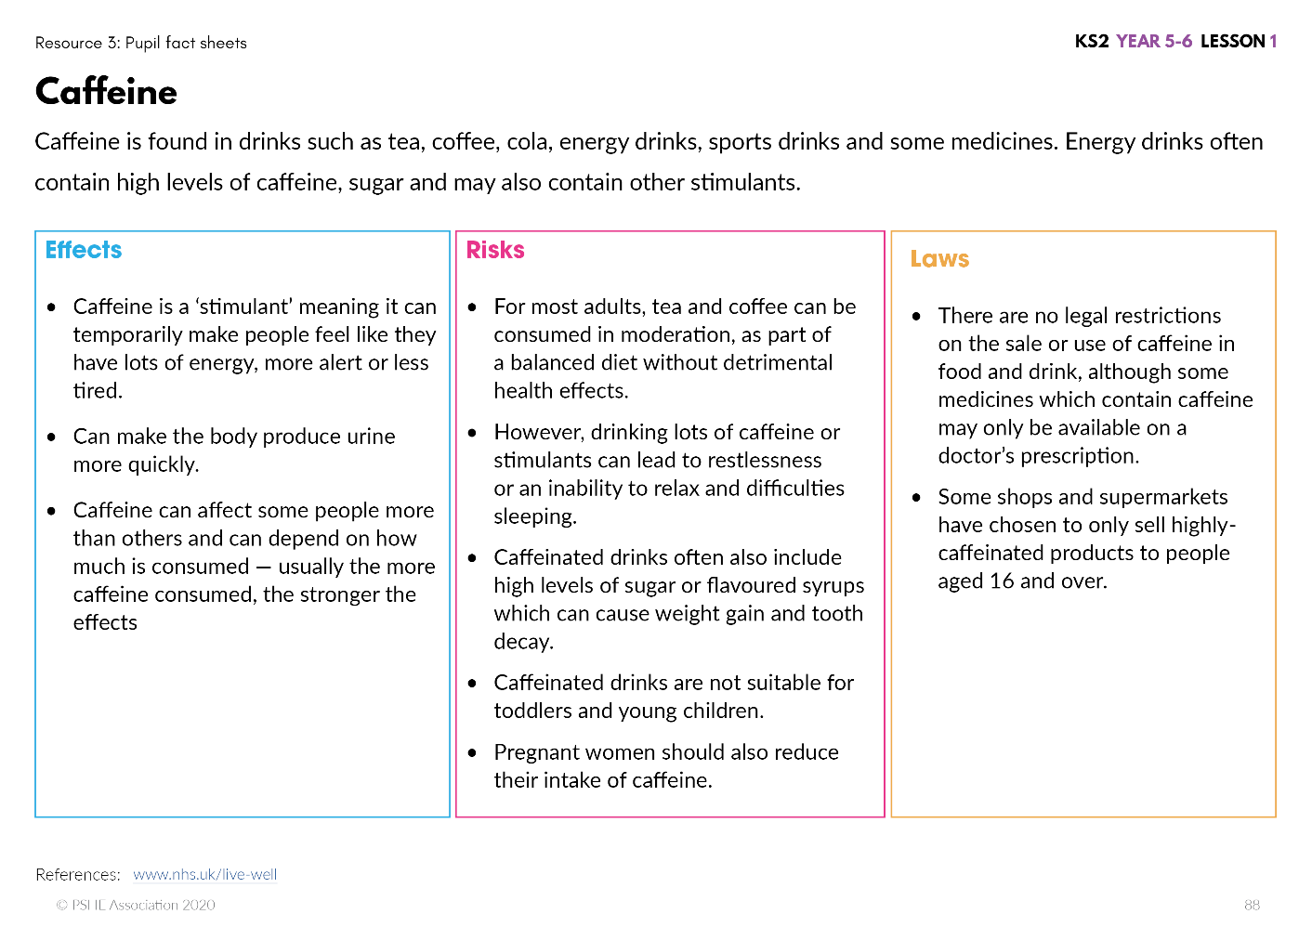
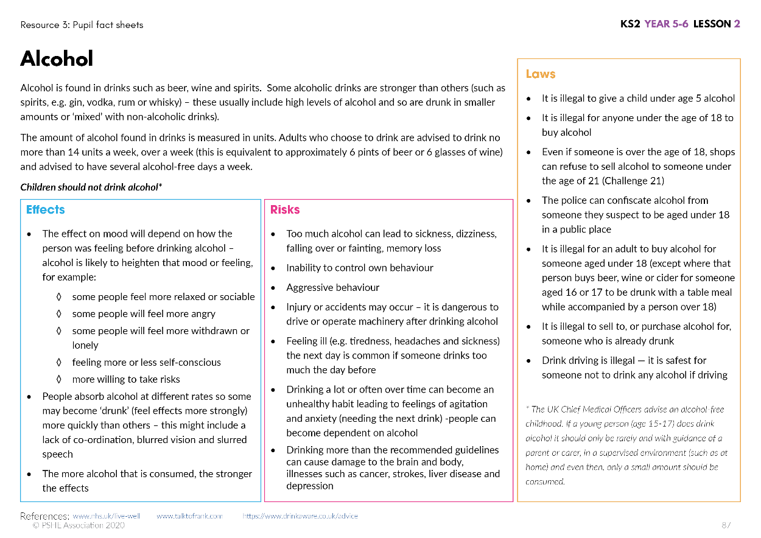
Fact check
Read your drug factsheet with your group and check your answers.
Were you surprised by any of the risks of the drug?
Do different drugs have similar risks?
Notes:
Teacher Notes – Fact check activity (10 mins)
Give the corresponding fact sheet (see Resource 3: Drug fact sheets) to the groups so they can check their answers.
Then bring the class back together and discuss some of their findings, such as whether different drugs have similar risks or if they were surprised by any of the risks of drugs they found out about.
Support: Pupils may need adult support to check their answers using Resource 3: Drugs fact sheets
Challenge: Are there differences between immediate use and regular use over a longer period of time?
How does the strength of the drug affect the effects and risks?
For example: Tobacco – one cigarette may make someone feel light headed and cough. But, smoking many cigarettes over years can damage someone’s lungs and other main organs, putting them at risk of illness and disease.
Teacher’s note: Although it has not been included in each fact sheet, you may want to share the following learning points with the class:
drug use can lead to loss of money or a decrease in control over personal finance.
used drugs can sometimes be left in the environment as litter
to produce drugs, large areas of land might be cleared to grow the plants needed which is contributing to deforestation and climate change.
Pupils will learn more about this is secondary school.

Slide 16
Drug risk scenarios
With your partner, read the scenarios and find out:
What is causing the risk?
How risky is the scenario? (high, medium, low)
Write your ideas on the sheet.
Risk
Drug – what it is, how strong is it?
Person– their age, mood, health
Situation– where the person is
Are there any characters who are taking a risk with their health or the health and wellbeing of those around them?
Notes:
Teacher Notes – Drug risk scenarios (15 mins)
Explain that drugs may not affect every person in the same way.
Risk depends on the drug (what it is, how strong it is); the person (their age, their mood, their general health); where they are and the situation they are in, and that we can think of this as the ‘risk’ triangle:
What is the drug? What do we (and don’t we) know about the drug?
Who is the person? What do we know about them?
What is the situation they are in?
In pairs, pupils read Resource 4: Drugs and risk scenarios activity, and using the information given, identify what is causing the risk and analyse how risky they think the scenario is (high, medium or low) and record their explanations on the sheet.
Take feedback from the class enabling pupils to explain and justify their ideas. Are there any characters who are taking a risk with their own health or the health and wellbeing of those around them?
Support: Pupils work in pairs or as a group to complete an adapted version of the activity using Resource 4a: Drugs and risk scenarios activity – support with scaffolded responses. You may prefer to make these separate cards so there are fewer scenarios.
Challenge: After completing Resource 4: Drugs and risk scenarios activity, pupils are given Resource 4b: Drugs and risk changing scenarios – challenge.
Pupils discuss whether the change in the scenario would increase or decrease the risk and record their responses on the sheet.

Slide 17

Drug risk scenarios
Higher or lower?
Jim = Higher risk
Jenny and Jay = Higher risk
Indie = Medium or lower risk
Dawn = Lower risk
Alba = Higher risk
Mo = Medium risk
Shanise = Higher risk
Notes:
Use this slide to take pupil’s feedback.
Suggestions for the teacher to support learning:
Jim – Higher risk because they are drinking over the recommended amounts
Jenny and Jay – Higher risk because cannabis is an illegal drug and by giving it to Jenny, Jay is supplying her with the drug, the strength of the drug is unknown and they do not know how it will affect them
Indie – Medium or lower risk because although alcohol is not recommended for people aged 15, she is with her family and only drinking a very small amount.
Dawn – Lower risk because e-cigarettes are much less harmful than tobacco cigarettes when used by adults to help them stop smoking, as recommended by NHS and Public Health England. E-cigarettes should not be used by children.
Alba – Higher risk because they cannot be sure what the drug is, how strong it is or how it will affect them, plus it sounds like it is an illegal drug which means they could face a criminal charge for having the drug.
Mo – Medium risk because although it is not an illegal drug, it sounds like it is affecting their balanced diet which is important to keep healthy and may affect their concentration and sleep.
Shanise – Higher risk because she does not know what the drug is, inhaling anything from a canister is very dangerous and being near water is not a safe place when there is a higher likelihood of accidents from drug use.

Slide 18

Reflecting and getting support
Do any of the characters from the scenarios need help and support?
How and where could they get this?
What might happen if they do?
If you have any worries or concerns:
Talk to a trusted adult – a
www.childline.co.uk 0800 1111
Contact the police using 101 or ring 999 if someone is seriously ill, unsafe or scared
Notes:
Teacher Notes – Plenary/reflecting on learning/signposting support (5 mins)
As a whole class, ask whether any of the characters from Resource 4: Drugs and risk scenarios activity might need help and support; how and where they could get this and what might happen if they do.
Inform pupils of where to find information, advice and support about any concerns they have now or in the future for themselves or people they know. They could get support by asking an adult for help, such as a parent or teacher.
Provide some examples of organisations where people can get further advice such as: www.childline.co.uk – 0800 1111 (information and advice for young people about drugs, alcohol and smoking) and that if they need urgent help if someone is seriously ill, scared or unsafe they should call 999.
Adults can contact:
www.nhs.co.uk – advice and support with drugs, alcohol and tobacco use
https://smokefree.gov/ - support to quit smoking
www.drinkaware.co.uk – alcohol support services

Slide 19

What has been learnt?
Go back to the spider-gram from the beginning of the lesson.
Using a different colour pen or pencil, add to or change your ideas based on any new learning about the risks and effects of drugs.
Notes:
Teacher Notes – End-point assessment (5-10 mins)
(This can be completed following the lesson if necessary)
Pupils return to their spider-gram baseline assessment and – in a different colour - add to or amend the information in light of their learning about the risks and effects of different drugs. This should be a general reflection of the different risks and effects of drug use and not specific to a particular drug.

Slide 20
More activities
Choose one of the drugs we have learnt about in this lesson. Discuss the following questions:
What (if anything) would reduce the risk of using the drug?
What would increase the risk of using the drug?
What could someone do if they were worried about the risk?
Notes:
Teacher Notes – Extension activity
Pupils could choose one of the drugs from Resource 1: Drugs cards (make sure that only the drugs discussed in the lesson are used) and discuss the following questions:
What (if anything) would reduce the risk of using the drug?
For example - smoking: cutting down on the amount of cigarettes smoked, trying to quit, not using the drug in the first place
What would increase the risk of using the drug?
For example - smoking: smoking every day for a long time, smoking around others/in the car
What could someone do if they were worried about the risk?
For example – smoking: Get in touch with an organisation who can give advice and help such as the NHS or Smokefree

