Slide 1



Ensure you read the guidance before teaching the lesson
Teacher
slide
Drug and alcohol education
KS2
Year 5/6 Lesson 1
Managing risk: medicines
© PSHE Association 2020

Slide 2

Using this PowerPoint
Teacher
slide
The slides in this presentation are divided into two sections:
Teacher slides (purple) – provide key information regarding lesson preparation
Pupil slides (white) – provide a visual focus point for pupils during the lesson and delivery notes for teachers about the activities. Click ‘notes’ to view these.
Ensure that you select ‘Use Presenter View’ under the ‘Slide Show’ tab – this will allow you to preview the teaching notes on your monitor while the main presentation is displayed on a screen/smartboard.
© PSHE Association 2020

Slide 3



Challenge and support
Teacher
slide
The lesson includes suggestions for challenge and support activities, to help you differentiate appropriately for your class.
Challenge activities deepen and extend the learning for those who need more challenge or who finish the activity quickly.
Support activities are adapted to be more accessible for those who need it.
Look for the logo on the pupil slides. See delivery notes for details of the activities.
Support
Challenge
© PSHE Association 2020

Slide 4
Context
Teacher
slide
This is the first of four lessons for upper key stage 2 pupils providing age-appropriate drug and alcohol education. This lesson focuses on using medicines correctly and safely, and how they contribute to people’s health and wellbeing, both every day and in emergency situations. Pupils also develop their knowledge and understanding of how vaccinations and immunisation can work to stop disease spreading and protect people from infection.
Neither this, nor any of the other lessons, is designed to be taught in isolation, but should always form part of a planned, developmental PSHE education programme.
In the light of the Covid-19 pandemic, consider carefully whether to teach this lesson at this time. Please see teacher guidance for further information.
© PSHE Association 2020

Slide 5
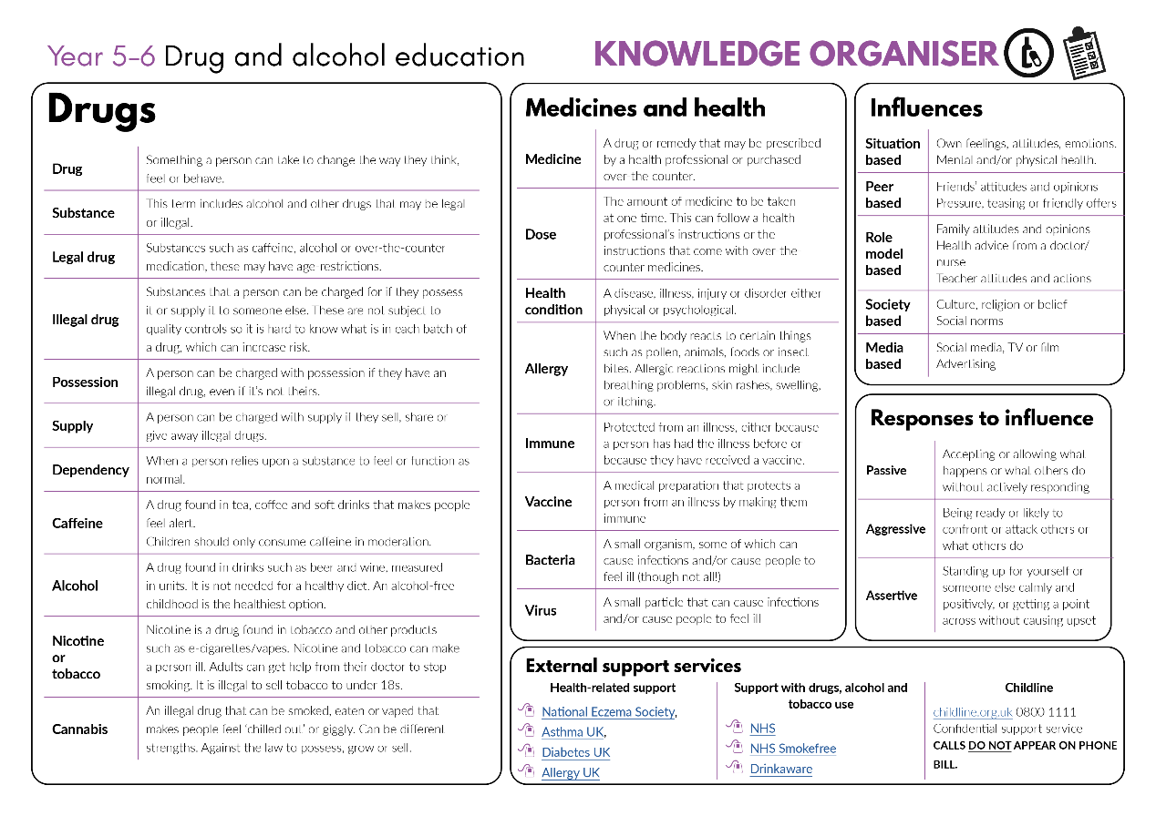


Developing subject knowledge
Teacher
slide
Key information on content related to these lessons can be found in the Year 5-6 Knowledge Organiser.
Advice on safe practice, dispelling common misconceptions, visitors to the classroom and other important information can be found in Teacher Guidance: Drug and alcohol education
Data sources to inform your planning can be found within our document that outlines the approach of these lessons Evidence Review: Effective drug and alcohol education, along with advice regarding how to talk to young people about addiction, dependency and problematic substance use.
© PSHE Association 2020

Slide 6



Teacher
slide
      Learning objective
To learn how the correct use of medicines, and how vaccinations and immunisation, can help to maintain health and wellbeing
      Learning outcomes
Pupils will be able to:
  describe how medicines, when used responsibly, can support health and wellbeing
  explain how preventative medicines such as vaccinations and immunisation can stop disease from spreading
  explain the safe use of medicines to help manage illness and allergies
  identify where to find further advice and guidance about the correct use of
    medicines

Slide 7




Teacher
slide
Preparing to teach
      Climate for learning
Make sure you have read the accompanying teacher guidance notes before teaching this lesson for guidance on establishing ground rules, the limits of confidentiality, communication and handling questions effectively.
      Resources required
Box or envelope for anonymous questions
Large pieces of paper and marker pens for group work
Resource 1: Thinking bubbles worksheet [Pupils write in their work books or complete the worksheet-1 copy per pupil]
Resource 2: Vaccination cards [1 sheet per group]
Resource 3: Case studies [1 set per group]
      Duration
      This has been designed to be taught as a sixty minute PSHE education lesson
      Further guidance
      Members of the PSHE Association can access our website for further guidance www.pshe-association.org.uk
60
© PSHE Association 2020

Slide 8
Teacher
slide
Lesson summary
Activity | Description | Timing
1. Baseline assessment | Individually, pupils write down what they already know about managing illness, allergies and disease | 10 MINS
2. Introduction | Reinforce ground rules. Pupils are reminded of the role of medicines | 5 MINS
3. Vaccination card game | In groups, pupils play a card game to develop their understanding of vaccination and immunity | 15 MINS
4. Rainbow groups | Pairs of pupils read medicine case studies, then in groups make a chart about what they have learned | 15 MINS
5. Plenary/signposting support | Pupils reflect on how medicines are administered safely and are provided with guidance on where to get further information and advice | 5 MINS
6. End-point assessment | Pupils go back to their baseline assessments, add to or amend them to demonstrate their new learning | 10 MINS
© PSHE Association 2020

Slide 9
Lesson 1
Managing risk: medicines

Slide 10

Ground rules
[Add your class rules here]
Notes:
Teacher Notes
Use this slide to display your class agreement / ground rules for PSHE education lessons. See Accompanying Teacher Guidance Notes (separate document).
Remind pupils of ground rules, pointing out any especially useful to remember for this lesson, such as not putting people on the spot by asking them personal questions about medication they use.

Slide 11
We are learning how the correct use of medicines, and how vaccinations and immunisation, can help to maintain health and wellbeing
      We will be able to:
  describe how correct use of medicines can support health and wellbeing
  explain how vaccinations and immunisation can stop disease from spreading
  explain the safe use of medicines to help manage illness and allergies
  identify where to find further advice about the correct use of medicines
Notes:
Teacher Notes – Learning objective and outcomes
Introduce the learning outcomes - these are a simplified, more pupil-friendly version of the outcomes on slide 6 (teacher slide).

Slide 12

Thinking bubbles
Write down what you think we can do to manage:
allergies
infectious diseases
illness
Notes:
Teacher Notes – Baseline assessment (10 mins)
In their exercise books or using Resource 1: Thinking bubbles worksheet, pupils write down what they know already about what can be done to manage illness, allergies or infectious diseases, by writing their ideas around these words.
Teacher’s note: Do not prompt the pupils or give further explanation as this activity is to establish their understanding prior to any lesson input. Therefore, reassure them that if they do not have much to add to their sheets at the moment, it doesn’t matter, as they will be learning about this in the lesson and this activity is to find out what they already know and think. They should ensure their ideas are their own and not work with others on this activity. Circulate the room as the pupils complete this to gain a sense of their starting point.

Slide 13

Medicine use
The use of a medicine depends on the type of disease or illness someone has. Medicines can:
Prevent someone from becoming ill or stop a disease from spreading
Help someone feel better and relieve pain, such as from a headache
Help someone manage an ongoing health condition, such as asthma or diabetes
Help the body recover from illness
Notes:
Teacher Notes – Introduction (5 mins)
Use this slide to explain to pupils that the use of a medicine depends on the type of disease or illness someone has. Medicines can:
help someone feel better and relieve pain, such as from a headache
help the body recover from illness
help someone manage an ongoing health condition, such as asthma or diabetes
prevent someone from becoming ill or stop a disease from spreading.

Slide 14
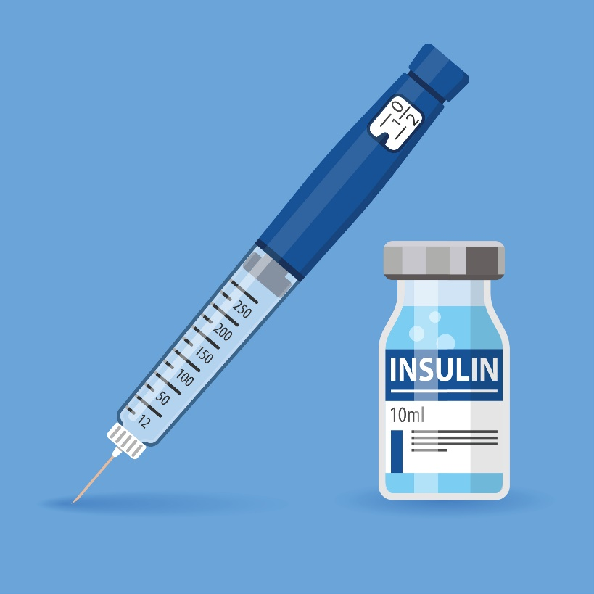
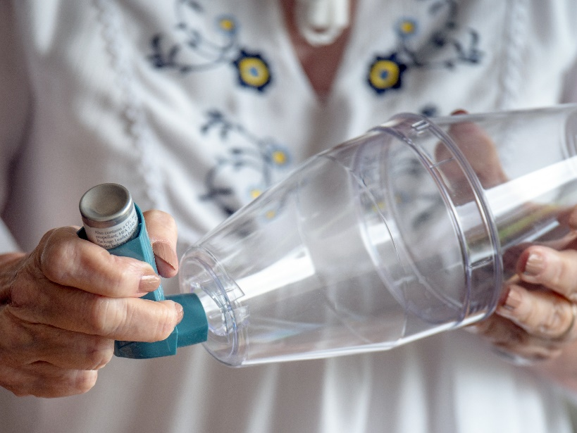

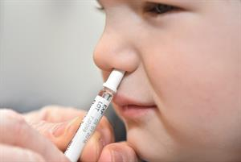
Rainbow groups
In your groups, read the case study.
Now discuss these questions with your group:
What is the medicine?
Why is it used?
How is it used?
Is it used for every day/sometimes, for emergencies or both? (If both, explain how)
Notes:
Teacher Notes – Rainbow Groups (15 mins)
Organise pupils into groups and label each group a different colour (e.g. yellow, blue, red, green, purple and orange). Give each group a different case study to read and discuss – select these from Resource 3: case studies. Ask pupils to discuss the questions in their group. For part 2 see next slide.

Slide 15







Rainbow groups
In your Rainbow group, share your information about your case study.
Now draw a grid with the following headings:
What? Why? How? Everyday/emergency
 | What? | Why? | How? | Everyday/ emergency
Write the names of the medicines down the left hand side. Add the information about the medicines to the grid.
Notes:
Teacher Notes – Rainbow Groups continued
Next, pupils make ‘rainbow groups’ ensuring that each group includes one person from each colour of the rainbow and so that each person in the group reads a different case study.
Teacher’s note: You may want to keep one of the case studies back to model the following activity.
In their groups, pupils draw a grid on a large piece of paper with the following headings across the top: What? Why? How? Every day/Emergency and the name of the medicines down the left hand side.
Pupils discuss the different medicines in their new groups and add the information to the grid.

Slide 16

Reflecting and getting support
Medicines are helpful for health but only if used, stored and disposed of correctly. Only trusted adults should give medicine to children.
If ever unsure about using a medicine, ask a trusted adult for help.
Further information and support about the health conditions in the lesson can be found here:
  National Eczema Society
  Asthma UK
  Diabetes UK
  Allergy UK
Notes:
Teacher Notes - Plenary / reflecting on today’s learning and signposting support (5 mins)
Reiterate that people use medicines differently depending on the type of illness they have. Some young people, such as those with diabetes and asthma, live with their health conditions every day and have been trained by a doctor or nurse to be able to take their medicines on their own.
Remind pupils that medicines are helpful for health but only if used correctly and stored/disposed of safely. Adults should administer medicines to children (with the exception of those mentioned above). Explain that if they are ever unsure about using a medicine they should ask a trusted adult. In addition, if they are ever in an emergency situation and a trusted adult is not available, then they should call the emergency services using 999.

Slide 17

What has been learnt?
Go back to your thinking bubbles from the beginning of the lesson.
Use a different colour pen or pencil to add to or change your ideas.
Notes:
Teacher Notes – End-point assessment (10 mins)
Pupils return to their baseline assessment activity and add to each thinking bubble in a different coloured pencil/pen, reflecting on what they have learned in the lesson about what can be done to manage illness, allergies and infectious diseases.

Slide 18

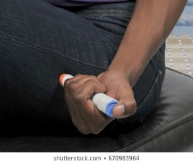
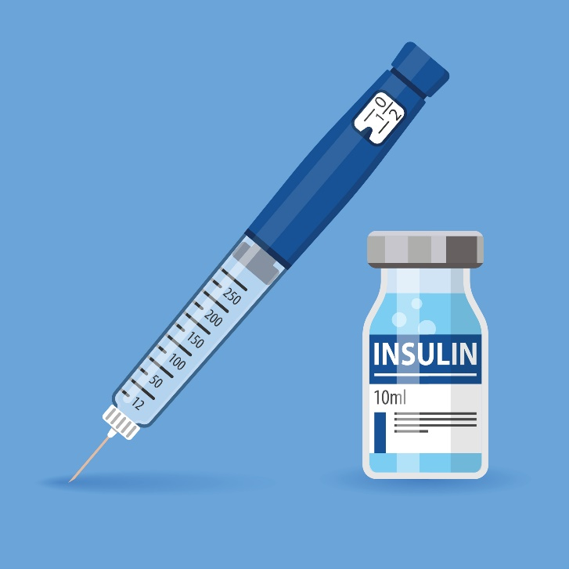

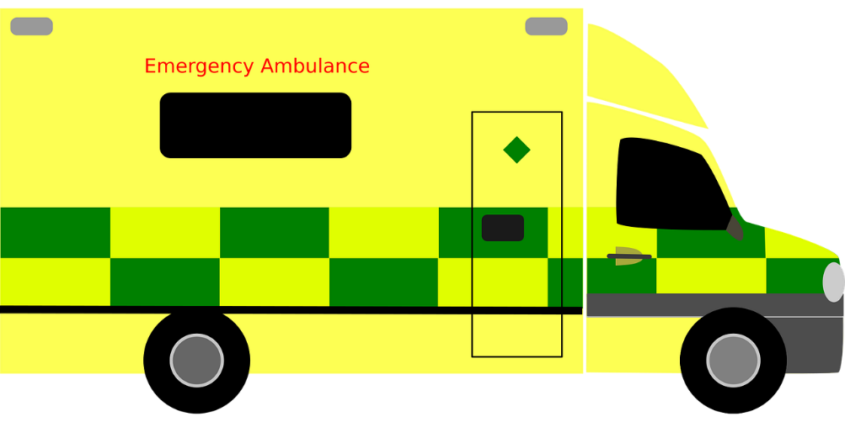
More activities
Choose one medicine from the lesson that might be used in an emergency (inhaler, EpiPen or insulin).
Write the steps for their safe use in an emergency.
Step 1:
Step 2:
Step 3:
Notes:
Teacher Notes – Extension activity
Pupils identify those medicines that might be used in an emergency and focus on one medicine - inhaler, EpiPen or insulin, and then write the steps for their safe use in an emergency situation.
For example:
Asthma attack:
Step 1: Sit upright
Step 2: Take one puff every minute for 10 minutes
Step 3: If attack continues call an ambulance

