Slide 1



Ensure you read the guidance before teaching the lesson
Teacher
slide
Drug and alcohol education
KS1
Year 3/4 Lesson 2:
Safety rules and risks: alcohol and smoking
© PSHE Association 2020

Slide 2

Using this PowerPoint
Teacher
slide
The slides in this presentation are divided into two sections:
Teacher slides (purple) – provide key information regarding lesson preparation
Pupil slides (white) – provide a visual focus point for pupils during the lesson and delivery notes for teachers about the activities. Click ‘notes’ to view these.
Ensure that you select ‘Use Presenter View’ under the ‘Slide Show’ tab – this will allow you to preview the teaching notes on your monitor while the main presentation is displayed on a screen/smartboard.
© PSHE Association 2020

Slide 3



Challenge and support
Teacher
slide
The lesson includes suggestions for challenge and support activities, to help you differentiate appropriately for your class.
Challenge activities deepen and extend the learning for those who need more challenge or who finish the activity quickly.
Support activities are adapted to be more accessible for those who need it.
Look for the logo on the pupil slides. See delivery notes for details of the activities.
Support
Challenge
© PSHE Association 2020

Slide 4
Context
Teacher
slide
This is the second of two lessons for lower key stage 2 pupils providing age-appropriate drug and alcohol education. This lesson focuses on caffeine, alcohol and cigarettes/e-cigarettes including their associated risks and effects. Pupils develop their knowledge of related laws and guidelines. They understand that for some people it is difficult to stop smoking but learn about ways people can access support and advice to protect theirs and others’ health.
Neither this, nor any of the other lessons, is designed to be taught in isolation, but should always form part of a planned, developmental PSHE education programme.
© PSHE Association 2020

Slide 5
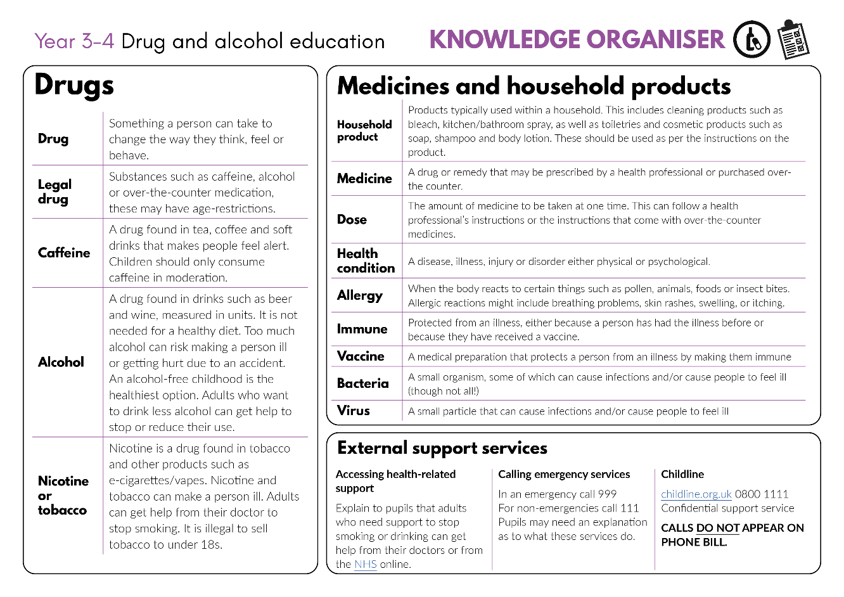


Developing subject knowledge
Teacher
slide
Key information on content related to these lessons can be found in the Year 3-4 Knowledge Organiser.
Advice on safe practice, dispelling common misconceptions, visitors to the classroom and other important information can be found in Teacher Guidance: Drug and alcohol education
Data sources to inform your planning can be found within our document that outlines the approach of these lessons Evidence Review: Effective drug and alcohol education, along with advice regarding how to talk to young people about addiction, dependency and problematic substance use.
© PSHE Association 2020

Slide 6



      Learning objective
To learn that caffeine, cigarettes, e-cigarettes/vaping and alcohol can affect people’s health
Teacher
slide
      Learning outcomes
Pupils will be able to:
  identify some of the risks of caffeine, cigarettes, e-cigarettes/vaping and alcohol
  identify how these risks can affect the person, or those around them
  explain how laws, guidelines and restrictions help to keep people safe and healthy
  identify where people can get help and support to protect their own and
    others’ health

Slide 7




Teacher
slide
Preparing to teach
      Climate for learning
Make sure you have read the accompanying teacher guidance notes before teaching this lesson for guidance on establishing ground rules, the limits of confidentiality, communication and handling questions effectively.
      Resources required
Box or envelope for anonymous questions
Resource 1: True or false quiz [1 per pair]
Resource 2: Teacher fact sheet (quiz answers) – Drugs common to everyday life [1 for the teacher]
Resource 3: Overheard conversation script [1 per class or pair]
Resource 4: Multiple choice questions [1per small group]
      Duration
      This has been designed to be taught as a sixty minute PSHE education lesson
      Further guidance
      Members of the PSHE Association can access our website for further guidance www.pshe-association.org.uk
60
© PSHE Association 2020

Slide 8
Teacher
slide
Lesson summary
Activity | Description | Timing
1. Baseline assessment | To be completed before the lesson. Pupils respond to a character’s questions about smoking and alcohol | 5-15 MINS
2. Introduction | Remind pupils of ground rules. Basic introduction to drugs other than medicines: caffeine, alcohol, cigarettes and e-cigarettes | 5 MINS
3. Quiz | Pairs complete a quiz about laws and guidelines relating to caffeine, cigarettes/e-cigarettes and alcohol | 10 MINS
4. Group discussion | In small groups, pupils discuss why adults may choose to use these different substances | 5 MINS
5. Overheard conversation | Pupils read a conversation script to find out about some of the risks of smoking and what can help people who smoke, to stop | 10 MINS
6. Multiple choice discussion | In small groups, pupils answer multiple choice questions using the information from the previous activity | 15 MINS
7. Plenary/signposting support | Pupils reflect on their learning, are reminded about advice and support for adults and who they can talk to about any concerns | 10 MINS
8. End-point assessment | Pupils revisit the baseline activity and add to or amend their ideas on their original or a new sheet of paper | 5 MINS
© PSHE Association 2020

Slide 9


Lesson 2
Safety rules and risks:
alcohol and smoking

Slide 10

Ground rules
[Add your class rules here]
Notes:
Teacher Notes
Use this slide to display your class agreement / ground rules for PSHE education lessons. See Accompanying Teacher Guidance Notes (separate document).
Remind pupils of their ground rules and highlight any particularly pertinent to this lesson, such as ‘we won’t share personal stories about people we know or name them if we do want to talk about their story, instead it is best we begin sentences with ‘someone I know…’ or ‘someone I heard about…’

Slide 11

News report
Aunt Lusia is watching a news report on TV. Afterwards she says:
Don’t drink too much caffeine and alcohol! Don’t smoke!
Why are there are all these rules?
Why are they important?
What should people do?
What would you say to Aunt Lusia?
What would help her or other people?
Notes:
Teacher notes – Baseline assessment (5-15 mins)
The Baseline assessment should be completed before the lesson. This allows time to look through pupils’ work and gain a sense of their current understanding. Assess their recognition of the skills someone might need to protect their own or others’ health. Ensure that ground rules have been established and remind the pupils of these, before carrying out the baseline activity. Read the scenario with the pupils and ask the questions underneath. Pupils can write their responses in their exercise books.

Slide 12
We are learning that caffeine, cigarettes, e-cigarettes/vaping and alcohol can affect people’s health
      We will be able to:
  identify some of the risks of caffeine, cigarettes, e-cigarettes/vaping and alcohol
  identify how risks can affect the person, or those around them
  explain how laws can help to keep people safe and healthy
  identify where people can get help to protect their own and others’ health
Notes:
Teacher Notes – Learning objective and outcomes
Introduce the learning outcomes - these are a simplified, more pupil-friendly version of the outcomes on slide 6 (teacher slide).
Explain to pupils that there are substances (other than medicines) that some people use in their home, or out and about, such as: caffeine (found in tea, coffee and energy drinks), cigarettes or e-cigarettes and alcohol. Some adults choose not to use these because their religion prohibits it or for health/other reasons. Some adults choose to use these but they are not meant for children. They can be harmful to health and wellbeing and for that reason there are laws and guidelines about their use.

Slide 13


True or false quiz
Work with your partner to decide whether the statements are true or false.
Notes:
Teacher Notes – True or false quiz (10 mins)
To find out more about the laws and guidelines on the use of caffeine, cigarettes/e-cigarettes and alcohol, pupils work in pairs to complete Resource 1: True or false quiz.
Support: Pupils may require some additional adult support to read or further explain the question.
Challenge: Ask pupils to suggest which laws/guidelines mainly protect adults, and which are there to protect children.

Slide 14


Quiz answers
1. Drinks that contain caffeine (tea, coffee, cola and energy drinks) are good for toddlers and young children.
FALSE
2. It is against the law to smoke in a car with anyone under 18.
TRUE
3. Vaping/Smoking an e-cigarette is completely safe.
FALSE
4. Smoking with the door or window open will stop others breathing in any smoke.
FALSE
Notes:
Teacher Notes – True or false quiz answers
Go through the answers with the class, using Resource 2: Teacher fact sheet (quiz answers) to help guide your responses. Discuss how these laws and guidelines help protect people and their health.

Slide 15

Quiz answers
5. It is legal to buy e-cigarettes at age 16.
FALSE
6. Anyone can buy alcohol in supermarkets, even if they are under age 18.
FALSE
7. Adults that drink alcohol, should have some ‘alcohol-free’ days each week.
TRUE
Notes:
Go through the answers with the class, using Resource 2: Teacher fact sheet (quiz answers) to help guide your responses. Discuss how these laws and guidelines help protect people and their health.

Slide 16



Alcohol, caffeine and cigarettes
Even though these come with risks, people might still choose to use them.
With your group, discuss what you think are the main reasons why some adults choose to drink alcohol and caffeine, or smoke cigarettes.
Notes:
Teacher Notes – Group Discussion (5 mins)
To further elicit pupils’ understanding and attitudes, ask them to discuss in small groups why even though these products come with risk, some adults might still choose to use them. Take feedback from each group.
Ask pupils: What do they think are the main reasons?
Pupil responses might include:
because they like it (the taste/the feeling); to relax; to socialise; because all their friends do it; because they always do it (habit); because they need it (dependent).

Slide 17

Overheard conversation
Listen to the conversation between Dad and Aunt Lusia about giving up smoking.
What are some of the risks of smoking?
What has Aunt Lusia tried to help her stop smoking?
Notes:
Teacher Notes – Overheard conversation (10 min)
Explain that for most adults, a little caffeine or alcohol (in small amounts and not too often) although not very healthy, is likely to have only a low risk on the health of their bodies over time. However, smoking is harmful, not only to the person smoking but also to those around them and the environment. Once someone starts to smoke frequently, it can be difficult for them to stop and that it is best not to start in the first place.
Read aloud Resource 3: Overheard conversation script to the pupils asking them to find out - What are some of the risks of smoking? What has Aunt Lusia tried to help her stop smoking so far?
Support: Pupils find two risks of smoking and one thing Aunt Lusia has tried to help her stop
Challenge: Challenge the pupils’ thinking further by asking: What are some of the challenges or difficulties for people like Aunt Lusia who want to stop smoking? What are some of the benefits of stopping?
Teacher’s note: If you choose to act out this conversation for the class it is best if adults play the role of Dad and Aunt Lusia and the pupils play the role of Frankie. If this is not possible, the teacher should be in role as Aunt Lusia and a pupil as dad. To ensure role play is managed sensitively clear signals should be used to show when ‘in-role’ and ‘out-of-role’, such as an item of clothing or prop.

Slide 18


Multiple choice
Answer the multiple choice questions with your group about health and smoking.
Which will be the best options for the characters to take?
Notes:
Teacher Notes – Multiple choice discussion (15 mins)
In small groups pupils answer the multiple choice questions using Resource 4: Multiple choice questions. Make the pupils aware that there is not necessarily a ‘right’ answer and that there may be more than one ‘best option’.
Discuss some of the pupils’ responses and ask: Which will be the best actions for the characters to take?

Slide 19

Reflecting and getting support
Think about these questions:
What has this lesson made you think about?
What has this lesson made you think about your health?
What has this lesson made you think about your health in the future?
If you are worried about someone you know, talk to a trusted adult – a parent/carer or a teacher at school.
Notes:
Teacher Notes - Plenary / reflecting on today’s lesson and signposting support (10 min)
Pupils reflect on their learning in the lesson using the questions
Explain that help is available for people who are drinking too much or too often and for those who want to stop smoking. Adults can get support and advice online (www.nhs.uk), through their local pharmacy or doctor.
If pupils are worried about someone they know or live with then they should talk to a trusted adult – a parent/carer or teacher at school. Reiterate that children are not responsible for adult’s decisions about their health but can think about how they can look after own health now and in the future.

Slide 20

What has been learnt?
Imagine you have been watching the news report with Aunt Lusia.
What would you say to help her now?
Add to your ideas from the beginning of the lesson with a different colour pencil or pen.
Notes:
Teacher Notes – End-point assessment (5 mins)
Pupils go back to their baseline assessment and imagine they have been watching the news report with Aunt Lusia. What would they say to help Aunt Lusia now?
Pupils should add their ideas to their original work using a different colour pencil.

Slide 21



More activities
Imagine you have been asked to produce a news report for World Health Day about the effects of smoking on people’s heath.
It could be for adults or someone your age.
Write down the key points
Act out the report and record it
Notes:
Teacher Notes – Extension Activity
Pupils imagine they have been asked to produce a news report for World Health Day explaining the effects of smoking on people’s health. They can choose to make it a report for adults or children around their age, write down the key points to be included, act out and record their report.

