Slide 1



Ensure you read the guidance before teaching the lesson
Teacher
slide
Drug and alcohol education
KS2
Year 3/4 Lesson 1:
Safety rules and risks: medicines and household products
© PSHE Association 2020

Slide 2

Using this PowerPoint
Teacher
slide
The slides in this presentation are divided into two sections:
Teacher slides (purple) – provide key information regarding lesson preparation
Pupil slides (white) – provide a visual focus point for pupils during the lesson and delivery notes for teachers about the activities. Click ‘notes’ to view these.
Ensure that you select ‘Use Presenter View’ under the ‘Slide Show’ tab – this will allow you to preview the teaching notes on your monitor while the main presentation is displayed on a screen/smartboard.
© PSHE Association 2020

Slide 3

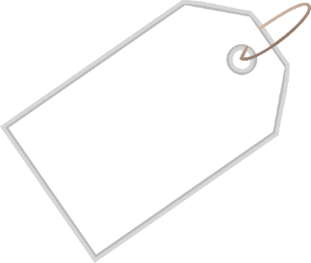

Challenge and support
Teacher
slide
The lesson includes suggestions for challenge and support activities, to help you differentiate appropriately for your class.
Challenge activities deepen and extend the learning for those who need more challenge or who finish the activity quickly.
Support activities are adapted to be more accessible for those who need it.
Look for the logo on the pupil slides. See delivery notes for details of the activities.
Support
Challenge
© PSHE Association 2020

Slide 4
Context
Teacher
slide
This is the first of two lessons for lower key stage 2 pupils providing age-appropriate drug and alcohol education. This lesson focuses on the reasons why we use household products and medicines and the importance of using them safely. Pupils explore a range of medicine labels and instructions and assess risk in different situations. They identify how to minimise/prevent further risk to help prevent accidents from occurring.
Neither this, nor any of the other lessons, is designed to be taught in isolation, but should always form part of a planned, developmental PSHE education programme.
© PSHE Association 2020

Slide 5
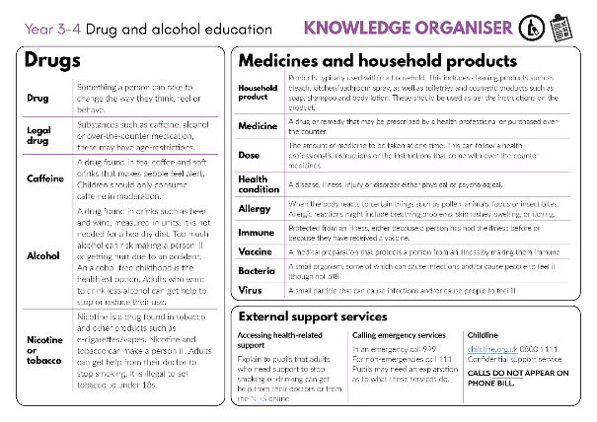


Developing subject knowledge
Teacher
slide
Key information on content related to these lessons can be found in the Year 3-4 Knowledge Organiser.
Advice on safe practice, dispelling common misconceptions, visitors to the classroom and other important information can be found in Teacher Guidance: Drug and alcohol education
Data sources to inform your planning can be found within our document that outlines the approach of these lessons Evidence Review: Effective drug and alcohol education, along with advice regarding how to talk to young people about addiction, dependency and problematic substance use.
© PSHE Association 2020

Slide 6



Teacher
slide
      Learning objective
To learn about the safe use of medicines and household products
      Learning outcomes
Pupils will be able to:
  explain the importance of taking medicines correctly and using household products safely
  identify risk in relation to the use of medicines and household products, and suggest what action to take to help prevent or minimise harm
  recognise sources of information and whom to ask for help with medicine safety

Slide 7




Teacher
slide
Preparing to teach
      Climate for learning
Make sure you have read the accompanying teacher guidance notes before teaching this lesson for guidance on establishing ground rules, the limits of confidentiality, communication and handling questions effectively.
      Resources required
Box or envelope for anonymous questions
Empty medicines packaging (boxes, clean and washed bottles) and instructions leaflets from over the counter and prescribed medicines. Ensure that personal information on printed labels from prescribed medicine is deleted.
Resource 1: Household products and medicines – benefits and risks list [1 per pupil, or pupils can create this grid in their work books or on a piece of paper]
Resource 2: A day in the life [1 per class]
Resource 3: Medicine safety scenarios [1 scenario per small group of three or pair]
      Duration
      This has been designed to be taught as a sixty minute PSHE education lesson
60
      Further guidance
      Members of the PSHE Association can access our website for further guidance www.pshe-association.org.uk
© PSHE Association 2020

Slide 8
Teacher
slide
Lesson summary
Activity | Description | Timing
1. Baseline assessment | To be completed before the lesson. Establish ground rules. Pupils write down the benefits and risks of using different household products and medicines, and suggest how risk of harm can be reduced | 5-15 MINS
2. Introduction | Remind pupils of ground rules. Pupils note how a family use medicines and household products safely and how they help them | 10 MINS
3. Medicine labels and analysis | Pupils discuss the importance of following instructions for using medicines – pupils explore medicine labels and instructions | 10 MINS
4. Freeze frame | Pupils use scenarios to create freeze frames about risks involving medicines, household products and safety | 10 MINS
5. Role play | Pupils role-play how the characters in the scenario can best manage the risk | 15 MINS
6. Plenary/Signposting support | Pupils share one thing this lesson has made them think about medicine safety; signpost further advice and emergency help | 5 MINS
7. End-point assessment | Pupils return to their list from the baseline assessment and add to or amend their ideas to demonstrate their learning | 5-15 MINS
© PSHE Association 2020

Slide 9



Lesson 1
Safety rules and risks: medicines and household products

Slide 10

Ground rules
[Add your class rules here]
Notes:
Teacher Notes
Use this slide to display your class agreement / ground rules for PSHE education lessons. See Accompanying Teacher Guidance Notes (separate document).
Remind pupils of the ground rules for PSHE lessons and highlight any particularly relevant to this lesson.

Slide 11

We are learning about the safe use of medicines and household products
      We will be able to:
  explain why it is important to take medicines correctly and use household products safely
  say why using medicines and household products can sometimes be risky, and suggest what to do to stay safe
  recognise whom to ask for help with medicine safety and where to get information about medicines
Notes:
Teacher Notes – Learning objective and outcomes
Introduce the learning outcomes - these are a simplified, more pupil-friendly version of the outcomes on slide 6 (teacher slide)..
Explain to the pupils that this lesson will focus on household products, especially medicines and the importance of people using these safely. In the lesson they will be looking at packaging from real medicines and that these have been emptied (and washed if required).
.

Slide 12

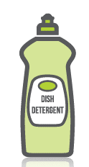



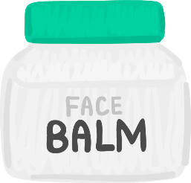


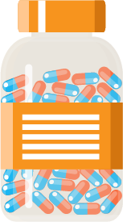

What’s our starting point?
Use the benefits and risks list sheet to answer these questions about household products and medicines:
How do these help us?
Are there any risks of using these products? What are the risks?
What will help reduce the risks?
Notes:
Teacher Notes – Baseline activity (5-15 mins)
This activity should be completed before the lesson. This allows time to look through the pupils’ work and gain a sense of their current understanding. Before setting this activity, ensure that ground rules for PSHE education lessons have been developed and shared with the class.
Display or provide copies for pupils of Resource 1: Household products and medicines – benefits and risks list
Ask the pupils the following questions: How do these help us? Are there any risks of using these products? What are the risks?
What will help reduce the risks?
Pupils record their ideas on Resource 1: Household products and medicines – benefits and risks list, in their exercise books or on a blank sheet of paper.

Slide 13
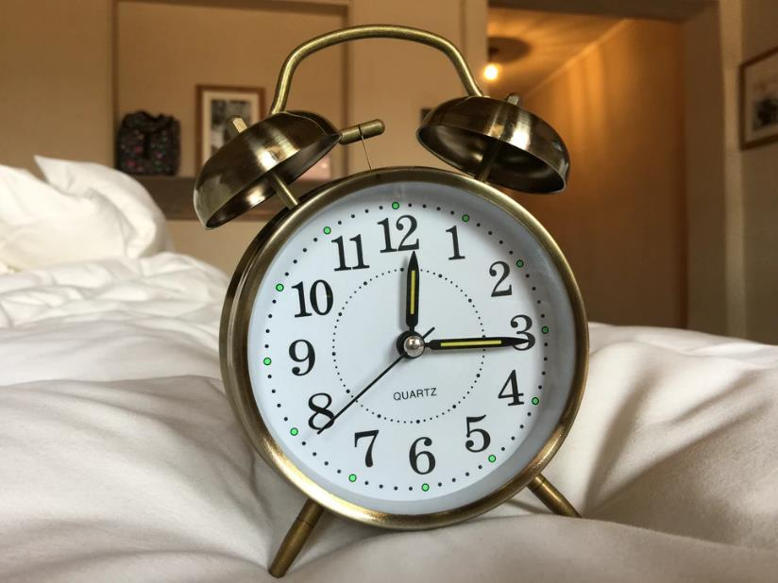
A day in the life
Listen to ‘A day in the life’ about the Grech family.
Talk about what different items are used by the family and how they are used safely.
Notes:
Teacher Notes – A day in the life (10 mins)
Display and read Resource 2: A day in the life to the class.
Pupils note the different items used by the family and how they use them safely, discussing in pairs and then feeding back.
Take responses, and circle in a coloured pen on Resource 2: A day in the life, the different items, pointing out any safety aspects.
Suggestions to support pupils’ learning:
Benefits:
Medicines and other products can help someone feel better if they are ill (e.g. paracetamol), protect them from becoming ill (e.g. vaccinations protect people from disease and sun-creams protect the skin from harmful sun rays), or help them stay healthy (e.g. if someone has asthma, medicines help them keep well; pets and farm animals might also need medicines to help them keep well)
Household products (such as cleaning sprays, liquids and capsules) help keep the house clean and free from germs, and keep bodies clean and protected from germs too (e.g. soap, shampoo and toothpaste).
Safety considerations:
Whilst some medicines can be bought over the counter in supermarkets and shops; pharmacists, doctors and nurses prescribe medicines and give medicines like vaccinations; it is important to read the instructions before using medicines and other household products; medicines and household products should be kept out of reach of children and disposed of carefully; spillages should be cleaned up immediately; if accidents occur the product should be washed off; gloves may be needed to use some household products and these should only be used by adults.

Slide 14
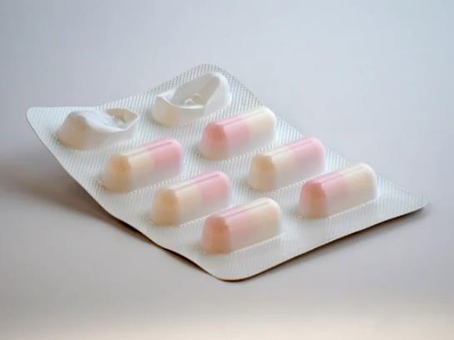
Medicine labels analysis
Think back to ‘A day in the life’ when Aunt Lusia had a headache. Before taking the tablets, she read the instructions on the medicine packet.
Why is it important for her to do this?
Now, look at the empty medicine packaging with your partner. Find the all the information someone would need before taking the medicine.
Notes:
Teacher Notes – Medicine labels analysis (10 mins)
Refer back to Resource 1: A day in the life, when Aunt Lusia has a headache. Point out that one of the things she does is read the label on the medicine’s packet before she takes the tablets.
Ask pupils: Why is it important for her to do this? Take some suggestions from the pupils.
Pupil responses might include:
So that she knows what the medicine is, to know how many to take and when (e.g. with a meal), to know if they are suitable (the right medicine for her), so she doesn’t take too many, to check it is safe to take with other medicines, to check the ‘use-by ’date (medicines may become ineffective if out-of-date, or - like food and drink - may go bad).
Using real empty medicine packaging, pupils work in pairs to analyse the labels and instructions flyers – noticing the information provided. Take feedback and make a list to display. As a class, discuss unfamiliar vocabulary and why instructions are printed on the medicine packaging/leaflets for safety.
Support: Pupils find just three different pieces of information on the medicine packaging label.
Challenge: Pupils are challenged to find 10 different pieces of information on the medicine packaging label.

Slide 15
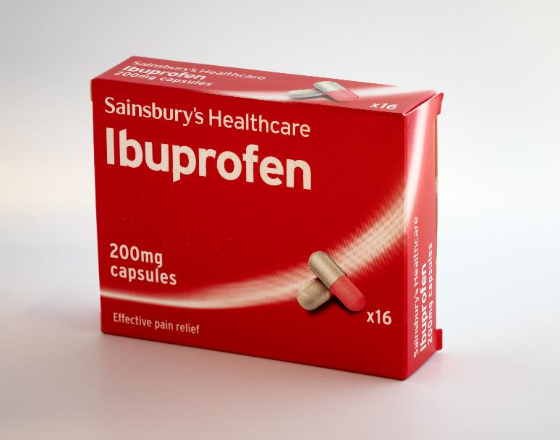
Medicine labels analysis
Possible side effects
Who the medicine is meant for
Name and type of medicine
How much to take and how to use it
Where and how to store the medicine
How many in the packet
What it does
Expiry date and manufacturer
Ingredients
Safety warnings and instructions
Notes:
Use this slide to take pupil’s feedback about what they have found.
Teacher’s note: It may be worth pointing out that sometimes medicines are removed from their original packaging and put in ‘pill boxes’ for example, which might have the days of the week or times of day on them. These are often used by a person who needs to take medicines regularly to help them remember when to take the medicine. Before they are dispensed into these pots, the adult responsible will be aware of the correct ways to take the medicine.
Discuss how some medicines can be bought in shops or pharmacies and some must be prescribed by a doctor or nurse. Explain that prescribed medicine is prepared for a specific individual but that medicines available to buy could be for anyone who is experiencing the illness. If possible, compare two different packages to demonstrate this.
For example:
Name and type of medicine
How much / How many in the packet
Uses - What it does, how it helps
Who the medicine is meant for
Dose - How much to take
How to use
Safety warning and instructions
Where and how to store the medicine
Side effects
Ingredients
Expiry date
Manufacturer

Slide 16

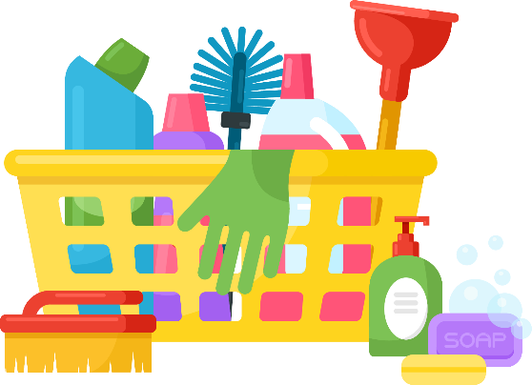
Freeze frame
In your pair or group, read the medicine safety scenario. Now, choose a role with your group and create a freeze frame of the scenario.
Once you’re ‘out of role’, talk about the risk in the scenario:
What is the risk?
What might happen?
Notes:
Teacher notes – Freeze frame (10 mins)
Organise pupils into small groups (of three) or pairs. Give each group a scenario from Resource 3: Medicine safety scenarios, ensuring an even spread of examples across the class.
Ask the pupils, in their groups, to read some examples of situations involving medicines and safety rules then get ‘into role’ and make a ‘freeze frame’ of the scenario, as if someone had taken a photograph of the scenario.
Once ‘out of role’, groups discuss the risk in the situation, answering the following questions:
What is the risk? What might happen?
Teacher’s note: If working in groups of three, one pupil can become the ‘director’ of the scene, rather than acting ‘in role’. To ensure role play is managed sensitively, provide a signal or countdown for pupils stepping ‘into role’ and another for coming ‘out of role’.
Support: Choose scenarios that are likely to have a more obvious outcome (such as scenarios 2, 4 and 7).
Challenge: Extend pupils’ thinking by asking, if this happens, how could this affect the health of the person or people in the situation?

Slide 17

Role play
Think about your scenario with your group.
  What should the characters do now to prevent any further risk?
  Who could help? Where could the person get more support or advice?
Stepping back ‘into role’, role play what the characters should do to prevent any further risk and identify who could help.
Notes:
Teacher Notes – Role play (15 mins)
Next, pupils discuss the following two questions for their given scenario:
What should the characters do now to prevent any further risk?
Who could help? Where could the person get more support or advice?
Stepping back ‘into role’, pupils role-play what the characters should do to prevent any further risk and identify who can help.
Some of the groups can show their role plays to the class. The class feedback on whether they think the characters did the right thing to help prevent any further risk and share further ideas.

Slide 18

Reflecting and getting support
Share one thing this lesson has made you think about medicine safety. It could be:
Something new you have learned
Something you think is important to remember in the future
Remember that medicines are helpful for health but only if they are used correctly. Trusted adults should give medicine to children.
If you are unsure about using a medicine, ask a trusted adult.
Notes:
Teacher Notes – Reflecting and getting support (5 mins)
Reiterate that medicines are helpful for health but only if they used correctly and stored/disposed of safely. Adults should administer medicines to children; there are some medicines children can use on their own if they have been trained to do so (such as inhalers) but usually adults should give medicines to children. Adults can find help about using medicines on the medicine packets, from a doctors’ surgery or pharmacy or by phoning the NHS helpline – dial 111. Explain that if they are ever unsure about using a medicine they should ask a trusted adult and if they are ever in a situation where a medicine has caused illness and a trusted adult is not available, they should call the emergency services by dialling 999.

Slide 19

What has been learnt?
Go back to the questions from your
benefits and risks list.
Is there anything you would like to change?
Is there anything you would like to add?
Use a different colour pen or pencil.
Notes:
Teacher Notes – End-point assessment (5-10 mins)
Pupils return to their baseline assessment activity, benefits and risks list and the questions they answered:
How do these help us?
Are there any risks of using these products? What are the risks?
What will help reduce the risks?
Thinking about their learning from the lesson, pupils add to or amend their ideas. They can do this on the original sheet using a different colour pencil or pen or start a clean page if preferred.

Slide 20

More activities
Make a leaflet for the Grech family about medicine safety and household products.
Notes:
Teacher Notes – Extension activity
Make a leaflet designed for the Grech Family about safety with medicines and household products.

