Slide 1


Ensure you read the guidance before teaching the lesson
Teacher
slide
Primary Extremism lessons
Lesson 3
Year 5/6: Stereotypes

Slide 2
Teacher
slide
Using this PowerPoint
The slides in this presentation are divided into two sections:
Teacher slides (purple) – provide key information regarding lesson preparation
Pupil slides (white) – provide a visual focus point for pupils during the lesson and delivery notes for teachers about the activities. Click ‘notes’ to view these.
Ensure that you select ‘Use Presenter View’ under the ‘Slide Show’ tab – this will allow you to preview the teaching notes on your monitor while the main presentation is displayed on a screen/smartboard.
© PSHE Association 2019

Slide 3



Challenge and support
Teacher
slide
The lesson includes suggestions for challenge and support activities, to help you differentiate appropriately for your class.
Challenge activities deepen and extend the learning for those who need more challenge or who finish the activity quickly.
Support activities are adapted to be more accessible for those who need it.
Look for the logo on the pupil slides. See delivery notes for details of the activities.
Support
Challenge
© PSHE Association 2019

Slide 4
Context
Teacher
slide
This is the third of a series of four lessons written for primary aged pupils with this particular lesson aimed at upper KS2.
This lesson aims to help pupils to recognise the ways in which stereotyping can negatively impact on attitudes towards different groups of people. It also explores how pupils can challenge the assumptions that underpin stereotyping.
Each lesson is intended to be delivered to different year groups and therefore should be placed within a suitable context to ensure it is part of a developmental, age-appropriate PSHE education programme.
© PSHE Association 2019

Slide 5



      Learning objective
About how negative stereotypes can influence behaviours and attitudes towards different groups of people
Teacher
slide
      Learning outcomes
Pupils will be able to:
Identify examples of different types of stereotyping
Describe how stereotypes can be unfair and unhelpful
Recognise how stereotyping may have a negative effect on someone’s behaviour, aspirations and feelings about themselves
Identify positive actions to challenge stereotyping
© PSHE Association 2019

Slide 6




Preparing to teach
      Resources required
A box or envelope for anonymous questions
Flipchart paper and pens
Pens and pencils
Resource 1: Stereotyping baseline activity
Resource 2: Sentence stems
Resource 2a: Sentence stems support
Resource 3: Overheard comments
Resource 4: Challenging stereotypes
      Climate for learning
Make sure you have read the accompanying teacher guidance notes before teaching this lesson – for guidance on establishing ground rules, the limits of
confidentiality, communication and handling questions effectively.
      Duration
      This lesson has been designed to be taught as a 60 minute PSHE education lesson.
      Further guidance
      Members of the PSHE Association can access our website for further guidance www.pshe-association.org.uk
60
© PSHE Association 2019

Slide 7
Lesson summary
Teacher
slide
Activity | Description | Timing
Baseline assessment | Pupils show their current understanding of the term stereotype | 5-10 MINS
2. Defining ‘stereotype’ | Pupils discuss and decide on a shared definition of stereotyping | 5 MINS
3. Different types of stereotyping | Pupils compose sentences which reflect their understanding of stereotyping | 10 MINS
4. How stereotyping can be negative and unfair | Pupils consider the effects of stereotyping on people’s behaviour | 10 MINS
5. Challenging stereotyping | Pupils consider strategies that help to challenge stereotyping | 10-15 MINS
6. Plenary | Pupils decide on one strategy they could use in their own lives | 5-10 MINS
7. Endpoint assessment | Pupils revisit their definitions from the beginning of the lesson and add to or amend them in light of their new learning | 5 MINS
8. Extension (optional) | Pupils write a short checklist for ways to identify and challenge stereotyping.
© PSHE Association 2019
© PSHE Asciation 2018 7.

Slide 8

Lesson 3:
Stereotypes

Slide 9

Ground rules
[Add your class rules here]
Notes:
Teacher Notes
Use this slide to display your class agreement / ground rules for PSHE education lessons. See Accompanying Teacher Guidance Notes (separate document).

Slide 10





Starting point
What do you know and understand about the word stereotype?
Draw and write what you already know on your stereotypes activity sheet.
Notes:
Teacher guidance 5-10 mins:
Give each pupil Resource 1: Stereotype baseline activity. Explain that you want them to think about everything they know and understand about the word ‘stereotype’. Give pupils time to draw or write their responses in each section. The purpose of this activity is to enable you to find out pupils’ existing understanding of the word stereotype and the concept of stereotyping.
Pupils should work individually. Whilst they are working, do not prompt them in any way. Circulate around the class, noting any responses and misconceptions that may need addressing through the lesson.

Slide 11

      We are learning about how negative stereotypes can influence behaviours and attitudes towards different groups of people
      We will be able to:
  Identify examples of different types of stereotyping
  Describe how stereotypes can be unfair and unhelpful
  Recognise how stereotyping may have a negative effect on someone’s behaviour, aspirations and feelings about themselves
  Identify positive actions to challenge stereotyping
Notes:
Teacher Notes – Learning objective and outcomes
Introduce the learning objectives and outcomes, explaining that this lesson will explore how negative stereotypes can influence behaviours and attitudes towards different groups of people.

Slide 12

What does the word stereotype mean?
Can we agree on a definition as a class?
Notes:
Teacher guidance 5 mins:
Take feedback on the first box (‘What does the word stereotype mean?’). As a class, agree a shared definition of what a stereotype is.
Share the following definitions if helpful:
A stereotype is an assumption about what someone will be like (e.g. their personal qualities or attributes) based on a group they belong to.
Cambridge Dictionary definition: “a set idea that people have about what someone or something is like, especially an idea that is wrong”
Write the agreed definition on a class working wall on ‘Stereotyping’ and keep it on display throughout the lesson.

Slide 13

What different kinds of stereotyping have you heard of?
In pairs, fill in what you think the end of the sentence could be.
What kind of stereotypes have you identified?
Notes:
Teacher guidance 10 mins:
Explain to the class that you want them to think about the different kinds of stereotyping they may have seen or heard. Using Resource 2: Sentence stems and working in pairs, ask pupils to fill in what they think the rest of each sentence could be (e.g. All girls… like to wear pink). Invite groups to feedback their ideas to the rest of the class.
What different kinds of stereotyping have the class identified? Draw out that these sentences have focussed on gender and age but stereotyping can relate to many things, such as gender, age, religion, race, nationality, disability, job, area someone lives etc.
Support: Resource 2a: Sentence stems support has fewer sentences and some words pupils can use to help them.
Challenge: Write a few sentences which promote a positive assumption (e.g. boys sometimes cry, girls don’t always like pink, old people have a lot to contribute to society).

Slide 14
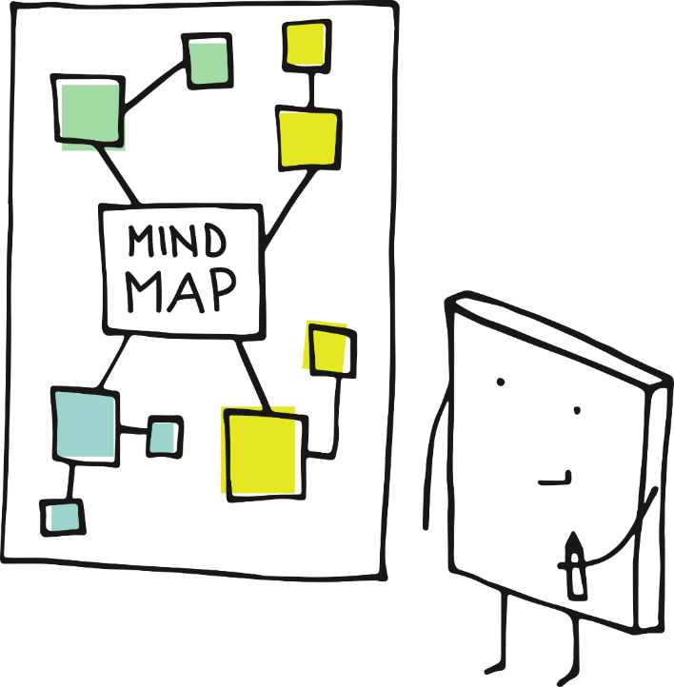
The impact of negative stereotypes
Sometimes we make unfair assumptions because we’ve been influenced by stereotypical thinking.
Mind map all the reasons you think stereotypes can negatively affect someone’s behaviour.
Notes:
Teacher guidance 10 mins (slides 14-15):
Explain to the class that sometimes we make assumptions about people which are entirely unfair because we have been influenced by stereotypical thinking. Ask pupils to consider the negative messages that stereotyping can sometimes promote (e.g. only boys like football, only girls enjoy playing with dolls). Working in small groups on large sheets of paper, pupils brainstorm all the reasons why, and ways in which, they think stereotypes can negatively affect people’s behaviour.
Take feedback (ideas might include: they can be rude or offensive; they’re not true of everyone in the group; they might stop people doing what they want to do; people might get bullied for not ‘fitting in’; they put people under pressure to behave in certain ways).
Finally, ask them to re-write their original sentences from a non-stereotypical viewpoint. Share and discuss their responses.

Slide 15

The impact of negative stereotypes
Have a look back at your sentences from earlier.
Can you re-write them from a non-stereotypical viewpoint?
Notes:
Teacher guidance 10 mins (slides 14-15):
Explain to the class that sometimes we make assumptions about people which are entirely unfair because we have been influenced by stereotypical thinking. Ask pupils to consider the negative messages that stereotyping can sometimes promote (e.g. only boys like football, only girls enjoy playing with dolls). Working in small groups on large sheets of paper, pupils brainstorm all the reasons why, and ways in which, they think stereotypes can negatively affect people’s behaviour.
Take feedback (ideas might include: they can be rude or offensive; they’re not true of everyone in the group; they might stop people doing what they want to do; people might get bullied for not ‘fitting in’; they put people under pressure to behave in certain ways).
Finally, ask them to re-write their original sentences from a non-stereotypical viewpoint. Share and discuss their responses.

Slide 16
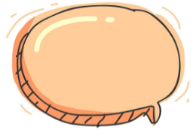
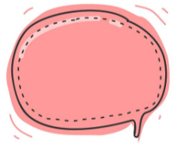
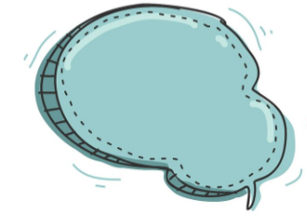
Challenging stereotyping
Read your group’s overheard comment and pull out a challenge question from the envelope.
Respond to the question and pull out another challenge question.
Keep going until you have responded to three or four questions!
Notes:
Teacher guidance 10-15 mins (slides 16-17):
Explain to the class that sometimes the way to reduce the impact that stereotyping can have on people is to challenge it where we can.
Tell pupils that they will be working in small groups in order to take the stereotype challenge! Give each group Resource 3: Overheard comments which contains overheard comments that promote stereotypical assumptions, together with an envelope containing a set of cut up prompts from Resource 4: Challenging stereotypes.
Allocate one speech bubble to each group.
Ask pupils to read their overheard comment, then pull out a challenge question from the envelope and respond to it for their comment. Repeat this until they have responded to three or four of the cut-up strips.
Ask groups to feedback to the rest of the class on how they dealt with one of the different challenges. What was the hardest challenge to manage? Which of the responses pupils decided upon would have the best outcome?

Slide 17
Challenging stereotyping
What was the hardest challenge to manage?
Which responses would have the best outcome?
Notes:
Teacher guidance 10-15 mins (slides 16-17):
Explain to the class that sometimes the way to reduce the impact that stereotyping can have on people is to challenge it where we can.
Tell pupils that they will be working in small groups in order to take the stereotype challenge! Give each group Resource 3: Overheard comments which contains overheard comments that promote stereotypical assumptions, together with an envelope containing a set of cut up prompts from Resource 4: Challenging stereotypes.
Allocate one speech bubble to each group.
Ask pupils to read their overheard comment, then pull out a challenge question from the envelope and respond to it for their comment. Repeat this until they have responded to three or four of the cut-up strips.
Ask groups to feedback to the rest of the class on how they dealt with one of the different challenges. What was the hardest challenge to manage? Which of the responses pupils decided upon would have the best outcome?

Slide 18

Our working wall
Think about all the different ways to challenge stereotyping we’ve talked about.
Choose one you could use and write it on a sticky note.
Add it to our working wall!
Notes:
Teacher Notes – Plenary (5 - 10 mins)
Ask pupils to consider the different ways for challenging stereotyping they have discussed. Invite them to consider one strategy they think they could use in their own lives in order to avoid promoting stereotypical assumptions. Ask them to write it on a sticky note and to add it to the class working wall on stereotyping.

Slide 19


Where are we now?
Go back to the first activity in which you wrote what you already knew about stereotyping.
In a different colour pen or pencil, write down anything you want to change or add.
Notes:
Teacher Notes – End-point assessment (5 mins)
Pupils revisit their baseline assessment activity with the four headings and amend in light of their new learning or add any further ideas, thoughts or questions using a different coloured pen or pencil.

Slide 20

More activities
Write a checklist for how to identify and challenge stereotyping.
Notes:
Teacher Notes – Extension activities
These activities can be included if you have additional time in the lesson or afterwards, to challenge pupils who need to be stretched or for pupils who demonstrate a particular interest in this topic.

