Slide 1



Ensure you read the guidance before teaching the lesson
Teacher
slide
Mental health and emotional wellbeing
KS2
Year 5/6
Lesson 3: Feelings and common anxieties when transitioning to secondary school

Slide 2
Teacher
slide
Using this PowerPoint
The slides in this presentation are divided into two sections:
Teacher slides (purple) – provide key information regarding lesson preparation
Pupil slides (white) – provide a visual focus point for pupils during the lesson and delivery notes for teachers about the activities. Click ‘notes’ to view these.
Ensure that you select ‘Use Presenter View’ under the ‘Slide Show’ tab – this will allow you to preview the teaching notes on your monitor while the main presentation is displayed on a screen/smartboard.
© PSHE Association 2018

Slide 3



Challenge and support
Teacher
slide
The lesson includes suggestions for challenge and support activities, to help you differentiate appropriately for your class.
Challenge activities deepen and extend the learning for those who need more challenge or who finish the activity quickly.
Support activities are adapted to be more accessible for those who need it.
Look for the logo on the pupil slides. See delivery notes for details of the activities.
Support
Challenge
© PSHE Association 2018

Slide 4
Context
Teacher
slide
This is the third in a series of three Key Stage 2 lessons for Year 5 or 6, exploring mental health and wellbeing.
This lesson focuses on the feelings and common anxieties pupils may face when starting Key Stage 3/starting secondary school. It considers ways in which pupils can positively manage their anxieties and encourages them to carefully consider the best sources of support when seeking help and advice.
Neither this, nor any of the other lessons, is designed to be taught in isolation, but should always form part of a planned, developmental PSHE education programme.

Slide 5

Working with parents
Teacher
slide
The engagement of parents in this topic would be advantageous. Parents could be informed via the school newsletter, website or blog – this would enable them to be supportive of this aspect of their child’s learning.
© PSHE Association 2018

Slide 6



      Learning objective
about the feelings and common anxieties pupils face when starting Key Stage 3/ moving to secondary school
ways of managing feelings
Teacher
slide
Pupils will learn:
      Learning outcomes
Pupils will be able to:
identify feelings people might experience when starting a new school/moving to secondary school (KS3)
recognise common causes of worry, challenges and opportunities that may be part of this transition
identify and evaluate the usefulness and reliability of different sources of support and information available; explain how to access them
identify ways to positively manage the move to secondary school (KS3)

Slide 7




Teacher
slide
Preparing to teach
      Climate for learning
Make sure you have read the accompanying teacher guidance notes before teaching this lesson – for guidance on establishing ground rules, the limits of confidentiality, communication and handling questions effectively.
      Resources required
Box/envelope for anonymous questions
Paper (blank)/pens and pencils
Flip chart paper and pens
Resource 1: Sources of support cards
Resource 2: Message to self
      Duration
      This has been designed to be taught as a sixty minute PSHE education lesson.
      Further guidance
      Members of the PSHE Association can access our website for further guidance www.pshe-association.org.uk
60
© PSHE Association 2018

Slide 8
Teacher
slide
Lesson summary
Activity | Description | Time
Baseline assessment: problem page | Pupils imagine they work for a problem page or online forum and respond to a concern | 5-15
2. Feelings brainstorm | Pairs of pupils jot down different feelings a person might have when moving to KS3; discuss conflicting feelings | 5
3. Hopes and challenges | A scenario about someone about to start KS 3 inspires pupils to consider their possible hopes and fears | 10
4. Managing challenges | Pupils work in groups to work out the best ways the character can manage their fears and share their ideas with each other | 20
5. Sources of help and support | Groups evaluate the most reliable sources of support to find information and advice regarding moving to KS 3 | 10
6. Plenary and endpoint assessment | Pupils consider advice to give themselves, to be ready for secondary school using Resource 2: Message to self and have time to write an anonymous question. Pupils add further ideas and thoughts to help their problem page/forum response | 15

Slide 9
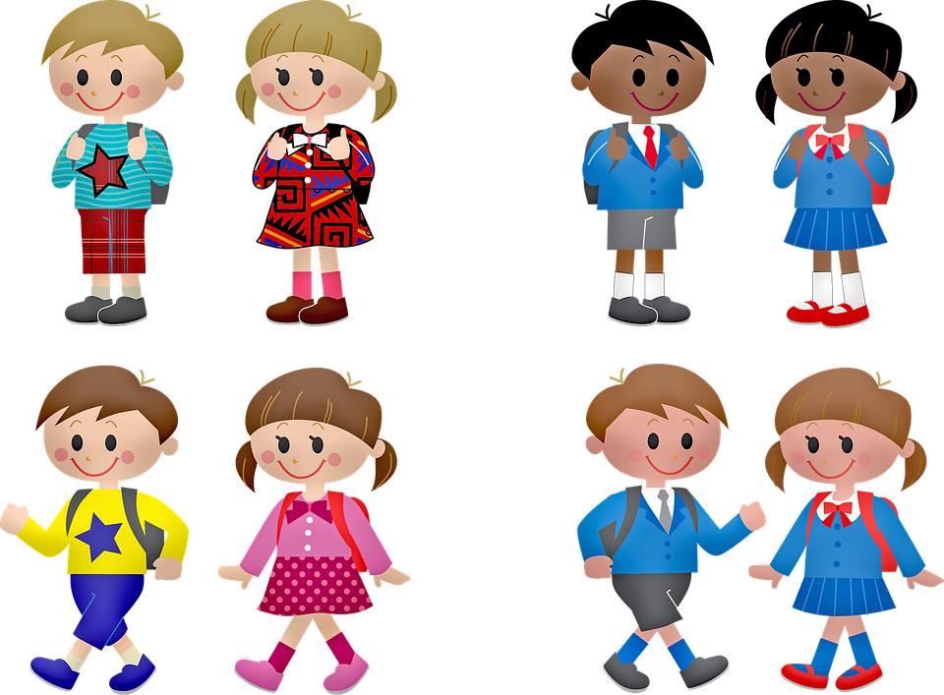
Lesson 3:
Feelings and common anxieties when transitioning to secondary school
Notes:
Image: https://pixabay.com/vectors/boy-girl-hand-in-hand-kids-school-160168/

Slide 10

Ground rules
[Add your class rules here]
Notes:
Teacher Notes
Use this slide to display your class agreement / ground rules for PSHE education lessons. See Accompanying Teacher Guidance Notes (separate document).

Slide 11


Problem page:
What’s our starting point?
Imagine you are working for a teenager’s advice column for a magazine or online forum.
Write a response to this concern:
Dear Ask Ali,
I am really worried about starting secondary school,
what is the best thing to do?
Nusrat, age 11
Notes:
Teacher Notes - Baseline assessment – problem page (5-15 mins)
Ensure this activity is completed before delivering the lesson.
Display the above concern from a teenager’s advice column on a flipchart or interactive whiteboard. Pupils write down their own personal responses without consulting other pupils. The purpose of this activity is to enable you to find out pupils’ existing knowledge, skills and attitudes towards mental health. Pupils should work individually. Whilst they are working, do not prompt them in any way. When complete, ensure pupils write their name at the top of their paper. Collect in and check pupil responses, noting any responses and any misconceptions that need addressing through the lesson. Keep the papers - pupils will return to this activity at the end of the lesson and the results used to assess their learning.
Image: https://pixabay.com/vectors/green-flag-pennon-waving-pennant-303922/
Image: https://pixabay.com/illustrations/writing-hand-writing-hand-pen-1891073/

Slide 12
      We are learning about the feelings and common anxieties pupils face when starting key stage 3 / moving to secondary school and ways of managing these feelings
      We will be able to:
  identify feelings people might experience when starting a new school/moving to secondary school (KS3)
  recognise common causes of worry, challenges and opportunities that may be part of this transition
  identify and evaluate the usefulness and reliability of different sources of support and information available; explain how to access them
  identify ways to positively manage the move to secondary school (KS3)
Notes:
Teacher Notes – Learning objective and outcomes
Introduce the learning objectives and outcomes, explaining that this lesson will explore some of the feelings and common anxieties pupils may face when starting KS3/secondary school and ways in which they can positively manage them. It will also give them time to carefully consider the best sources of support when seeking help and advice.

Slide 13

Starting secondary school/key stage 3
What feelings might a person might have?
Notes:
Teacher Notes – Feelings brainstorm (5 mins)
Ask pupils to work in pairs to jot down feelings a person might have when moving to secondary school/KS 3.
Invite them to compare responses and discuss how this situation can cause people to experience mixed-up or conflicting feelings; people can feel lots of different emotions all at once.
Refer back to Lesson 2 – different situations that can prompt similar feelings.

Slide 14

Hopes and challenges
It’s the night before Nusrat starts secondary school (KS3) and they’re in their bedroom thinking about the next day. Nusrat’s uniform is all laid out and their bag is packed and ready. Nusrat feels kind of excited, but a few things are worrying them too.
What might Nusrat be excited about (hopes) and worried about (challenges)?
Notes:
Teacher Notes – Hopes and challenges activity (10 mins)
Read aloud the scenario. On a piece of flipchart paper or interactive whiteboard write ‘hopes’ as a heading on the left-hand side and on the right-hand side write ‘challenges’. Pupils suggest what Nusrat might be excited about (hopes) and worried about (challenges). Record their responses under the headings.
Hopes might include: making new friends, learning about new subjects, joining different clubs and after school activities, meeting new teachers, going on different school trips, new responsibilities.
Challenges might include: getting lost around the new school building, not being in the same class as best friend/s, more homework, big lunch hall and choosing a meal, don’t understand new subjects, wanting to join a club but don’t know whom to go with, not knowing the rules and getting detention.
Note that some aspects may be both a hope and challenge, such as new responsibilities or making new friends.

Slide 15



Managing challenges
How could Nusrat manage the worry?
What could be sources of help or support?
Put a or a next to those ideas which you think would be the most effective strategies
Notes:
Teacher Notes – Managing challenges (20 mins)
Organise pupils into small groups and assign each group one of the challenges from the list made in the previous activity. Pupils write the worry at the centre of their paper and then brainstorm ways in which they could manage the particular worry, including sources of support or help.
Once complete, each group displays their brainstorm on the classroom wall.
Allow each group a few minutes to look at all the other groups’ work and discuss what they think might work well. Invite groups to put a tick or a smiley face next to those ideas that they think would be the most effective strategies.
Each group feeds back one or two reasons why they thought some strategies would be particularly effective.

Slide 16

Sources of help and support
In groups:
Which sources of support would be most useful for Nusrat to talk to about their concerns?
Rank the cards in order of reliability and usefulness (explain and justify your views)
How could Nusrat approach the chosen sources of support and what could they say?
Notes:
Teacher Notes – Sources of help and support (10 mins)
Remind pupils that help and advice is available but that some help and advice may be more useful or more valid than others. Inevitably, there may be rumours or gossip about starting secondary school/key stage 3 that are not helpful, so finding reliable sources of support will be useful.
Introduce Resource 1: Sources of support cards – each group needs one set.
Working in their groups and reflecting on their work from the previous activity, ask pupils to consider which sources of support would be most useful for Nusrat to talk to about their concerns. Pupils rank the cards in order of reliability and usefulness, explaining and justifying their views.
Pupils discuss how Nusrat could approach the chosen sources of support and what they could say.
Support: Pupils choose three sources of support that will be the most useful to Nusrat and explain why.
Challenge: Pupils consider some of the advantages and disadvantages of each of the sources of support. What types of concerns might be more useful than others?
Image: https://pixabay.com/illustrations/away-junction-direction-1020200/

Slide 17


Message to self!
Write a short uplifting message of advice to yourself. This can be opened and read on the evening before you start your new school.
Revisit your response to Nusrat’s question from the beginning of
the lesson. Add any new learning or further ideas, using a different coloured pen.
Which key bits of advice are going to help you manage your thoughts and feelings so that you are ready to cope with all the opportunities and challenges of moving into Year 7?
Notes:
Teacher Notes – Plenary and endpoint assessment (15 mins)
Ask pupils to write a short uplifting message of advice using Resource 2: Message to self, to open and read on the evening before they start their new school. Which key bits of advice are going to help them manage their thoughts and feelings so that they are ready to cope with all the opportunities and challenges of moving into Year 7?
Allow time for pupils to write anonymous questions and follow up as appropriate following this lesson.
Pupils revisit their response to Nusrat’s question…
Dear Ask Ali,
I am really worried about starting secondary school, what is the best thing to do?
Nusrat, age 11
…and amend it in the light of their new learning, adding any further ideas, using a different coloured pen.

Slide 18

More activities
News piece for school website or newsletter!
Describe practical steps to take between now and the start of secondary school for how to manage feelings and anxieties:
over the Summer break
on the evening before you start school
on the first day
Notes:
Teacher Notes – Extension activity – OPTIONAL
Invite pupils to write a news piece for the school website or newsletter describing practical steps to take between now and the start of secondary school. This could include how to manage feelings and anxieties over the Summer holiday break, on the evening before they start their new school and on the first day. This could then be shared and promoted with Year 6 pupils and parents.

