Slide 1



Ensure you read the guidance before teaching the lesson
Teacher
slide
Mental health and
Emotional wellbeing
KS2
Year 1 / 2
Lesson 1: We all have feelings

Slide 2

Teacher
slide
Using this PowerPoint
The slides in this presentation are divided into two sections:
Teacher slides (purple) – provide key information regarding lesson preparation
Pupil slides (white) – provide a visual focus point for pupils during the lesson and delivery notes for teachers about the activities. Click ‘notes’ to view these.
Ensure that you select ‘Use Presenter View’ under the ‘Slide Show’ tab – this will allow you to preview the teaching notes on your monitor while the main presentation is displayed on a screen/smartboard.
© PSHE Association 2018

Slide 3



Challenge and support
Teacher
slide
The lesson includes suggestions for challenge and support activities, to help you differentiate appropriately for your class.
Challenge activities deepen and extend the learning for those who need more challenge or who finish the activity quickly.
Support activities are adapted to be more accessible for those who need it.
Look for the logo on the pupil slides. See delivery notes for details of the activities.
Support
Challenge
© PSHE Association 2018

Slide 4
Context
Teacher
slide
This is the first in a series of three KS1 lessons written for Year 1 or 2, exploring mental health and wellbeing.
This lesson helps pupils to recognise and describe different feelings in themselves and others; and what (or who) helps them with their feelings.
Neither this, nor any of the other lessons, is designed to be taught in isolation, but should always form part of a planned, developmental PSHE education programme

Slide 5
Developing subject knowledge
Teacher
slide
For pupils in KS1 we suggest using the term ‘feelings’. For your own subject knowledge ‘feelings’ and ‘emotions’ are interchangeable as their definition is similar, but for your own subject knowledge these words can be defined as:
Emotion: a strong feeling deriving from one's circumstances, mood, or relationships with others; an instinctive or intuitive feeling as distinguished from reasoning or knowledge
Feeling: an emotional state or reaction, an idea or belief, especially a vague or irrational one, or the adjective feeling: showing emotion or sensitivity

Slide 6

Working with parents
Teacher
slide
The engagement of parents in this topic would be advantageous. Parents could be informed via the school newsletter, website or blog — this would enable them to be supportive of this aspect of their child’s learning.
© PSHE Association 2018

Slide 7



Teacher
slide
      Learning objective
to recognise and describe different feelings in themselves and others
Pupils will learn:
      Learning outcomes
Pupils will be able to:
recognise and name some feelings that they might have
explain how feelings can make their bodies feel inside
describe how other’s might be feeling
identify who can help them with feelings, and how they can help others
© PSHE Association 2018

Slide 8




Preparing to teach
      Resources required
A box or envelope for anonymous questions
Flipchart paper and pens
Pens and pencils
Resource 1: Image
Resource 2: Feelings vocabulary cards
Resource 3: Feelings scenarios
Resource 4: Help cards
      Climate for learning
Make sure you have read the accompanying teacher guidance notes before teaching this lesson – for guidance on establishing ground rules, the limits of
confidentiality, communication and handling questions effectively.
      Duration
      This lesson has been designed to be taught as a 60 minute PSHE education lesson.
      Further guidance
      Members of the PSHE Association can access our website for further guidance www.pshe-association.org.uk
60
© PSHE Association 2018

Slide 9
Teacher
slide
Lesson summary
Activity | Description | Time
Introduction and baseline assessment | Pupils begin by reflecting on how they are feeling. A short activity designed to capture pupils current knowledge and understanding of feelings. | 10
2. Everyday feelings | Pupils create a list of everyday feelings. | 5
3. Recognising feelings | Pupils apply facial expressions and body movements to everyday feelings. | 10
4. How it feels inside | Using words and phrases, pupils describe everyday feelings. | 10
5. What are they feeling? | Feelings are identified from real life scenarios. | 10
6. Signposting support | Pupils evaluate the effectiveness of different examples of support. | 10
7. Plenary – assessing progress | Pupils reflect on and annotate their baseline activity with their new learning. | 5

Slide 10
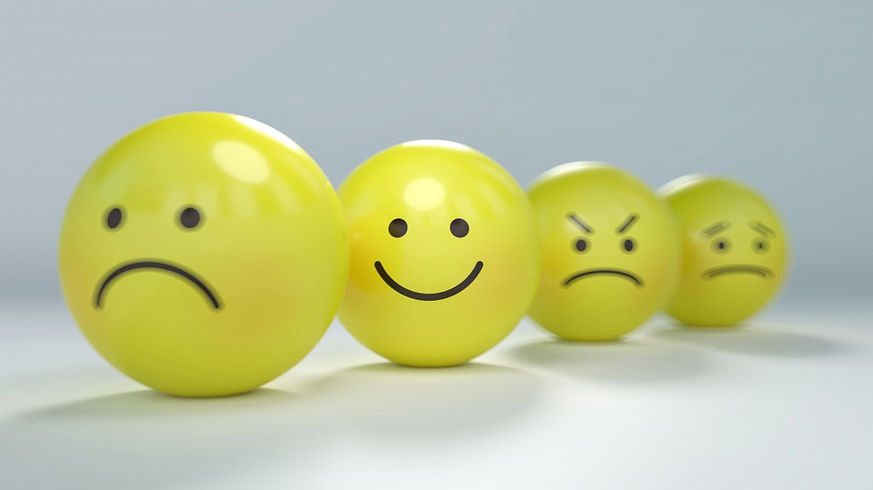
Lesson 1:
We all have feelings

Slide 11

Ground rules
[Add your class rules here]
Notes:
Teacher Notes
Use this slide to display your class agreement / ground rules for PSHE education lessons. See Accompanying Teacher Guidance Notes (separate document).
At the beginning of the lesson, establish or reinforce existing ground rules – add or emphasise any ground rules that are especially relevant to this lesson.

Slide 12

Feelings: personal reflections
How do you feel today?
Notes:
This quick activity encourages pupils to begin to think about their own feelings. Responses should not be shared with the class.
Ask ‘How do you feel today?’
Without telling anyone else, pupils should think quietly to themselves about how they feel.

Slide 13


We all have feelings:
What’s our starting point?
Meet Maz.
Maz is visiting earth to discover more about humans. Today Maz wants to learn all about feelings.
Tell Maz anything that you know about feelings…
Notes:
Teacher Notes - Baseline assessment (10 mins)
Introduce Maz, and read slide to pupils.
Ask pupils to tell Maz anything that they know about feelings. Record their responses on the board/flipchart
The purpose of this baseline activity is to enable you to find out the pupil’s existing knowledge, understanding and attitudes about feelings. . Pupils will return to this activity at the end of the lesson.

Slide 14
      We are learning to recognise and describe different feelings in ourselves and others
      We will be able to:
  recognise and name some feelings we might have
  explain how feelings can make our bodies feel inside
  describe how other people might be feeling
  identify who can help us with our feelings, and how we can help others
Notes:
Teacher Notes – Learning objective and outcomes
Introduce the learning objectives and outcomes, explaining that this lesson will explore different feelings that we all have

Slide 15
Everyday feelings
Which feelings might someone have everyday?
Which feelings might we have every day?
Notes:
Teacher notes – 5 mins
Following on from the baseline activity, tell pupils that Maz wants to know the names of the feelings that we might have every day. From the pupils’ responses, create a list on the flip chart and include any feelings given in the baseline activity. If necessary, support pupils with keywords from the vocabulary section on lesson plan. Keep this list of Everyday Feelings displayed on the working wall, as this will be used again in the next lesson.
Teaching point: Explain that we all have different feelings – some we might feel every day, and others just sometimes. Our feelings can come and go, and can change over time.

Slide 16


Recognising feelings
Can you show Maz…
a happy face?
what an angry face might look like?
how we look when we’re excited?
a happy body?
what an angry body might look like?
how our body might look when we are excited?
Notes:
Recognising feelings: 10mins
Using the feelings that pupils identified in the previous activity, pupils show Maz what different feelings might look like on people’s faces and bodies. Extend to other feelings that pupils identified.
Support: Feelings face match
Provide one set of cards printed with faces showing feelings (available online from educational resources websites), and one set of cards printed with corresponding feelings words. Pupils match the face to the feelings word.
Challenge:
Pupils tell Maz what signs to look out for if someone was scared, or any of the other feelings. What might they say, do, behave like?

Slide 17

?
How it feels inside
?
Read the word on your feelings card.
How might the feeling make Maz’s body feel?
Where in his body might Maz experience this feeling?
Which might happen to his face when he feels it?
What might happen to his body when he feels it?
Write some sentences to describe how Maz might experience the feeling.
?
?
?
?
Notes:
Teacher Notes – How it feels inside 10mins
Organise pupils into groups and give each group one or two of the cut out word cards from Resource 2: Feelings vocabulary cards. Each group should discuss and describe how the word on their card might feel in Maz’s body. Ask questions on slide to support discussion.
Using flipchart paper and pens, groups should record some sentences to describe how Maz might experience the feeling. Examples for pupils: Worried: Maz might…clench his fist. Maz’s legs start feeling shaky. Maz’s tummy hurts. Maz bites his nails. Maz’s teeth start to chatter.
Teaching point: note that we all are all different we might have the same feeling but our bodies might react in different ways.

Slide 18



What are they feeling?
Read the characters’ stories.
Talk about which feelings the characters are experiencing.
Write the feelings on the sheet.
Talk about the stories as a class.
Do you all agree on what the feeling was?
Are there any other feelings that the characters might have?
What might the character say that would give us a clue as to how they were feeling?
Notes:
Teacher Notes – What are they feeling? 10mins
In their groups, pupils read Resource 3: Feelings scenarios, then discuss which feelings they think the characters are experiencing and write their answers on the sheet.
Pupils may attribute feelings such as: Amir – worried; Mia – excited; Jade – happy; Ty – embarrassed; Mo – scared; Daisy – angry; Carlos – confident/proud; Maddy – jealous; Leo – lonely/nervous.
Discuss as a class whether or not they agreed within their group on what the feeling was, and ask if there were any other feelings that the characters could also be feeling. What might the character say that would give a clue as to how they were feeling?
Teaching point: Note that not everyone will feel the same in these situations and that people’s bodies and faces may react in different ways.

Slide 19

Signposting support
Which of the characters might need help with their feelings?
Read the help cards and decide which of the suggestions is best for helping the characters.
Put the cards in order of most useful to least useful.
Notes:
Teacher Notes – Signposting support (10mins)
Ask the class to identify which of the characters might need help with their feelings (Amir, Ty, Mo Daisy or Maddy). Tell pupils that they are going to help them.
Provide each group with cut up Resource 4: Help cards. Pupils should discuss how effective each of the suggestions is in helping the characters and put them in order of usefulness.

Slide 20

We all have feelings
Go back to the ‘What’s our starting point?’ activity
Do you remember that Maz wanted to find out about feelings?
  Is there anything else that you would like to tell Maz?
  Is there anything you would like to add?
  Is there anything that you would like to change?
Notes:
Teacher Notes – End-point assessment (5 mins)
Return to the whole class baseline assessment activity and remind the pupils that Maz wanted to find out about feelings. Is there anything that they’d like to add, to tell Maz or to change?
Annotate any new learning in a different colour on flip chart paper.

Slide 21

More activities
Using Resource 3: Feelings scenarios, pupils identify what the characters might say that would give a clue about how they feeling?
Notes:
Teacher Notes – Extension activities
These activities can be included if you have additional time in the lesson or afterwards, to challenge pupils who need to be stretched or for pupils who demonstrate a particular interest in this topic.

