Slide 1



Ensure you read the guidance before teaching the lesson
Teacher
slide
Mental health and emotional wellbeing
KS2
Year 5/6
Lesson 1: Mental health and
keeping well

Slide 2
Teacher
slide
Using this PowerPoint
The slides in this presentation are divided into two sections:
Teacher slides (purple) – provide key information regarding lesson preparation
Pupil slides (white) – provide a visual focus point for pupils during the lesson and delivery notes for teachers about the activities. Click ‘notes’ to view these.
Ensure that you select ‘Use Presenter View’ under the ‘Slide Show’ tab – this will allow you to preview the teaching notes on your monitor while the main presentation is displayed on a screen/smartboard.
© PSHE Association 2018

Slide 3



Challenge and support
Teacher
slide
The lesson includes suggestions for challenge and support activities, to help you differentiate appropriately for your class.
Challenge activities deepen and extend the learning for those who need more challenge or who finish the activity quickly.
Support activities are adapted to be more accessible for those who need it.
Look for the logo on the pupil slides. See delivery notes for details of the activities.
Support
Challenge
© PSHE Association 2018

Slide 4
Context
Teacher
slide
This is the first in a series of three KS2 lessons for Year 5 or 6, exploring mental health and wellbeing.
This first lesson builds on learning from lower KS2 about different feelings and emotions and shifts the focus to ‘mental health’ – what we mean by this and how we look after it.
Neither this, nor any of the other lessons, is designed to be taught in isolation, but should always form part of a planned, developmental PSHE education programme.

Slide 5
Teacher
slide
Developing subject knowledge
For pupils in KS2, we suggest using the terms ‘feelings’ and ‘emotions’ interchangeably as their definition is similar, but for your own subject knowledge these words can be defined as:
Emotion: a strong feeling deriving from one’s circumstances, mood, or relationships with others; an instinctive or intuitive feeling as distinguished from reasoning or knowledge
Feeling: an emotional state or reaction, an idea or belief, especially a vague or irrational one, or the adjective feeling: showing emotion or sensitivity

Slide 6

Working with parents
Teacher
slide
The engagement of parents in this topic would be advantageous. Parents could be informed via the school newsletter, website or blog – this would enable them to be supportive of this aspect of their child’s learning.
© PSHE Association 2018

Slide 7



Teacher
slide
      Learning objective
about mental health; what it means and how we can take care of it.
Pupils will learn:
      Learning outcomes
Pupils will be able to:
explain what is meant by the term ‘mental health’
identify everyday behaviours that can help to support mental (and physical) health
recognise that we can take care of our mental health (as well as our physical health)
© PSHE Association 2018

Slide 8




Teacher
slide
Preparing to teach
      Resources required
Box/envelope for anonymous questions
Sticky notes/A4 paper (blank)/pens and pencils
Resource 1: Mental health definitions
Resource 1a: Mental health thermometer
Resource 2a: Activities for health cards
Resource 2b: Activities for health cards – teacher guide
Resource 3: Jay’s story
Optional: magazines and newspapers, scissors, glue or sticky-tape
      Climate for learning
Make sure you have read the accompanying teacher guidance notes before teaching this lesson – for guidance on establishing ground rules, the limits of confidentiality, communication and handling questions effectively.
      Duration
      This has been designed to be taught as a sixty minute PSHE education lesson.
      Further guidance
      Members of the PSHE Association can access our website for further guidance www.pshe-association.org.uk
60
© PSHE Association 2018

Slide 9
Teacher
slide
Lesson summary
Activity | Description | Time
Baseline assessment: mental health/first thoughts | Pupils draw/write or make a collage of words/images associated with mental health | 10-15
2. Introduction: definitions | Pupils choose and explain the best definition to sum up mental health | 5-10
3. Class discussion | Pupils discuss how we know if someone feels good in their body and their mind | 10
4. Card sort: activities for health | Pupils work in groups to sort activities that support physical health, then mental health – everyday, sometimes, if there is a problem, rarely, or not at all | 15
5. Mental health thermometer | Pupils apply the thermometer to a scenario and suggest ways to support being mentally healthy | 10
6. Plenary and signposting support | Pupils consider one strategy they could use in their own lives to help support their mental health | 5
7. Endpoint assessment | Pupils go back to their ‘mental health words wall’ they completed at the beginning of the lesson and add to or amend them in light of their new learning | 5-10

Slide 10

Lesson 1:
Mental health and keeping well
Notes:
Image:
https://pixabay.com/illustrations/watercolour-watercolor-paint-ink-1768921/

Slide 11

Ground rules
[Add your class rules here]
Notes:
Teacher Notes
Use this slide to display your class agreement / ground rules for PSHE education lessons. See Accompanying Teacher Guidance Notes (separate document).

Slide 12



Mental health:
What’s our starting point?
Write down all the words, feelings and emotions you think are associated with mental health.
Notes:
Teacher Notes - Baseline assessment (10 mins)
Ensure this activity is completed before delivering the lesson.
Provide pupils with a piece of blank A4 paper and ask them to write down all the words, feelings and emotions they think are associated with mental health. Alternatively, pupils may prefer to draw or make a collage from magazine and newspaper cuttings. The purpose of this activity is to enable you to find out pupils’ existing knowledge, skills and attitudes towards mental health. Pupils should work individually. Whilst they are working, do not prompt them in any way. When complete, ensure pupils write their name at the top of their paper. Collect in and check pupil responses, noting any responses and any misconceptions that need addressing through the lesson. Keep the papers - pupils will return to this activity at the end of the lesson and the results used to assess their learning.

Slide 13
      We are learning about mental health; what it means and how we can take care of it
      We will be able to:
  explain what is meant by the term ‘mental health’
  identify everyday behaviours that can help to support mental (and physical) health
  recognise that we can take care of our mental health (as well as our physical health)
Notes:
Teacher Notes – Learning objective and outcomes
Introduce the learning objectives and outcomes, explaining that this lesson will explore what mental health means and the different ways in which we can take care of it.

Slide 14
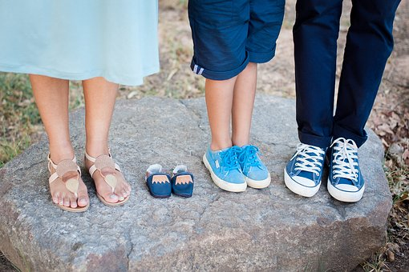
What is mental health?
Look at the definitions of mental health displayed around the classroom.
Stand next to the one which you feel best sums up what mental health is.
Be ready to give reasons for your choice.
Notes:
Teacher Notes – What is mental health? (5- 10 mins)
Display definitions of mental health around the classroom: Resource 1: Mental health definitions. Invite pupils to stand next to the definition they feel best sums up what mental health means to them. Ask pupils to explain and give reasons for why they have decided to stand next to a particular definition.
It may be useful for the class to come up with a shared definition of mental health as there is a lot of a confusion surrounding the term ‘mental health’. You may wish to share the below definitions with the class.
The World Health Organisation describes mental health as being:
‘A state of well-being in which every individual realises his or her own potential, can cope with the normal stresses of life, can work productively and fruitfully, and is able to make a contribution to her or his community.’
NHS England describes it as
‘How we think, feel and behave’.

Slide 15
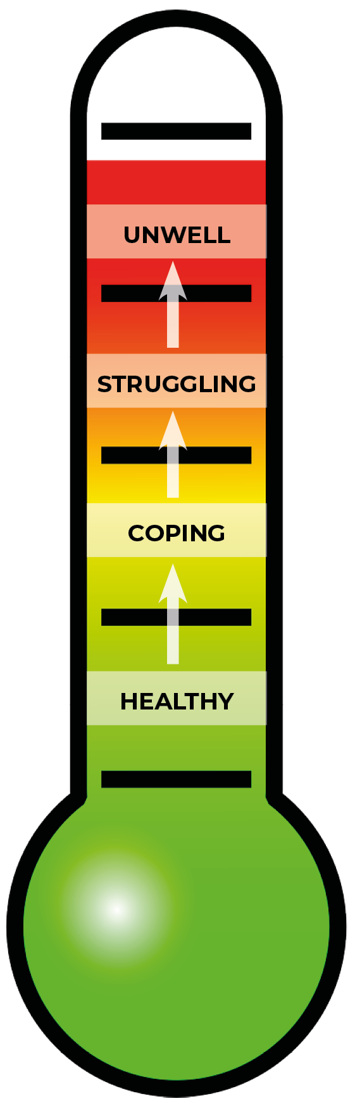
What is mental health?
Mental health can be thought of as being on a scale that can move up or down, a bit like a thermometer.
We can move along the scale at any time, between being healthy or unwell.
There are things we can put in place to help us feel better and move out of the struggling or unwell areas.
Notes:
Teacher Notes – What is mental health? (5- 10 mins)
Display Resource 1a: Mental health thermometer. Explain that our mental health can be thought of as being on a scale that can move up or down, a bit like a thermometer. Mental health can move anywhere up or down the thermometer, between being healthy or unwell. We can all move along the scale at any time, but there are things that we can do to support us to stay in the healthy and coping areas. Sometimes, we may go in to the struggling or unwell areas. To support us with our mental health, we can put things in place to help us feel better and move out of the struggling or unwell areas.
Leave the thermometer on display through out the lesson.

Slide 16
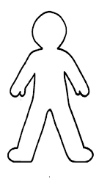
Signs of wellbeing
How do we know if someone feels good:
- in their body (physical health)?
- in their mind (mental health)?
How do we know if someone does not feel good:
in their body (physical health)?
in their mind (mental health)?
Remember we cannot always tell – sometimes illness or ill-health is not obvious to others (either physical or mental health)
Notes:
Teacher Notes – Class discussion (10 mins)
Display a drawing of a person on a piece of flipchart paper (a stick-person is fine). Discuss with the class how we know if someone feels good in their body (physical health) and their mind (mental health). Write the pupils’ ideas around the body outline.
Pupils might say things like: they seem happy most of the time; can talk about they feel; take exercise; get out and about; skin and hair look fresh and glossy, look clean and tidy.
Then discuss clues that might mean someone does not feel good in their body. How do we know? What about if someone does not feel good in their mind? Are there similar clues? Are we always able to tell how someone feels (physically or mentally)?
Pupils might say things like: they feel ill, are tired all the time, look sad, don’t have any get-up-and-go, skin looks pale or grey; need to take medicine.
Explain that how a person looks or behaves can suggest how they are feeling (in their mind or body), but we cannot always tell – sometimes illness or ill-health is not obvious to others.

Slide 17

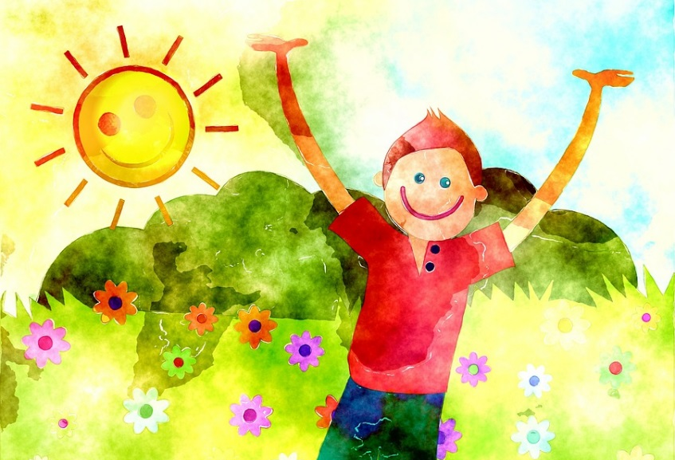
Activities for health
Card Sort – Physical health
Things we should do:
- Every day
- Sometimes
- If there is a problem
- Rarely or not at all
Card Sort – Mental health
Things we should do:
- Every day
- Sometimes
- If there is a problem
- Rarely or not at all
Notes:
Teacher Notes – Card Sort: activities for health (15 mins)
Working in small groups, pupils organise Resource 2a: Activities for health cards under headings written on flipchart paper: things we should do ‘everyday’; ‘sometimes’; if there is a problem; rarely or not at all.
First, ask pupils to do this for physical health (looking after bodies). Then ask them to repeat this activity, but this time considering mental health (looking after minds – feelings and emotions). Pupils should place the cards according to what they consider to be a ‘best fit’. For possible responses, see Resource 2b: Activities for health cards – teacher guide.
Compare pupils responses. Draw out that taking care of our mental health is just as important as taking care of our physical health and that the two are closely linked; many of the activities that help people’s physical health also support their mental health.
It may also be worth pointing out that in order for some people to maintain good health (physical or mental) there may be things they have to do every day, that other people may only do sometimes, e.g. taking medication.

Slide 18
Mental health thermometer
Plot Jay’s mental health on the thermometer.
How could Jay strengthen the ability to cope in order to avoid moving into the struggling zone?
How could this reduce Jay’s chances of being in the unwell area?
Notes:
Teacher Notes – Mental health thermometer (10 mins)
Provide pupils with copies of Resource 1a: Mental health thermometer. Recap that mental health can move anywhere along the scale but there are things that we can do to look after it to reduce chances of being in the unwell area.
Read pupils the following scenario. This is provided for pupils on Resource 3: Jay’s story:
Jay enjoys drawing cartoons and skateboarding. Jay is quiet and thoughtful, has good friends and likes school. Mostly Jay feels generally happy, although like everyone, Jay has ups and downs.
Jay has recently started feeling sad. Most days the sadness seems to come and go, but some days it feels as though a dark cloud is gathering above and following Jay around all day. Skateboarding takes Jay’s mind off it and when the feelings start to get stronger Jay draws a cartoon that shows the feelings and the cloud.
Jay feels very sad most of the time. Every day when Jay wakes up, Jay feels the day ahead is just too much. Everything feels grey and dark. Jay is finding it hard to concentrate at school and some days doesn’t want to go to school at all. Nothing seems enjoyable anymore, not even skateboarding! Jay’s friends are worried.
Pupils should plot Jay’s mental health on the thermometer, then suggest ways to strengthen Jay’s ability to cope, so that Jay can manage his wellbeing to avoid moving in to the struggling zone, and reduce his chances of being in the unwell area.
Support: pupils may need additional support for this activity, and can be supported by Resource 2a: Activities for health cards
Challenge: pupils work individually or in pairs

Slide 19



What strategy from today’s lesson could we use in our own lives?
Talk to a trusted adult at home or at school
ChildLine: www.childline.org.uk
0800 1111
Notes:
Teacher Notes – Plenary and signposting support (5 mins)
Remind pupils that if they, or someone they know, does not feel good, help and support are available. In the first instance and if possible, they should talk to a trusted adult (at home or school). Advice can also be accessed at ChildLine: www.childline.org.uk, 0800 1111, including for mental health. Ask pupils to show on the thermometer scale where seeking help and advice would be a good idea.
Invite pupils to consider one strategy from today’s lesson that they think they could use in their own lives, to support their own mental health and wellbeing. Ask them to write it on a sticky note and to keep it as a reminder.

Slide 20


Mental Health
Go back to the ‘What’s our starting point?’ activity
Is there anything you would like to change?
Is there anything you would like to add?
Use a different coloured pen or pencil to amend your first thoughts activity and show how your thinking has developed or changed.
Notes:
Teacher Notes – End-point assessment (5-10 mins)
Ask pupils to revisit their mental health – first thoughts activity from the beginning of the lesson, amend it in the light of their new learning or add any further ideas or thoughts, words or images, using a different coloured pen or pencil or additional collage materials.
Image: https://pixabay.com/photos/artistic-bright-color-colored-2069/

Slide 21

More activities
Top tips checklist
Create a top tips checklist to help people take care of their mental health.
Who might be a good audience to write for?
(other pupils in school, parents/grandparents or teachers?)
Notes:
Teacher Notes – Extension activities
These activities can be included if you have additional time in the lesson or afterwards, to challenge pupils who need to be stretched or for pupils who demonstrate a particular interest in this topic.
Pupils work in groups to compile a top tips checklist to help people take care of their mental health. They could choose a specific audience to write for, such as other primary pupils, parents/grandparents or teachers.
These could be shared with the rest of the school community via the school website, class blog, in a school assembly, or form a display in a communal part of the building. You might also include a selection of pupils’ ideas in the school prospectus or handbook so that parents can see the value placed on taking care of mental health within the school community.

