Slide 1

Helping Your Child Prepare for the Year 4 Multiplication Tables Check (MTC)

Slide 2
What Is the MTC?
A short online check for Year 4 pupils
Assesses recall of times tables up to 12×12.
25 questions — 6 seconds per question.
Administered in June.
It’s not a test of methods or working out — it’s all about recall and speed.

Slide 3
Why are times tables important?
Foundation for most areas of maths:
  Division, fractions, ratios, algebra, area, perimeter and problem solving.
Builds confidence and fluency.
Reduces cognitive load — frees up brain space for higher-level maths.

Slide 4
What Does Fluency Look Like?
Knowing facts automatically (e.g., “6 × 7 = 42”) without working it out.
Recalling them in any order, forwards or backwards.
Using patterns and understanding relationships (e.g., “if 4×6=24, then 6×4=24”).
Fluency isn’t about rote memorisation only — it’s about quick, confident recall with understanding.
Challenges that pupils can face include:
Mixing up similar facts (e.g., 6×7 vs. 7×8).
Relying on skip-counting or finger strategies.
Anxiety or lack of confidence.
Not enough regular short practice.

Slide 5
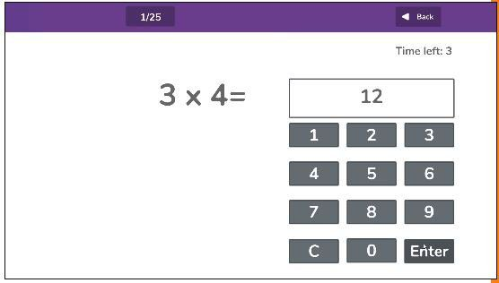
What does the MTC look like for pupils?
Digital check on a laptop or tablet.
One question at a time.
6 seconds per question with 3 seconds in between.
Example:
Q: 8 × 7 = ?
Child types the answer quickly.
Pupils will get the opportunity to have a practice run. This is optional and each pupils will be asked their preference.

Slide 6
How can you help at home?
✅ Short, daily practice — 5 minutes
✅ Make it fun — songs, games, apps
✅ Focus on tricky tables
✅ Praise effort, not just accuracy
✅ Talk about patterns (e.g. 5s and 10s are easy; use them to find others)
✅ Encourage routine – perhaps after dinner or in the car

Slide 7

Fun Ideas to Support Recall
Online: Times Table Rock Stars, Hit the Button, Maths Frame MTC Check
Offline: Flashcards, dice games, bingo, quick-fire quizzes
Creative: Sing-along songs, rhymes, or multiplication raps

Slide 8

Any Questions?
Thank you for your ongoing support.

