Slide 1

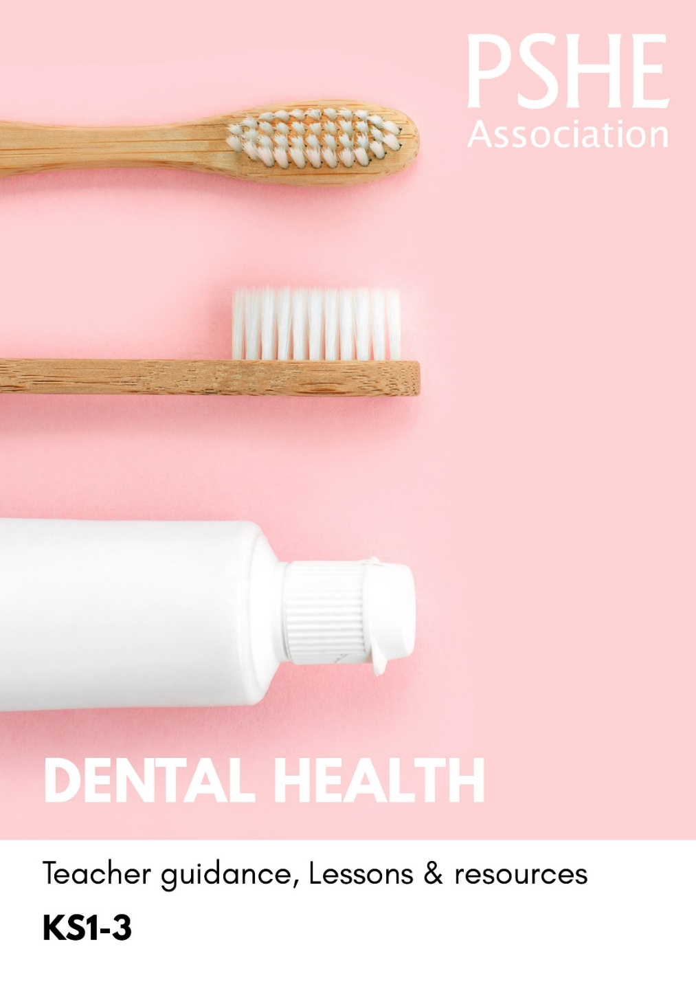
Teacher
slide
Ensure you read the guidance before teaching the lesson
Dental Health, KS1
Keeping our teeth healthy

Slide 2
Teacher
slide
Using this PowerPoint
The slides in this presentation are divided into two sections:
Teacher slides (purple) – provide key information regarding lesson preparation
Pupil slides (white) – provide a visual focus point for pupils during the lesson and delivery notes for teachers about the activities. Click ‘notes’ to view these.
Ensure that you select ‘Use Presenter View’ under the ‘Slide Show’ tab – this will allow you to preview the teaching notes on your monitor while the main presentation is displayed on a screen/smartboard.

Slide 3



Teacher
slide
Challenge and support
The lesson includes suggestions for challenge and support activities, to help you differentiate appropriately for your class.
Challenge activities deepen and extend the learning for those who need more challenge or who finish the activity quickly.
Support activities are adapted to be more accessible for those who need it.
Look for the logo on the student slides. See delivery notes for details of the activities.
Support
Challenge

Slide 4
Teacher
slide
Context
There is an accompanying lesson for key stage 2, which builds on the learning in this lesson about keeping teeth healthy through oral hygiene routines such as flossing; and for key stage 3, which encourages independence in maintaining dental health and accessing dental health services.
This key stage 1 lesson written for Year 1 or Year 2 explores dental health. The lesson supports pupils to identify teeth-friendly food and drink, as well as how to keep their teeth clean and recognise the role of a parent/carer and dentist in keeping their teeth healthy.
This lesson is best used within the context of a unit of work on healthy, balanced lifestyles.

Slide 5
Developing subject knowledge
Teacher
slide
Children aged 5-7 years should brush their teeth twice a day; last thing at night before bed and at least one other occasion e.g. as part of morning routine.
For children up to 6 years, the toothpaste used should contain no less than 1,000ppm fluoride or could be family toothpaste containing between 1350-1500ppm fluoride (children 7 years and older should use this toothpaste).
For children under 7 years, a pea-sized amount of toothpaste is recommended and brushing should be supervised.
Children should be encouraged to spit out after brushing rather than rinsing with water, so that the fluoride remains on the teeth.
It is recommended that water and plain milk are drunk during the school day.
After eating, a period of demineralisation starts to damage the tooth surface. It is important to limit the amount of demineralisation time after eating and increasing the amount of remineralisation time. For this reason it is recommended that high sugar items, such as fruit juices and smoothies, only be consumed once a day, and with a meal (150 ml).
Children aged 5-7 years should visit their dentist for a regular check-up (every 6 months)
Notes:
More information can be found in the guidance notes that accompany this resource.

Slide 6



Teacher
slide
      Learning objective
To learn about keeping teeth healthy
      Learning outcomes
Pupils will be able to:
identify food and drink with different sugar content
describe how to clean teeth properly
recognise who can help with keeping teeth healthy

Slide 7




Teacher
slide
Preparing to teach
      Climate for learning
Make sure you have read the accompanying teacher guidance notes before teaching this lesson
for guidance on establishing ground rules, the limits of confidentiality, communication and handling
questions effectively.
    Resources required
Box or envelope for anonymous questions
Resource 1: Food and drink cards
Resource 1a: Food and drink teacher guidance
Resource 2: Steps to brushing teeth
Resource 2a: Steps to brushing teeth (support)
Resource 3: Who can help cards
      Duration
      This has been designed to be taught as a sixty minute PSHE education lesson
      Further guidance
      Members of the Association can access our website for further guidance
      www.pshe-association.org.uk
60

Slide 8

Draw and write
Draw a person’s face with healthy teeth
Then:
Draw or write who can help to keep their teeth healthy
Draw or write what could harm their teeth
Notes:
Teacher Notes – Baseline – Draw and write (10 mins)
Lead pupils in a draw and write activity focussing on dental health, using the instructions above
It is important that pupils complete this activity individually and that they are not guided or prompted. When finished, collect in their papers and explain you will revisit this work at the end of the lesson. Look through pupils’ ideas to elicit an understanding of what they already know about maintaining dental health including routines such as brushing and visiting the dentist as well as what could harm teeth.

Slide 9

Ground rules
[Add your class rules here]
Notes:
Teacher Notes
Use this slide to display your class agreement / ground rules for PSHE education lessons. See Accompanying Teacher Guidance Notes (separate document).

Slide 10

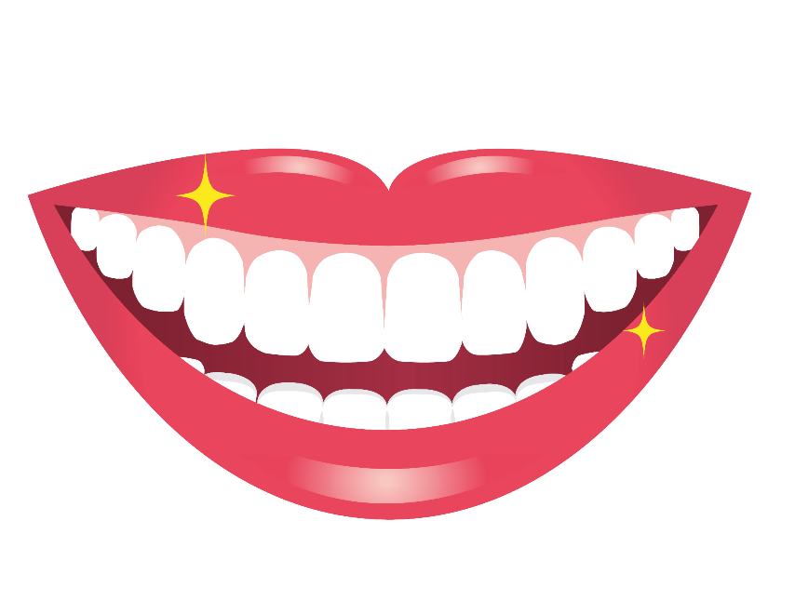


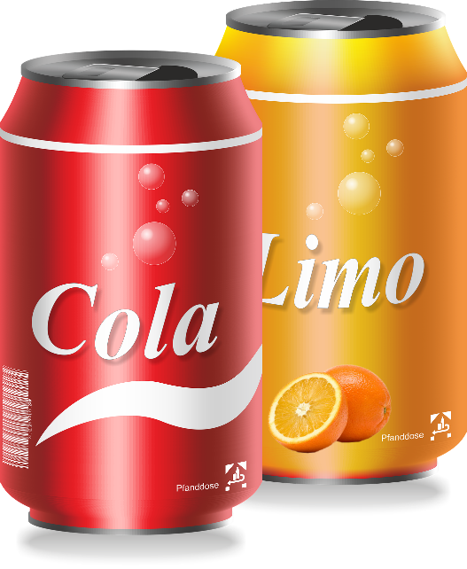

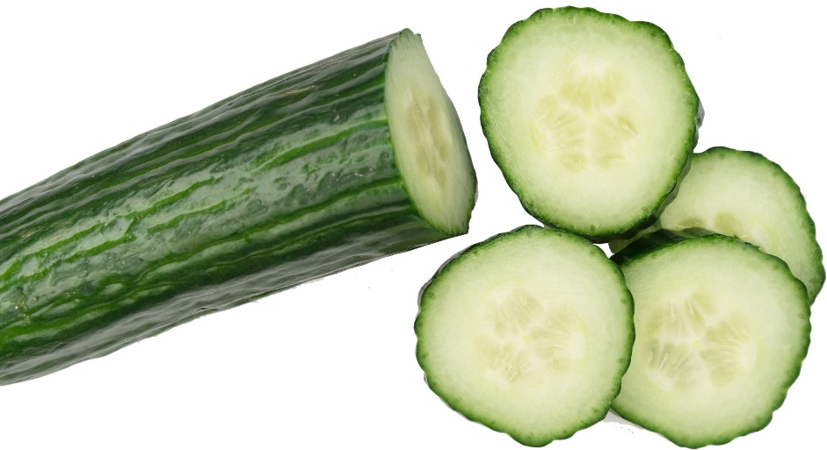

Introduction
This is Jamal. He has nearly ALL of his adult teeth!
Jamal needs help with keeping his teeth healthy. First, he needs to work out which food and drink to choose….
Notes:
Teacher Notes-Introduction (5 mins)
Explain to pupils that Jamal now has lots of adult teeth, they are the last set to grow and so it is important that he looks after them. Emphasise that Jamal wants to know about food and drink choices, how to brush his teeth properly and who can help with keeping his teeth healthy.

Slide 11
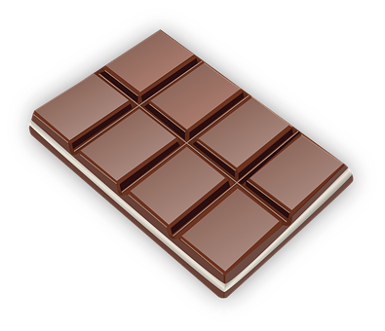
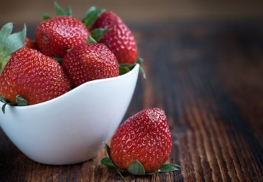
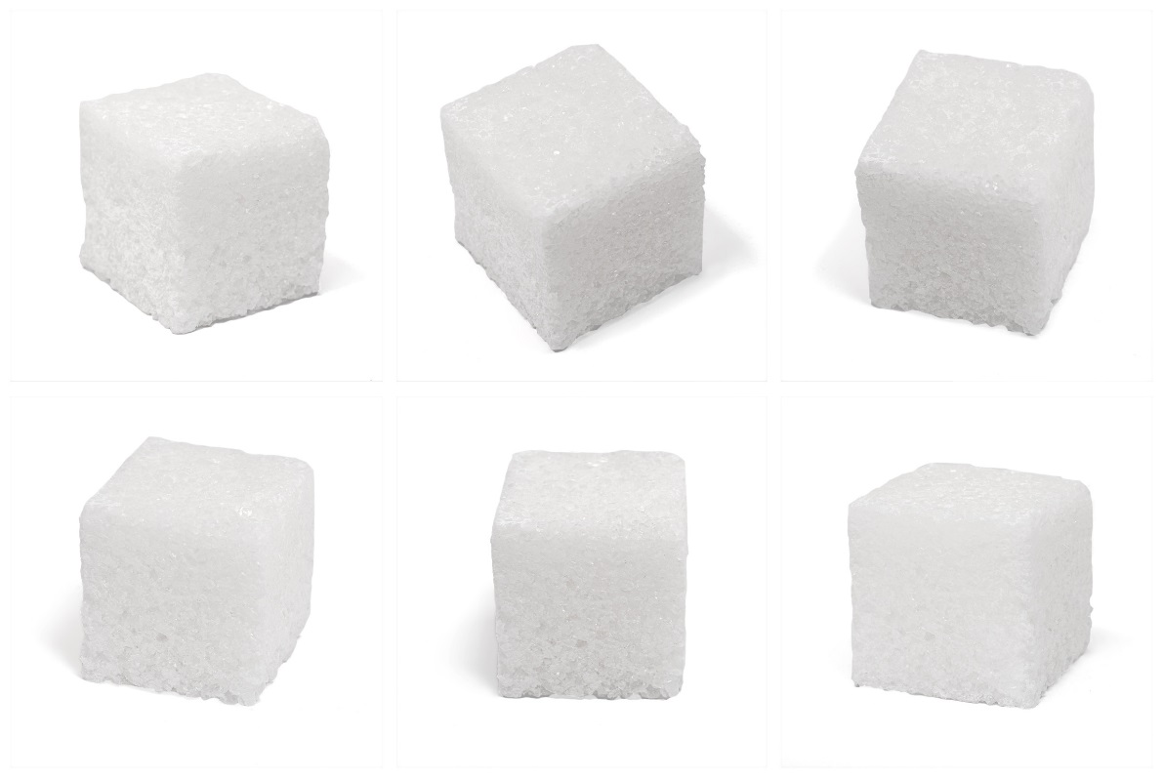

Which has more sugar in?
Notes:
Explain to pupils that food and drink with lots of sugar in can cause plaque and harm teeth.
ask pupils to identify which food they think is highest and lowest in sugar - chocolate bar contains more sugar (25g) than a portion of strawberries (4g).
* If available, you could show real portions of sugar to demonstrate the difference in scale.

Slide 12
Food and drink card sort
Jamal needs to know which food and drink is higher in sugar and which is lower….
Sort the cards into two piles
Higher in sugar
Lower in sugar
Notes:
Teacher Notes (10 mins) Food and drink card sort
Spilt pupils into groups and give each group a set of Food and drink cards. Ask them to sort food and drink that is lower in sugar and food and drink that is higher in sugar into two piles.
Support:
Model making some decisions about two or three cards as a class before beginning the activity.
Challenge:
Pupils create a lunchbox containing teeth-friendly foods, either by drawing on plain paper or cutting and sticking the images from Resource 1: Food and drink cards.

Slide 13

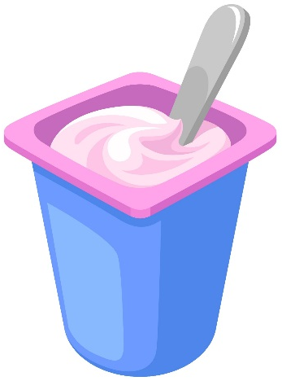
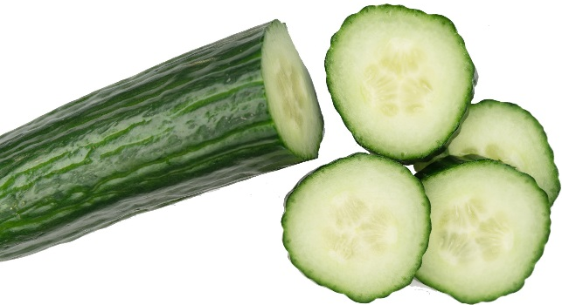
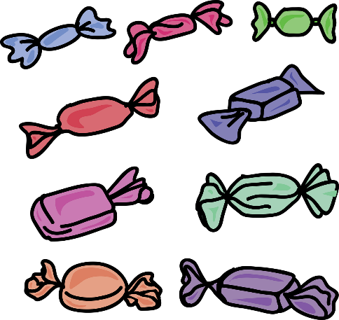
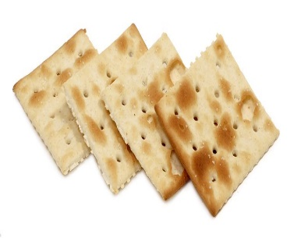
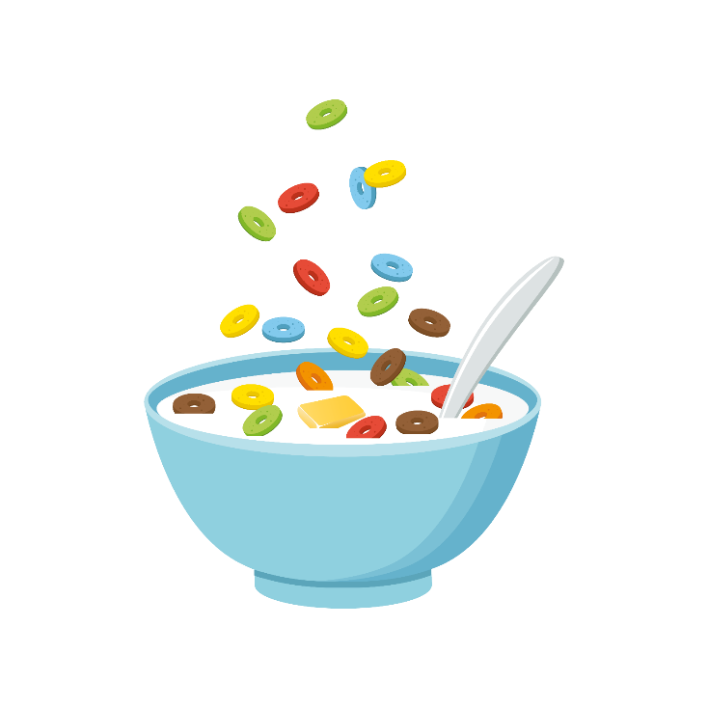


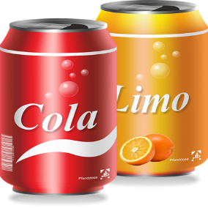

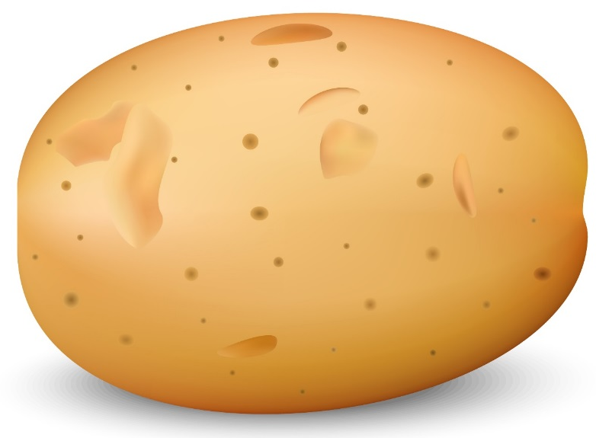

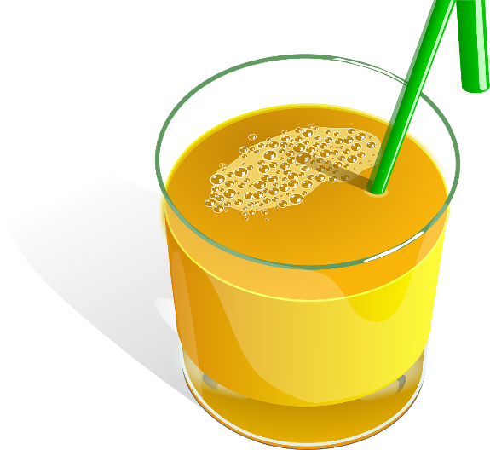
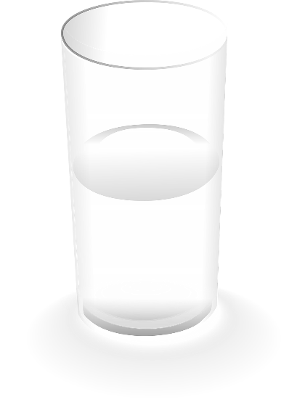
Higher in sugar
Lower in sugar
Notes:
Which food and drink contain the higher amount of sugar and which contain the lower?
Note: Explain to pupils that although apples and bananas are higher in sugar, these are ‘natural’ sugars and are not as harmful to teeth.

Slide 14
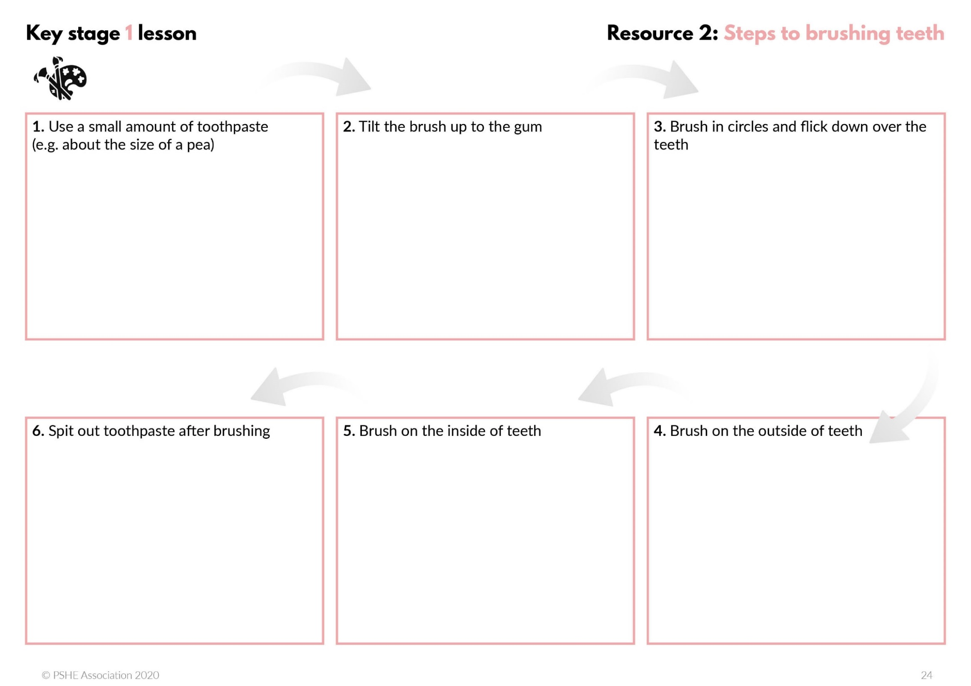
Teeth brushing
Fill in the steps to brushing teeth by drawing a picture in each box
Notes:
Teacher Notes (15-20 mins) Teeth brushing
Ask pupils to complete Resource 2: Steps to brushing teeth, drawing each step in the boxes provided.
Support: Pupils complete Resource 2 Support: Steps to brushing teeth
Challenge: Using Resource 3: Brushing golden rules, ask pupils to come up with 5 golden rules for teeth brushing.
Pupil responses could include: Using a small amount of toothpaste, spit out toothpaste, brush on outside and inside of teeth, brush gently in circles and flick, brush twice a day, brush for 2 minutes, ask for help from a parent/adult

Slide 15
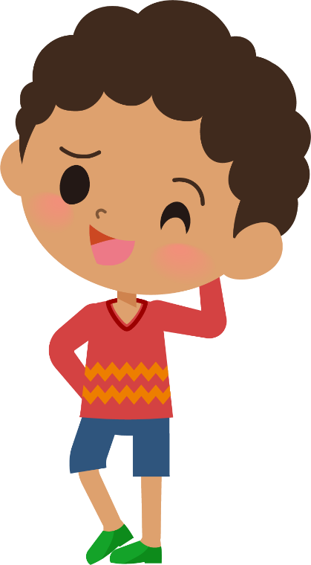
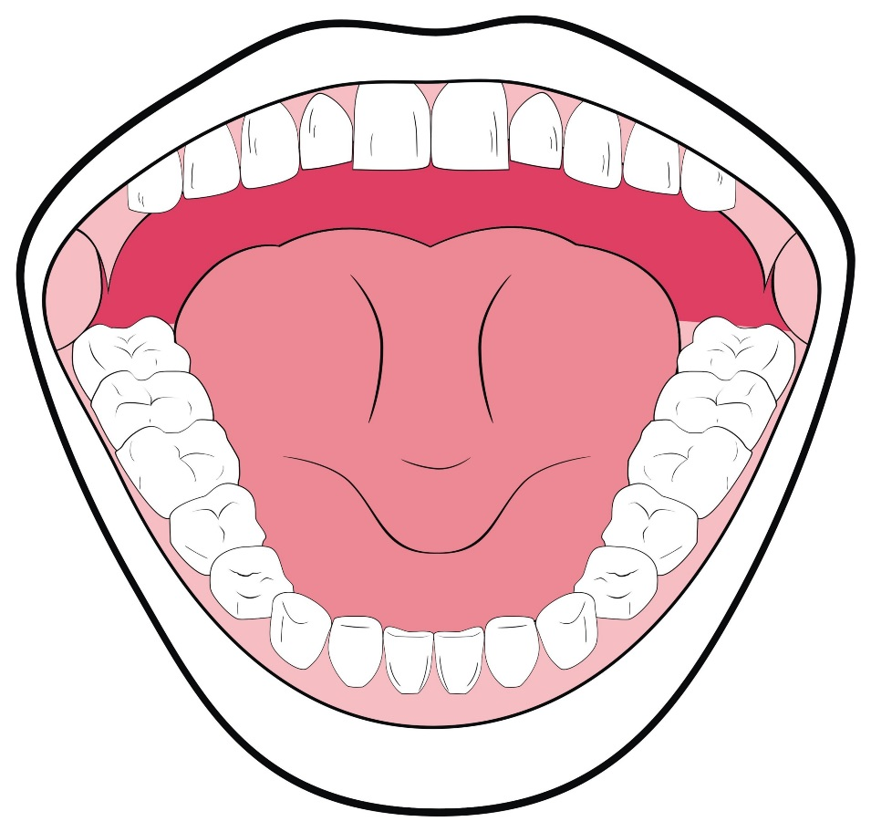
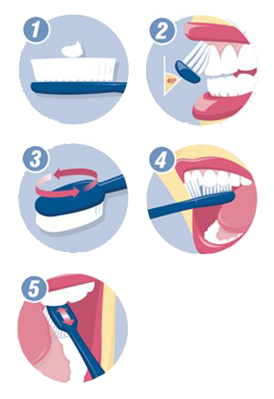
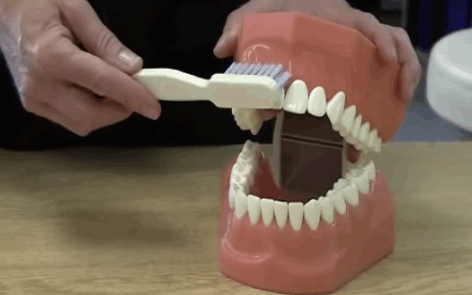
Teeth brushing
Brush for 2 minutes
Spit out the toothpaste after brushing
Notes:
Take pupils through the brushing routine and technique for Jamal. Using a model set of teeth (or using the image on this slide), demonstrate the brushing technique to pupils.
Steps:
1. Use a small amount of toothpaste (about the size of a pea)
2. Tilt the brush up to the gum
3. Brush in circles and flick
4. Brush on the outside of teeth
5. Brush on the inside of teeth
In addition, explain to pupils:
the importance of brushing for 2 minutes
that spitting out the toothpaste after brushing rather than rinsing with water is important, as the toothpaste protects the teeth.
It is recommended that brushing should be supervised by a parent or carer up until the age of 6 years old, and so this could be discussed with pupils, especially if this lesson is completed with a Year 1 class.

Slide 16
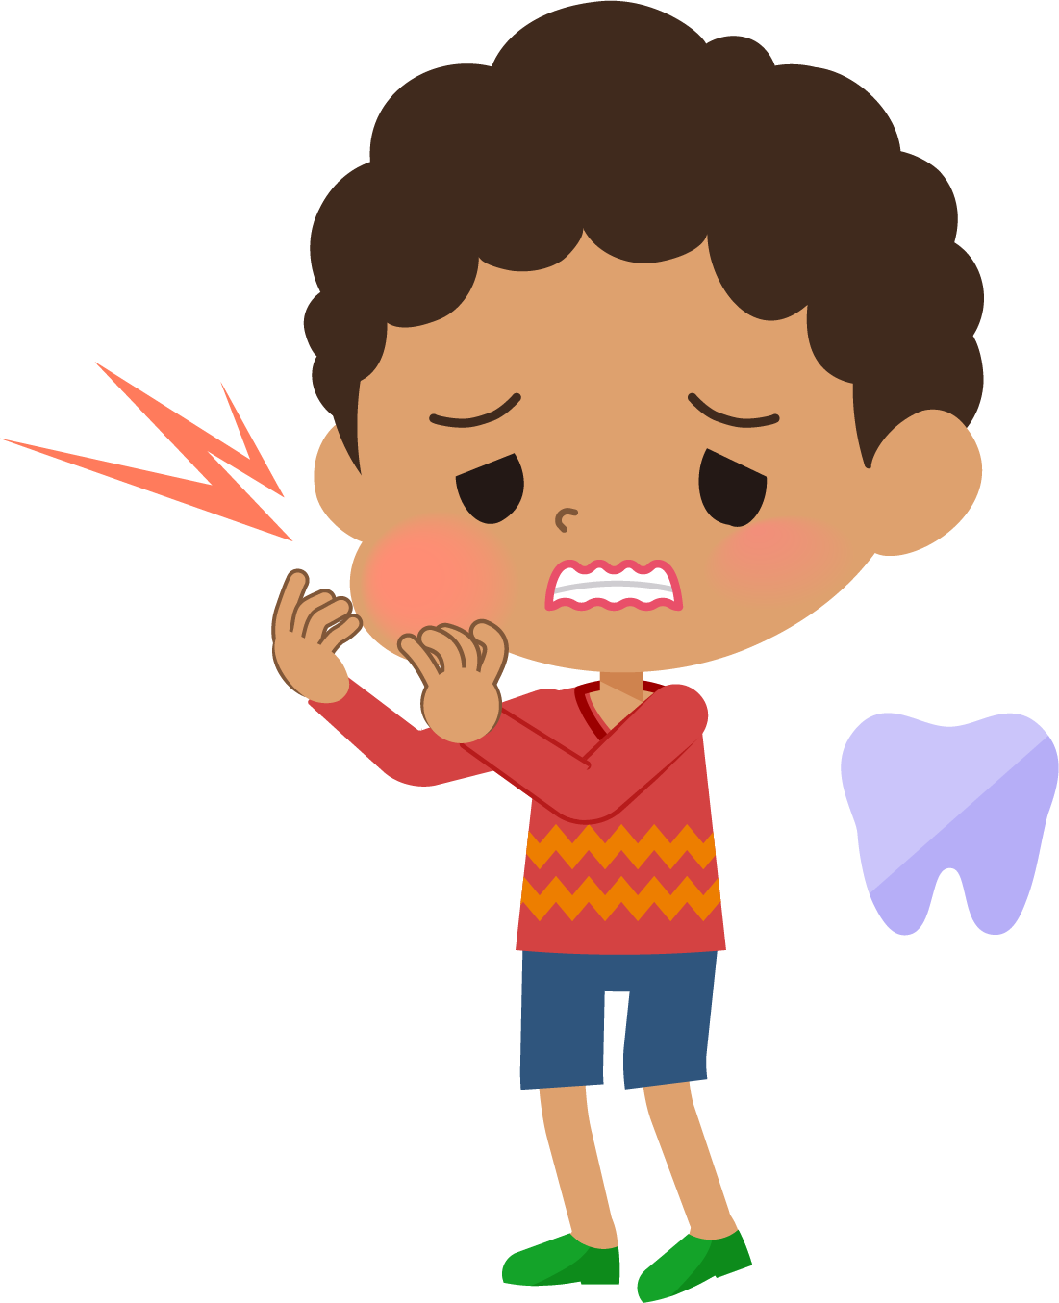
Ouch!
Jamal is getting much better at brushing his teeth properly and his Dad has helped him. But sometimes, Jamal has been busy playing with his toys before bed and has forgotten to brush his teeth. One morning he wakes up and “Ouch!”, Jamal’s mouth is hurting a lot and is swollen.
What is making Jamal’s mouth hurt?
What should Jamal do next?
Notes:
Teacher Notes (5 mins) OUCH! Scenario
Paired discussion: Jamal didn’t brush his teeth because he was doing something else before bed and forgot. What other reasons could there be for someone not brushing their teeth? Watching TV/games/activities before bed, being too tired, disliking how brushing feels or how toothpaste tastes, parent/carer didn’t remind them, not got a bedtime routine, rushing in the morning.
What could help Jamal to remember to brush his teeth twice every day? Parent/carer could remind him, make a poster for his bedroom, do it right after bath time/just before getting into bed, set a reminder, getting a reward for brushing his teeth, do it alongside his siblings.

Slide 17
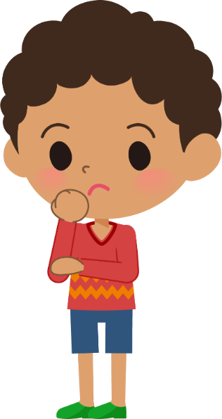
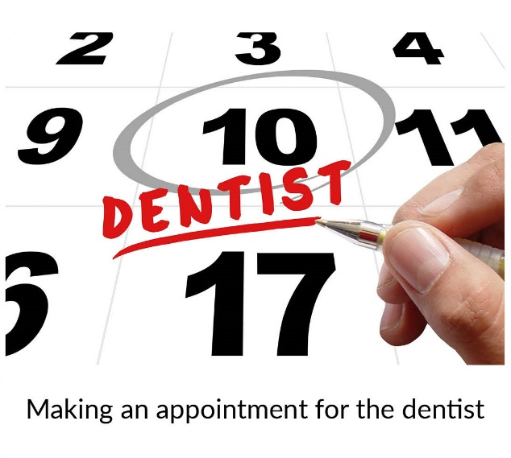




Who can help?
Decide who can help with each card
Parent or carer
Dentist
Notes:
Teacher Notes (5-10 min) Who can help?
Explain to pupils that Jamal is going to the dentist so that they can help with the toothache. Explain to pupils that Jamal should go to the dentist if there is a problem with his teeth but also for regular check- ups to keep his teeth healthy.
As a class group, ask pupils to decide who can help with each part of their dental routine. Pupils choose between ‘parent or carer’ or ‘dentist’ or ‘both’ and place onto the Venn diagram. Alternatively, the cards in Resource 4: Who can help could be drawn one by one from a bag with pupils deciding who can help with each.

Slide 18
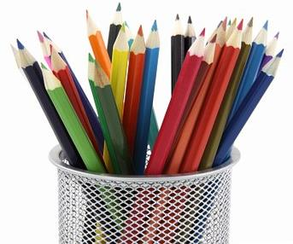
What has been learnt?
Go back to the Draw and write activity
Is there anything you would like to change?
Is there anything you would like to add?
Use a different colour pen or pencil to change your draw and write
Notes:
Teacher Notes (5 mins) End point assessment Draw and write
Return pupils’ draw and write sheets from the start of the lesson. Ask them to now use a different colour pen / pencil to make any additions or changes they can to their original draw and write, showing what they have learnt in today’s lesson.

Slide 19

More activities
Create a teeth brushing guide for younger children. It could include:
  Steps to brushing teeth
  Facts about keeping teeth healthy
Notes:
Alternatively, pupils could also work in pairs or small groups to produce this digitally; using a school tablet or camera to create a short film on how to brush teeth correctly

