Slide 1



Ensure you read the guidance before teaching the lesson
Teacher
slide
Mental health and
emotional wellbeing
KS2
Year 3/4
Lesson 2 : Expressing feelings

Slide 2

Teacher
slide
Using this PowerPoint
The slides in this presentation are divided into two sections:
Teacher slides (purple) – provide key information regarding lesson preparation
Pupil slides (white) – provide a visual focus point for pupils during the lesson and delivery notes for teachers about the activities. Click ‘notes’ to view these.
Ensure that you select ‘Use Presenter View’ under the ‘Slide Show’ tab – this will allow you to preview the teaching notes on your monitor while the main presentation is displayed on a screen/smartboard.
© PSHE Association 2019

Slide 3



Challenge and support
Teacher
slide
The lesson includes suggestions for challenge and support activities, to help you differentiate appropriately for your class.
Challenge activities deepen and extend the learning for those who need more challenge or who finish the activity quickly.
Support activities are adapted to be more accessible for those who need it.
Look for the logo on the pupil slides. See delivery notes for details of the activities.
Support
Challenge
© PSHE Association 2019

Slide 4
Context
Teacher
slide
This is the second in a series of three lessons KS2 lessons written for Year 3 or 4 exploring mental health and wellbeing.
This lesson focuses on learning to describe and express feelings and the importance of doing so.
Neither this, nor any of the other lessons, is designed to be taught in isolation, but should always form part of a planned, developmental PSHE education programme.

Slide 5



Teacher
slide
      Learning objective
about ways of expressing feelings and emotions and why this important
Pupils will learn:
      Learning outcomes
Pupils will be able to:
name a wide range of feelings and emotions
match feelings to a scale of intensity and identify strong feelings
describe different feelings and how they are experienced in the body
recognise why it is important for people to express their feelings
© PSHE Association 2019

Slide 6




Teacher
slide
Preparing to teach
      Climate for learning
Make sure you have read the accompanying teacher guidance notes before teaching this lesson – for guidance on establishing ground rules, the limits of
confidentiality, communication and handling questions effectively.
      Resources required
Box/envelope for anonymous questions
Flipchart paper/sugar paper for ‘Graffiti wall’
Ball or bean bag
Resource 1: Feelings match up
Resource 2: Picture a feeling – stimulus a, b, c, d
Resource 3: Body outline
Optional: dictionaries and thesauruses
Optional: additional range of poetry and artwork on the theme of ‘feelings’
      Duration
      This has been designed to be taught as a sixty minute PSHE education lesson
      Further guidance
      Members of the PSHE Association can access our website for further guidance www.pshe-association.org.uk
60
© PSHE Association 2018

Slide 7
Teacher
slide
Lesson summary
Activity | Description | Time
Baseline assessment: feelings graffiti wall | Pupils write all the feelings and emotions they can think of on the graffiti wall. | 10
2. Warm up game: Feelings hot potato | Pupils throw a ball or beanbag (hot potato) to each other – each person tries to name a different feeling or emotion | 5
3. Feelings thermometers | In groups, pupils match synonyms to a ‘root’ word, then identify the strong or intense feelings by ranking similar vocabulary on a scale of intensity | 15
4. Expressing feelings | Pupils use pictorial and descriptive imagery to talk about different feelings, then draw and write about a feeling on body outline to describe how it is experienced | 20
5. Scenario: giving advice and providing support | Pupils read a scenario about a child who is not expressing some difficult feelings – they provide advice | 10
6. Plenary and endpoint assessment | Pupils feedback something they learned about feelings today, that they have not thought of before. Pupils go back to their feelings graffiti wall activity - add to or amend it in light of their new learning | 10

Slide 8

Lesson 2:
Expressing feelings

Slide 9

Ground rules
[Add your class rules here]
Notes:
Teacher Notes
Use this slide to display your class agreement / ground rules for PSHE education lessons. See Accompanying Teacher Guidance Notes (separate document). At the beginning of the lesson, reinforce existing ground rules – add or emphasise any ground rules that are especially relevant to this lesson.

Slide 10

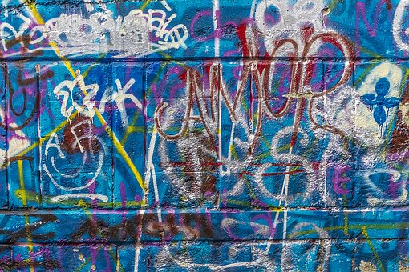

Expressing feelings:
What’s our starting point?
Make a ‘feelings’ graffiti board
Jot down all of the words you can think of to describe feelings and emotions.
Notes:
Teacher Notes - Baseline assessment - feelings graffiti wall (10 mins).
Ensure this activity is completed before delivering the lesson.
Ask pupils to come up to the graffiti wall and write all the words they can think of to describe a range of feelings and emotions.
The purpose of this activity is to enable you to find out the pupils’ existing knowledge, understanding and attitudes, as well as reconnecting them with the learning from last lesson. Whilst they are working, note any responses, gaps in understanding, or misconceptions that need addressing through the lesson. Keep the graffiti wall displayed throughout the lesson - pupils will return to this activity at the end of the lesson to assess their learning.

Slide 11
      We are learning about ways of expressing feelings and emotions and why this is important
      We will be able to:
  name a range of feelings and emotions
  match feelings to a scale of intensity and identify strong feelings
  describe different feelings and how they are experienced in the body
  recognise why it is important for people to express their feelings
Notes:
Teacher Notes – Learning objective and outcomes
Introduce the learning objectives and outcomes

Slide 12
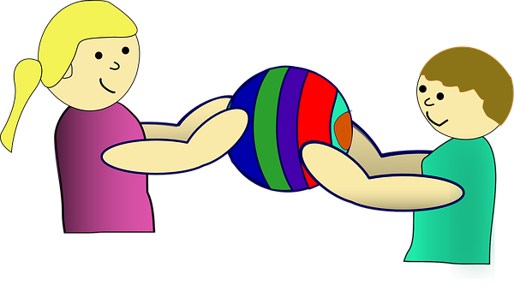

Game: Feelings hot potato
Each time you catch the ‘hot potato’ say a word to name or describe a different feeling.
How many different words can we think of?
Notes:
Teacher Notes – Warm up game: feelings hot potato (5 mins)
Remind pupils of the previous lesson about different feelings.
Pupils stand in a circle and throw a ball or beanbag (a ‘hot potato’) to each other. When each pupil catches the ‘hot potato’ they try to name a different feeling or emotion. Pupils have the right to pass if they can’t think of one.

Slide 13
Feelings thermometers
exhausted
Match the synonyms to their root word
Identify the ‘strong’ feelings
Rank the feelings in order of intensity
tired
Here is an example. Sleepy is the root word and exhausted is the strongest or most intense feeling.
weary
sleepy
Notes:
Teacher Notes – feelings thermometers (15 mins)
This activity will help to introduce more words to describe the intensity of feelings.
Pupils work in groups to match the word cards from Resource 1: Feelings match up to the root words (happy, sad, scared, angry, worried, pleased). You may wish to provide dictionaries. Should some groups complete this activity quickly they should use the blank cards to think of other words in each set, as an additional challenge.
Next, pupils rank the synonyms of the root words on a scale of intensity to show how feelings can build up or suddenly burst. Ask them to clearly identify the words that best describe the strongest or most intense feelings.
As a class, discuss their work explaining that: feelings change all the time, but sometimes things happen that make our feelings build up and up until they become very strong or intense. Sometimes we get a very strong or intense feeling from just one thing or moment in time. Eventually, for the most part, very strong feelings tend to fade. You may want to add that if someone feels like this a lot of the time or if they know someone who does, it is best they talk to someone (trusted adult) about what is happening. It is important to be able to describe our feelings as it help us and others know how to manage them.
Support: Pupils may need adult support to discuss the meanings of the different words. Pupils are given fewer root words and synonyms to match up and then identify the words that suggest a more intense or strong feeling, rather than making a scale of intensity.
Challenge: On flipchart paper, pupils work in groups to brainstorm as many other words as they can associated with a given root word (e.g. happy, sad, scared, angry, worried, pleased), then choose three words to rank on a scale of intensity. They can also think of different root words. You may wish to provide thesauruses to help.

Slide 14

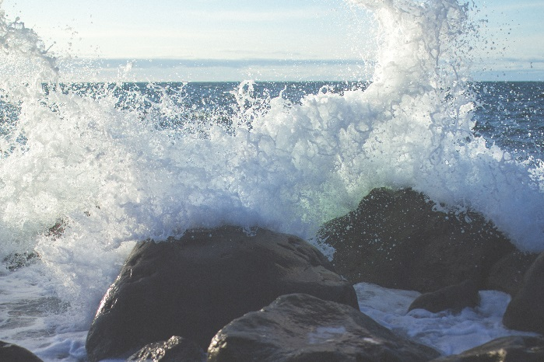
Expressing feelings
What feelings words do these images make you think of?
Notes:
Teacher Notes – Expressing feelings (5 mins)
Display images from Resource 2: Picture a feeling around the classroom. Pupils suggest which feelings words are suggested by each image, share ideas and discuss.

Slide 15
Feelings can be described as colours…
She saw red
Tickled pink
Feeling blue
Green with envy
In a black mood
Notes:
Teacher Notes – Expressing feelings (5 mins)
Provide the class with examples of how feelings are often described as similes or metaphors and discuss their meaning, for example:
Colours: ‘she saw red’, ‘feeling blue’, ‘in a black mood’, ‘tickled pink’ or ‘green with envy’

Slide 16
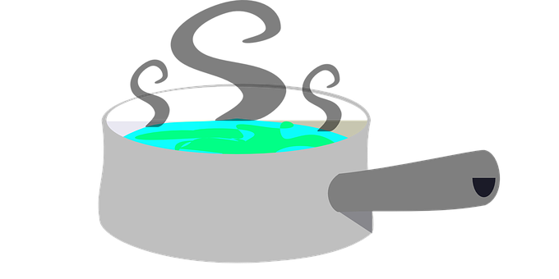


or temperature…
Fiery temper
Boiling over with rage
As cool as a cucumber
Notes:
Teacher Notes – Expressing feelings (2.5 mins)
Provide the class with examples of how feelings are often described as similes or metaphors and discuss their meaning, for example:
Temperature: ‘ fiery temper’, ‘boiling over with rage’ or ‘cool as a cucumber’

Slide 17

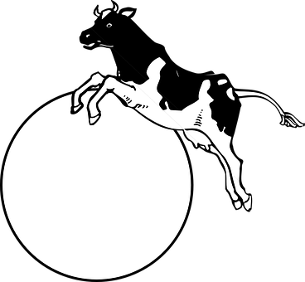

or imagined images…
So excited – over the moon
So scared –
shaking like a leaf
So happy – walking on sunshine
Notes:
Teacher Notes – Expressing feelings 2.5 mins)
Provide the class with examples of how feelings are often described as similes or metaphors and discuss their meaning, for example:

Slide 18


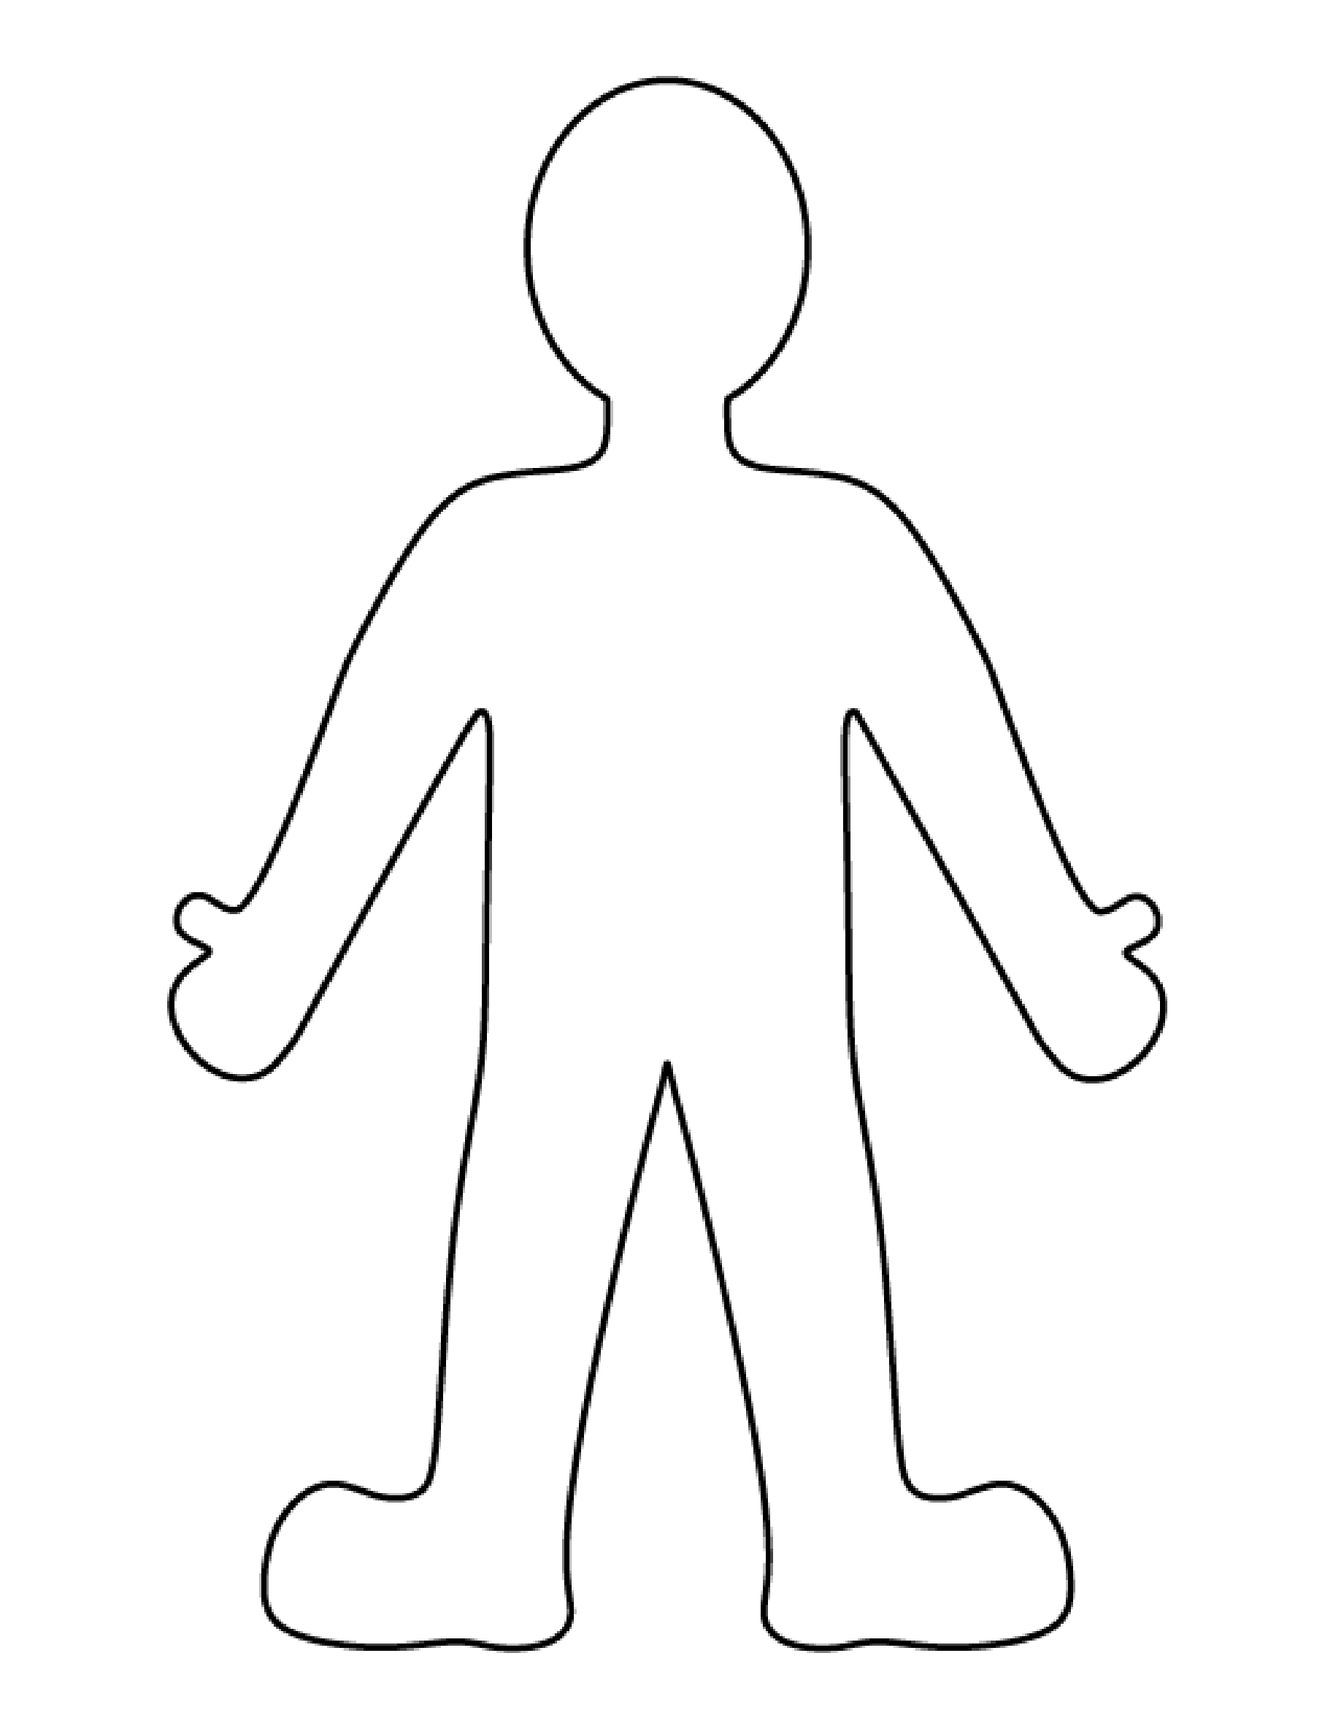
Expressing feelings
Draw and write on and around the body outline
Choose one word to describe a feeling
Where in the body would someone experience that feeling?
If the feeling had a colour, what colour would it be?
If it had a shape what shape would it be?
If it had a texture, what texture would it be?
If the feeling were an image or a picture, what would this be?
If the feeling had a sound, what would this be?
Notes:
Teacher Notes – Expressing feelings (10 mins)
Explain that feelings can be expressed in lots of different ways: art – drawing and paintings, poetry; singing; listening to, playing or composing music; writing a diary or journal; making a chart of feelings or just saying them aloud.
Each pupil chooses one of the words from the feelings thermometer activity (it is a good idea to choose a more intense word or feeling) and using Resource 3: Body outline as a basic template on which to draw and write, they respond to the questions.
Display these around the classroom, ask pupils to walk around to look at the different ways they have interpreted and expressed the feelings.
Pupils can go on to develop artwork or write further about feelings – see optional extension activity.

Slide 19
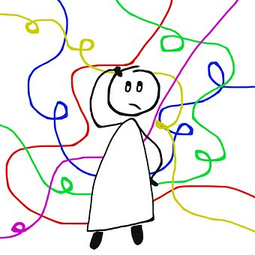
Why is it important to express feelings?
Notes:
Teacher Notes – The importance of expressing feelings
Discuss with the class, why finding ways to express feelings is important for our health and wellbeing. For example: if we allow a feeling (like anger) to build up without expressing it, it can build up so much that it explodes and this may come out in unhealthy or not-very-nice ways, like if someone shouts at someone else for no reason.

Slide 20

Giving advice and getting support
Jamie feels worried a lot of the time. Everything seems to worry Jamie. It feels like all the worries in the world are building up into a big pile, sometimes it feels like a wall of worries. Jamie tries not to think about what is happening or the feelings.
Discuss:
  What would help Jamie express the feelings?
  What might be stopping Jamie from doing this?
  What might be the consequences of Jamie not expressing the feelings?
  What would most help Jamie in this situation?
Notes:
Teacher Notes – Scenario: giving advice and getting support (10 mins)
Pupils discuss in pairs or small groups, then take feedback.

Slide 21


Getting support
If someone is experiencing difficult feelings (maybe feeling sad, lonely or worried for example) they should talk to an adult they trust.
This can help the situation and can stop it from getting worse.
You can also get advice on the ChildLine website.
Talk to a trusted adult at home or at school
ChildLine: www.childline.org.uk
0800 1111
Notes:
Teacher Notes – Scenario: giving advice and getting support (10 mins)
Reiterate the importance of talking to someone about difficult feelings, especially if they have feelings not so good feelings like worry, sadness or loneliness. Recap different ways to express feelings (including writing, art-work) but include the importance of talking to others.

Slide 22

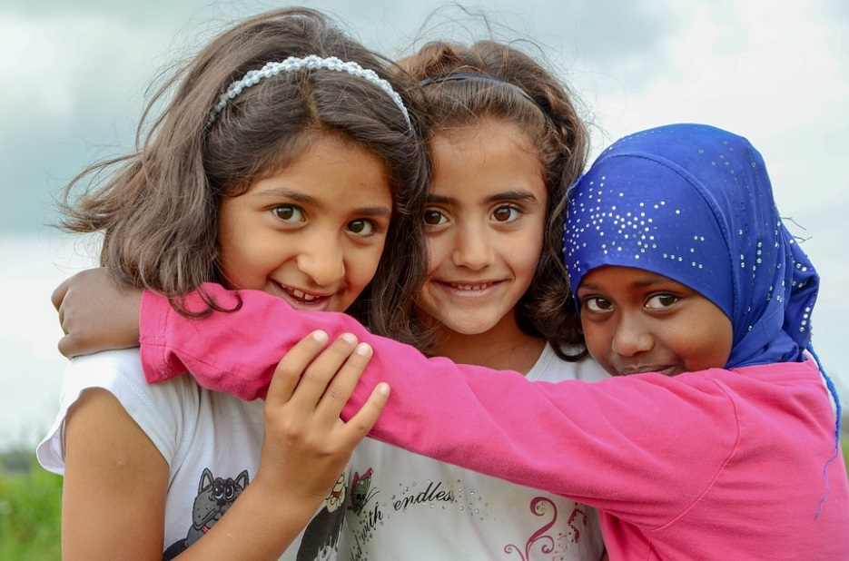
Expressing feelings:
Where are we now?
Share something you have learned today that you didn’t know before.
Then, go back to the ‘graffiti board?’ activity
Is there anything you would like to change?
Is there anything you would like to add?
Use a different coloured pen or pencil to amend your draw and write and show how your thinking has developed or changed.
Notes:
Teacher Notes – End-point assessment (10 mins)
Pupils feedback something they learned about feelings today, that they have not thought of before.
Ask pupils to come back to their feelings graffiti wall from the beginning of the lesson with a different coloured pen or pencil. Ask the pupils to amend or add their new learning to the wall.

Slide 23
Additional activity
Produce a piece of artwork or descriptive writing about feelings.
Notes:
Teacher Notes – Extension activities
These activities can be included if you have additional time in the lesson or afterwards, to challenge pupils who need to be stretched or for pupils who demonstrate a particular interest in this topic.
Make links to pupils’ learning in other subjects such as English or Art. Make a school or classroom display.
Introduce pupils to poetry and descriptive writing about feelings. Pupils create their own short pieces of descriptive writing about feelings.
Look at work by different artists about feelings. Pupils produce collages or pieces of art work about different feelings.

