Slide 1


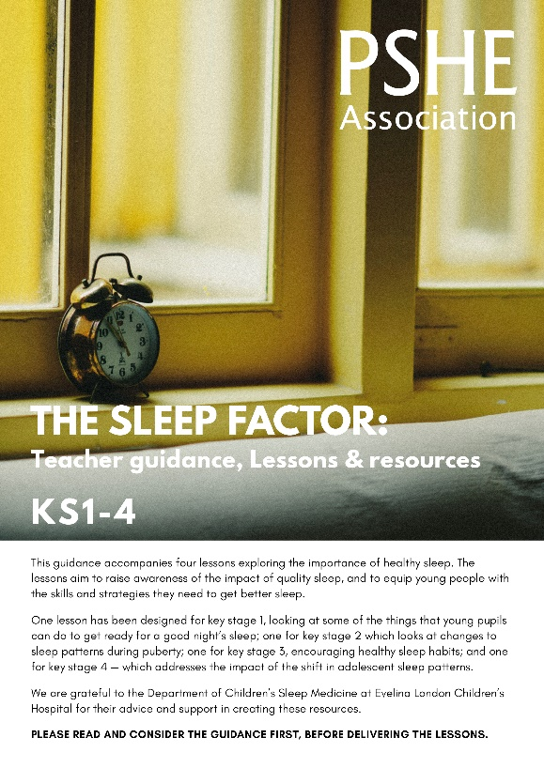
Ensure you read the guidance before teaching the lesson
Teacher
slide
The Sleep Factor
KS1
Taking care of myself:
Ready for sleep

Slide 2

Teacher
slide
Using this PowerPoint
The slides in this presentation are divided into two sections:
Teacher slides (purple) – provide key information regarding lesson preparation
Pupil slides (white) – provide a visual focus point for pupils during the lesson and delivery notes for teachers about the activities. Click ‘notes’ to view these.
Ensure that you select ‘Use Presenter View’ under the ‘Slide Show’ tab – this will allow you to preview the teaching notes on your monitor while the main presentation is displayed on a screen/smartboard.
© PSHE Association 2018

Slide 3



Challenge and support
Teacher
slide
The lesson includes suggestions for challenge and support activities, to help you differentiate appropriately for your class.
Challenge activities deepen and extend the learning for those who need more challenge or who finish the activity quickly.
Support activities are adapted to be more accessible for those who need it.
Look for the logo on the pupil slides. See delivery notes for details of the activities.
Support
Challenge
© PSHE Association 2018

Slide 4
Context
Teacher
slide
This lesson explores why sleep is so important in children’s lives, how it can sometimes be difficult to fall asleep or stay asleep, and some of the reasons for this. It considers what young children can do to help themselves foster good habits that can help them to fall asleep.
This lesson is written to accompany the KS2-4 Sleep Factor lessons which promote the development of healthy sleep habits
This lesson is best used within units of work on healthy lifestyles including physical wellbeing; preparing for transition to key stage 2 or during teaching about mental health.

Slide 5
Developing subject knowledge
Teacher
slide
5-7 year olds:
require 10-11 hours of sleep per night, but many only average between 9-10 hours although the amount of sleep required will vary between individuals
may wake briefly throughout the night
may experience sleep problems such as: nighttime fears, nightmares, sleepwalking, sleep terrors and snoring,
need a regular sleep schedule – waking up and going to sleep at the same time, before 9pm every day (including weekends)
should have bedtime routines that include time limited calming activities such as a bath and bedtime stories
should avoid screen use or overly energetic activities an hour before bed
should avoid high sugar products, such as tea, sweets and fizzy drinks, particularly during the afternoon and evening

Slide 6


Working with parents
Teacher
slide
The engagement of parents in this topic would be advantageous. Parents could be informed via the school newsletter, website or blog – they may wish to discuss their family’s sleep routines with their children. Healthy sleep tips are suggested in the ‘signposting support’ section which could be shared with parents.
© PSHE Association 2018

Slide 7



Teacher
slide
      Learning objective
About the things that will help us to fall asleep and get a good night’s sleep
      Learning outcomes
Pupils will be able to:
Describe some reasons why sleep is important
Recognise some things that may be stopping us getting to sleep and ideas to manage them
Identify some things that might help us get to sleep (including rest and relaxation)
© PSHE Association 2018

Slide 8




Teacher
slide
Preparing to teach
      Climate for learning
      Make sure you have read the accompanying teacher guidance notes before teaching this lesson – for guidance on establishing ground rules, the limits of confidentiality, communication and handling questions effectively
      Resources required
Box/envelope for anonymous questions
Resource 1: Mia’s story
Resource 2: What can Mia do to rest and relax?
Resources 3a: Mia’s new bedtime routine
Resource 3b: Mia’s new bedtime routine – support
Resource 3b: Mia’s new bedtime routine – challenge
      Duration
      This has been designed to be taught as a sixty minute PSHE education lesson
      Further guidance
      Members of the PSHE Association can access our website for further guidance www.pshe-association.org.uk
60
© PSHE Association 2018

Slide 9
Lesson summary
Teacher
slide
Activity | Description | Timing
Introduction | Introduce or revisit ground rules | 5 min
2. Baseline assessment | Pupils draw and write their first thoughts about sleep and falling asleep | 10 MINS
3. Spider diagram | Pupils listen to a story and identify key reasons as to why the character is having difficulty falling asleep | 15 MINS
4. Card sort | Pupils identify some good and not so good ways to rest and relax before bedtime | 10 MINS
5. Sequencing | Pupils suggest a relaxing bedtime routine | 10 MINS
6. Endpoint assessment | Pupils revisit their first thoughts baseline to capture what they have learnt about relaxing and falling asleep | 5 MINS
© PSHE Association 2018

Slide 10

Z
Z
Z
Taking care of myself:
Ready for sleep

Slide 11

Ground rules
[Add your class rules here]
Notes:
Teacher Notes
Use this slide to display your class agreement / ground rules for PSHE education lessons. See Accompanying Teacher Guidance Notes (separate document).

Slide 12


Sleep: What’s our starting point?
Can you draw and write about:
All of the things that you know about sleep
The things someone can do to help them fall asleep
The things that may stop someone from falling asleep
Notes:
Teacher Notes - Baseline assessment (10 mins)
It is important that pupils complete this activity individually. Do not guide or prompt their answers. When finished, collect in their papers. Explain you will revisit this work at the end of the lesson. Look through pupils’ ideas to elicit an understanding of what pupils already know about the importance of sleep and routines that promote good sleep.

Slide 13
      We are learning about the things that will help us to fall asleep and get a good night’s sleep
      We will be able to:
  describe some reasons why sleep is important
  recognise some things that may be stopping us getting to sleep, and ideas to manage them
  Identify some things that might help us get to sleep (including rest and relaxation)
Notes:
Teacher Notes – Learning objective and outcomes
Introduce the learning objectives and outcomes, explaining that this lesson will explore why sleep is so important in children’s lives, how it can sometimes be difficult to fall asleep or stay asleep, and some of the reasons for this.

Slide 14

Mia’s story
Listen to a story about Mia’s day…
Now have a go at answering the questions:
What does Mia’s mum say every night to show Mia that it is time for her to go to sleep? What might other families say or do?
Mia has lost the snuggly that usually helps her to fall asleep. What might this snuggly be?
Does everyone have a special snuggly?
Notes:
Teacher Notes – Mia’s story (5mins)
To the whole class, read the scenario on Resource 1: Mia’s story.
Ask pupils the following questions:
What does Mia’s mum say every night to show Mia that it is time for her to go to sleep?
What might other families say or do? Encourage pupils to respond with the phrase: ‘Other families might…’
Mia has lost the snuggly that usually helps her to fall asleep, what might this snuggly be? Possible answers: a favourite pillow, a special blanket, toy or teddy, a thumb or dummy to suck.
Does everyone have a special snuggly? Ensure that pupils know that this is personal choice as some people do, and some people don’t.
Talk about how different families have different routines for bedtime. Sometimes families have special words or customs that they do at bedtime, and this is a good way to mark the end of the day and shows that it’s time for sleep.

Slide 15



Mia’s story: Things that keep Mia awake
Notes:
Teacher Notes – Mia’s story: Things that keep Mia awake (10 mins)
Draw or display a spider diagram on the board/flip chart with ‘Things that keep Mia awake’ in the middle section. In pairs or talk partners, pupils should discuss some of the things that are keeping Mia awake. Volunteers should feedback their ideas to the whole class. Record these ideas on the spider diagram, grouping them in to categories as you go.
Some of the responses that pupils may give, and possible categories could be:
Night time fears – of the dark/being alone or away from loved ones/imagined threats (such as monsters)/something she has seen or heard about
Physical – busy minds/busy bodies (jumpy legs)/tummy ache – this may be a result of being worried about something/feeling unwell/thirsty or hungry
Environment – noise (outside and inside)/temperature/screens or tech in sleeping area.
Pick up on any commonalities or misconceptions and draw out the learning that most of these fears or worries are normal and that anyone can experience them. Quite often the things that we fear at night aren’t very scary during the day – Mia isn’t scared of her wardrobe during the day, nor of being on her own in her bedroom.

Slide 16

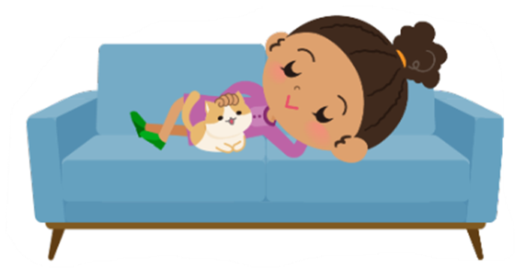





What can Mia do to rest and relax?
1. Good for relaxing | 2. Not so good for relaxing | 3. Unsure
Notes:
Teacher Notes – What can Mia do to rest and relax (10 mins)
Explain to the pupils that we know that Mia had a really busy day with school, shopping, visiting family and playing. She didn’t have a lot of time to rest or relax before going to bed.
Working in pairs or small groups pupils use Resource 2: What can Mia do to rest and relax to sort each of the suggestions into the three categories:
1) good suggestions for what Mia can do that might help her to rest and relax throughout her day and when she is getting ready for bed
2) suggestions that are not so good for relaxing
3) suggestions that you are unsure of
Sorting rings can be used if required.
Support: Pupils who may require some support could be given fewer cards to sort
Challenge: Ask pupils the challenge question: Do you have any ideas of your own? Provide pupils with some paper for recording ideas of their own.
Discuss results as a class, using the expected answers on Resource 2 to support feedback. Are there any not-so-good suggestions? Why are these not a good idea? Are there any suggestions that you’re unsure of?
An alternative to cutting out cards could be to highlight the three categories in different colours. Pupils could then highlight each statement according to the colour of the category.

Slide 17

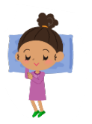


Mia’s new bedtime routine
Plan a calm and relaxing bedtime routine for Mia.
Use the ideas given, and add some ideas of your own.
What might someone do or say to help Mia feel relaxed and ready for bed?
What other things might help Mia to get to sleep?
Notes:
Teacher Notes – Mia’s new bedtime routine (10 mins)
Ask pupils to suggest a relaxing bedtime routine for Mia.
Working in pairs, pupils are provided with cut out cards from Resource 3a: Mia’s new bedtime routine. Using the suggestions on the cards, pupils should sequence these into a calm and relaxing bedtime routine for Mia. They can add any of their own ideas. Discuss the routines that pupils create and ask them to suggest something that someone might do or say to help Mia feel relaxed and ready for bed. Identify that different families might have different night time routines, which include some of these suggestions as well as different ways to get to sleep.
Support: Resource 3b – pupils should sequence the cut out picture cards, and talk about the routine they have created
Challenge: Resource 3c - pupils complete the sentence starters and justify their choices.

Slide 18



Sleep: What is our endpoint?
Go back to the ‘What’s our starting point?’ activity
Use a different color pen or pencil to amend your draw and write and show how your thinking has developed or changed.
Is there anything new that you have learned that you’d like to add?
Is there anything you would like ask?
Is there anything that you would like to change?
Notes:
Teacher Notes – End-point assessment (5 mins)
This is an opportunity to gather evidence of the learning that has taken place and to inform planning for subsequent learning.
Return the baseline assessment activity sheets to pupils. Using a different coloured pen or pencil, pupils should add anything new that they have learned, or any questions that they have, or anything that they’d still like to find out/be able to do. If time allows, you could ask pupils to quietly reflect on one thing they would try doing if they had difficulty falling asleep.
If time allows, you could ask pupils to quietly reflect on one thing they would consider changing about their bedtime routine to help them get better sleep.

Slide 19


Remember…
That can happen to a lot of people. Anyone can have night time fears, bad dreams and trouble sleeping. At your age it a normal part of growing up.
Let’s see what we can do to help you…
I’m worried about falling asleep in case I have a bad dream.
The NHS website also has advice about sleep tips for children of your age: www.nhs.uk/live-well/sleep-and-tiredness/healthy-sleep-tips-for-children
Notes:
Teacher Notes – Signposting support
Important to tell pupils:
Remember: Finding it hard to get to sleep and having night time fears or upsetting dreams is a normal part of growing up. Even adults can sometimes find it hard to get to sleep and they have bad dreams too. In fact anyone can have night time fears, bad dreams and trouble sleeping at any age.
If you’re having trouble falling asleep, having bad dreams or a have any worries, it’s always a good ideas to speak to your parent or a trusted adult in school so that they can help you.
Websites such as NHS UK provide helpful advice on ‘healthy sleep tips for children:
www.nhs.uk/live-well/sleep-and-tiredness/healthy-sleep-tips-for-children
This information could be shared with pupils or with parents/carers via the school newsletter/website.

Slide 20

More activities
Mia has woken up in the middle of the night because she has had a bad dream.
What ideas do you have to help her feel better?
What ideas do you have that could help her
to go back to sleep?
Notes:
Teacher Notes – Extension activity
This activity can be included if you have additional time in the lesson or afterwards, to challenge pupils who need to be stretched or for pupils who demonstrate a particular interest in this topic.
Explain to pupils that Mia has woken up in the middle of the night because she has had a bad dream. What ideas do they have to help her feel better and go back to sleep?
Ask pupils to discuss or record answers in pairs or small groups.

