Slide 1



Ensure you read the guidance before teaching the lesson
Teacher
slide
Mental health and emotional wellbeing
KS1
Lesson 3: Big feelings
Lesson 3:

Slide 2
Teacher
slide
Using this PowerPoint
The slides in this presentation are divided into two sections:
Teacher slides (purple) – provide key information regarding lesson preparation
Pupil slides (white) – provide a visual focus point for pupils during the lesson and delivery notes for teachers about the activities. Click ‘notes’ to view these.
Ensure that you select ‘Use Presenter View’ under the ‘Slide Show’ tab – this will allow you to preview the teaching notes on your monitor while the main presentation is displayed on a screen/smartboard.
© PSHE Association 2018

Slide 3



Challenge and support
Teacher
slide
The lesson includes suggestions for challenge and support activities, to help you differentiate appropriately for your class.
Challenge activities deepen and extend the learning for those who need more challenge or who finish the activity quickly.
Support activities are adapted to be more accessible for those who need it.
Look for the logo on the pupil slides. See delivery notes for details of the activities.
Support
Challenge
© PSHE Association 2018

Slide 4
Context
Teacher
slide
This is the third in a series of three KS1 lessons written for Year 1 or 2, exploring mental health and wellbeing.
This lesson helps pupils to explore the impact of ‘big’ feelings on their behaviour and how to manage this, and to practice asking for help.
Neither this, nor any of the other lessons, is designed to be taught in isolation, but should always form part of a planned, developmental PSHE education programme

Slide 5
Developing subject knowledge
Teacher
slide
Big feelings can be defined as intense feelings which can often appear suddenly and in response to a situation.
Children may recognize these feelings as being good or not so good. They can feel and express many big feelings.
Big feelings can sometimes change someone's behaviour.

Slide 6

Working with parents
Teacher
slide
The engagement of parents in this topic would be advantageous. Parents could be informed via the school newsletter, website or blog — this would enable them to be supportive of this aspect of their child’s learning.
© PSHE Association 2018

Slide 7



Teacher
slide
      Learning objective
about ‘big’ feelings and how to manage them
      Pupils will learn:
      Learning outcomes
Pupils will be able to:
recognise that feelings can intensify (get stronger)
describe how big feelings can affect their behaviour
identify what can help them feel better when they have a big feeling
use words or phrases to ask for help with feelings
© PSHE Association 2018

Slide 8




Teacher
slide
Preparing to teach
      Climate for learning
Make sure you have read the accompanying teacher guidance notes before teaching this lesson – for guidance on establishing ground rules, the limits of
confidentiality, communication and handling questions effectively.
      Resources required
F
Box/envelope for anonymous questions
Flipchart paper and pens
Resource 1: Say and think sheet
Resource 2: Sorting feelings – 1 copy per group, cut out into individual word cards
      Duration
      This has been designed to be taught as a sixty minute PSHE education lesson
      Further guidance
      Members of the PSHE Association can access our website for further guidance www.pshe-association.org.uk
60
© PSHE Association 2018

Slide 9
Lesson summary
Teacher
slide
Activity | Description | Time
1. Baseline assessment | Pupils show their current understanding of ‘big’ feelings and how to manage them | 5
2. Big and little feelings | A simple card sort activity to classify feelings | 10
3. Big feelings and behaviour | Pupils discuss big feelings and strategies for feeling better | 15
4. Asking for help | A role-play in which pupils practice asking for help | 20
5. Plenary: reflection and signposting support | Pupils reflect on the main pints from today’s lesson. Support and where to go for help is given. | 5
6. Endpoint assessment | Returning to the baseline assessment, pupils annotate the draw and write sheet with new learning. | 5
© PSHE Association 2018

Slide 10
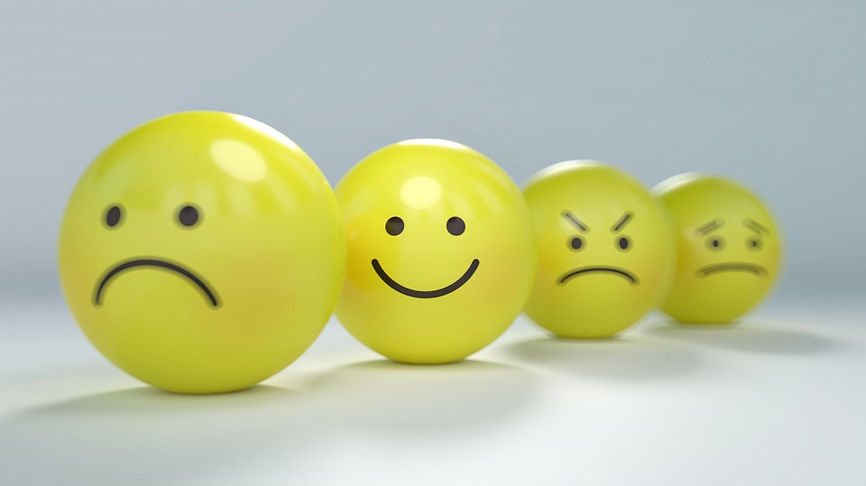
Lesson 3:
Big feelings

Slide 11

Ground rules
[Add your class rules here]
Notes:
Teacher Notes
Use this slide to display your class agreement / ground rules for PSHE education lessons. See Accompanying Teacher Guidance Notes (separate document).
At the beginning of the lesson, establish or reinforce existing ground rules – add or emphasise any ground rules that are especially relevant to this lesson.

Slide 12


Big feelings
What’s our starting point?
clenched fists
Maz is having a big feeling.
Maz’s body is tense and shaking, and Maz’s fists are tightly clenched.
In the speech bubble, write or draw what Maz might say to someone to tell them how he is feeling.
In the box, write or draw two things that Maz can do that might help with the big feeling.
tense
body shaking
Notes:
Teacher Notes - Baseline assessment (5 mins)
Explain that Maz the alien is having a ‘big’ feeling. He knows it’s a big feeling because his body is tense and shaking, and his fists are tight.
Ask: What might his big feeling be? Answer: ANGRY
Tell pupils that Maz is feeling really angry.
Ask: Can they give him some advice on what he could do to help with his big feeling?
Using Resource 1: Say and do sheet, pupils write in the speech bubble what Maz might say to someone to tell them how he is feeling. In the box, write or draw two things that he can do that might help him with his big feeling.
The purpose of this activity is to enable the class teacher to find out the pupils’ existing knowledge, skills and attitudes towards big feelings and how to manage them. Pupils should work individually, however an adult should scribe for those who need support. Whilst they are working, do not prompt them in any way. When complete, ensure pupils write their name at the top of their paper. Collect in and note any responses and any misconceptions that need addressing through the lesson. Keep the sheets - pupils will return to this activity at the end of the lesson to assess their learning.

Slide 13
      We are learning about big feelings and how to manage them.
      We will be able to:
  recognise that feelings can intensify and get stronger
  describe how big feelings can affect someone’s behaviour
  identify what can help someone to feel better when they have a big feeling
  know how to ask for help with feelings
Notes:
Teacher Notes – Learning objective and outcomes
Introduce the learning objectives and outcomes, explaining that this lesson will explore big feelings and how to manage them

Slide 14





Big and little feelings
Big feelings don’t always start off as big feelings.
They can start as little feelings.
If they don’t go away they can grow and grow until they become big feelings.
Sometimes big feelings happen very suddenly.
Notes:
Teacher Notes – Big and little feelings (10 mins)
This slide has animations.
Begin by showing slide with title only.
Remind pupils that today’s lesson will look at big feelings.
Display the Everyday Feelings list from lessons 1 & 2. Pupils should decide which feelings on the list are ‘big’ feelings. Are there any other big feelings that they want to tell Maz about? Provide examples from the key words section if necessary.
Click for animation 1: explain that sometimes these big feelings don’t start off as big feelings – click for animations 2: they can start as little feelings – click for animation 3 and 4 then say: If they don’t go away they can grow and grow until they become big feelings – click for aminations 5, 6, 7 and 8, then say: Sometimes big feelings happen very suddenly – click for animation 9

Slide 15
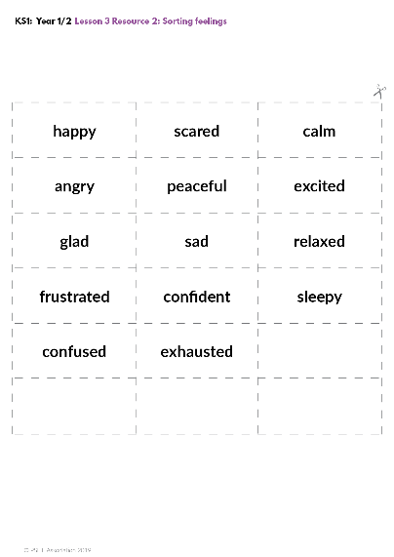
Big and little feelings
In groups sort your word cards into ‘big’ or ‘little’ feelings.
Has every groups sorted the same?
Were there any feelings that you were unsure of if they were big or little?
Notes:
Teacher Notes – Big and little feelings (10 mins)
Provide Resource 2: Sorting feelings. Pupils work in groups to sort their word cards into ‘big’ or ‘little’ feelings. Compare how groups have sorted their cards. Were there any that they were unsure of?
Support:
Pupils match feelings pictures to a simple scale of ‘little’ and ‘big’ feelings. Provide pictures from magazines or newspapers which show feelings.
Challenge:
Provide Resource 2a: Sorting feelings as above. Pupils should sort cards into 3 piles: ‘little feelings’ ‘big feelings’ and ‘unsure’. Some cards have been left blank - challenge pupils to add their own suggestions. Compare how pupils have sorted their cards. Were there any that they were unsure of? Were they able to add their own suggestions? What can they tell Maz about how feelings can get bigger?

Slide 16

Big feelings and behaviour
Listen to the story about Maz.
Can you suggest how the big feeling has affected Maz’s behaviour?
Now answer these questions…
Like all feelings, our big feelings can change and can
get smaller, just like a balloon that goes down.
Notes:
Teacher Notes – Big feelings and behaviour (15 mins)
This slide is animated
Read aloud the following story about Maz:
Maz finds out that his best friend from his home planet is coming to earth to visit him. Maz starts talking really loud and fast and shouts and whoops; he is jumping up and down and spinning round and round. He starts to jump and bounce on the sofa, even though the grown-ups tell him not too. Ooops – he makes a tear in the cushion. Maz realises that he is having a big feeling that is affecting his behaviour.
Click for animation 1 and ask pupils to suggest how the big feeling has affected Maz’s behaviour – discuss
Click for animation 2 and ask the following questions:
1. Can you identify the big feeling that Maz is having? (He is excited)
2. How is the big feeling changing Maz’s behaviour? (He is talking fast and loud/jumping around/shouting out, jumping on the sofa)
3. Which parts of Maz’s behaviour are not so good? (Jumping on the sofa, tearing the cushion and ignoring the grown-ups)
4. Can you suggest ways that he could make the situation better? (Talking to an adult about feelings should be included - provide this if pupils do not volunteer as a response)
5. What could you do to help Maz or what advice would you give him? (Stress that feeling excited is a good feeling but that any big feeling can affect our behaviour in not so good ways and it’s this that Maz needs help to manage)
As a whole class discuss how some of the big feelings on Resource 2 can affect and change people’s behaviour. Ask pupils to suggest ways that someone could help themselves feel better. Ask pupils if they think that Maz’s big feelings might change?
Click for animation 3, 4 and 5, and explain that like all feelings, our big feelings can change and can get smaller, just like a balloon that goes down.

Slide 17

Asking for help
What advice would you give?
Role play
Freeze frame a big feeling. Use your faces and bodies to show this feeling.
Remember to talk to an adult about big feelings.
Notes:
Teacher Notes – Asking for help (20 min)
This slide is animated
Explain that you’ve received some text messages from some children who want to ask the class their advice. Read the questions and ask the pupils what advice they would give, drawing out that it’s often a good idea to ask an adult or someone they trust, for help.
Text messages:
‘I’m feeling so angry today, I wonder what can help me feel better. Any ideas?’ – Grace, age 7
‘What do you do when you feel excited?’ – Ali, aged 6
‘I need some quiet time because I feel exhausted, who should I tell?’ – Milo, age 8
‘I’m really scared – I feel sick in my body, what will help?’ – Tali, age 5
Click for animation 1: Next, pupils role-play asking for help. They should begin by freeze framing a big feeling (use feelings from Resource 2), which they should show on their face and bodies. Chose a few children to demonstrate asking for help.
Click for animation 2: After the role plays, tell pupils that talking to an adult won’t always solve a problem – but it might start to help them feel better. This is because adults have experience and can come up with ideas that might help them to feel better.

Slide 18

Reflecting and signposting
What are some of the things that someone can do to help them when they have a big feeling?
What are some of the things that someone shouldn’t do when they are having a big feeling?
Speak to someone that you trust in school or at home if
you are having trouble with any feeling, big or small, or
if you are feeling particularly sad, scared or worried
about something.
Notes:
Teacher Notes – Reflecting on and Signposting support 5 mins
Pupils identify some of the things that someone can do to help them when they have a big feeling, and some of the things that they shouldn’t do:
For example:
Do talk about it
Do something to help you calm down
Do remember that feelings can change
Don’t hurt yourself
Don’t hurt others
Don’t hurt things or property
It is important to reassure pupils that everyone experiences big feelings, even adults, its’s how we deal with them that is important and that it’s never right to hurt someone because of how we are feeling. It’s always best to speak to a parent or a trusted adult in school if they are having trouble with any feelings, big or small, or if they are feeling particularly sad, scared or worried about something.

Slide 19


Where are we now?
Go back to the ‘What’s our starting point?’ activity
Is there anything you would like to change?
Is there anything you would like to add?
Use a different colour pen or pencil to amend your Say and Do sheet and show how your thinking has developed or changed.
Notes:
Teacher Notes – End-point assessment (5 mins)
Return Resource 1: Say and do sheet to pupils, on which they write on any new learning from today’s lesson in a different colour pencil. They should include anything from the three lessons that they think will be useful for them.

Slide 20

More activities
Use class story time to read books about feelings, such as:
  Angry Arthur by Hiawyn Oran
  The Great Big Book of Feelings by Mary Hoffman, or
  The Huge Bag of Worries by Virginia Ironside
Notes:
Teacher Notes – Extension activities
These activities can be included if you have additional time in the lesson or afterwards, to challenge pupils who need to be stretched or for pupils who demonstrate a particular interest in this topic.

