Slide 1



Ensure you read the guidance before teaching the lesson
Teacher
slide
Mental health and emotional wellbeing
KS1
Lesson 2:
Good and not so good feelings

Slide 2
Teacher
slide
Using this PowerPoint
The slides in this presentation are divided into two sections:
Teacher slides (purple) – provide key information regarding lesson preparation
Pupil slides (white) – provide a visual focus point for pupils during the lesson and delivery notes for teachers about the activities. Click ‘notes’ to view these.
Ensure that you select ‘Use Presenter View’ under the ‘Slide Show’ tab – this will allow you to preview the teaching notes on your monitor while the main presentation is displayed on a screen/smartboard.
© PSHE Association 2018

Slide 3



Challenge and support
Teacher
slide
The lesson includes suggestions for challenge and support activities, to help you differentiate appropriately for your class.
Challenge activities deepen and extend the learning for those who need more challenge or who finish the activity quickly.
Support activities are adapted to be more accessible for those who need it.
Look for the logo on the pupil slides. See delivery notes for details of the activities.
Support
Challenge
© PSHE Association 2018

Slide 4
Context
Teacher
slide
This is the second in a series of KS1 lessons written for Year 1 or 2, exploring mental health and wellbeing.
This lesson focuses on good and not so good feelings, recognising that not everyone feels the same about different things and exploring what helps people to feel better. For pupils in KS1 we suggest using the terms ‘good’ and ‘not so good’ when describing some feelings. This avoids using terminology such as ‘bad’ feelings.
Neither this, nor any of the other lessons, is designed to be taught in isolation, but should always form part of a planned, developmental PSHE education programme.

Slide 5



Teacher
slide
      Learning objective
that feelings change and that not everyone experiences the same feeling in the same situation.
Pupils will learn:
      Learning outcomes
Pupils will be able to:
identify feelings that are good and not so good
recognise that people feel differently about things and situations
explain what can change their feelings (from good to not so good and from not so good to good)
suggest things that can help themselves and others to feel better
© PSHE Association 2018

Slide 6




Preparing to teach
      Resources required
Box/envelope for anonymous questions
Flipchart paper and pens, pens and pencils
Resource 1: feelings grid
Resource 2a: Display words
Resource 2b: Everyday situations – teachers list
Resource 3a: My feelings frame
Resource 3b: My feelings frame (challenge)
Resource 4a: Maz’s feelings - teacher cards
Resource 4b: Maz’s changing feelings grid
      Climate for learning
Before teaching these lessons ensure that you read the accompanying PSHE Association document Teaching about mental health and emotional wellbeing for guidance on establishing ground rules, the limits of confidentiality, handling questions, and additional advice relating to teaching about mental health effectively and safely.
      Duration
      This has been designed to be taught as a sixty minute PSHE education lesson
      Further guidance
      Members of the PSHE Association can access our website for further guidance www.pshe-association.org.uk
60
© PSHE Association 2018

Slide 7
Teacher
slide
Lesson summary
Activity | Description | Time
Baseline assessment | This activity is designed to capture pupils’ knowledge, skills and attitudes about good and not so good feelings. | 10
2. Maz’s feelings | Pupils decide if a feeling is good or not so good. | 5
3. How does Maz feel about…? | Pupils identify how they think Maz might feel about some everyday things and situations. | 10
4. My feelings | Personal reflection on how pupils feel about some everyday things and situations. | 10
5. Feelings can change | Pupils work in pairs to look at ways feelings change, and identify ways that can help someone to feel better. | 15
6. Personal reflection and signposting | Pupils summarise what can help Maz to feel better and write a whole-class postcard with some advice. A personal reflection on feelings | 5
7. Endpoint assessment | Return to baseline assessment and add to or amend in light of their new learning. Identify sources of support at school and home. | 5
© PSHE Association 2018

Slide 8
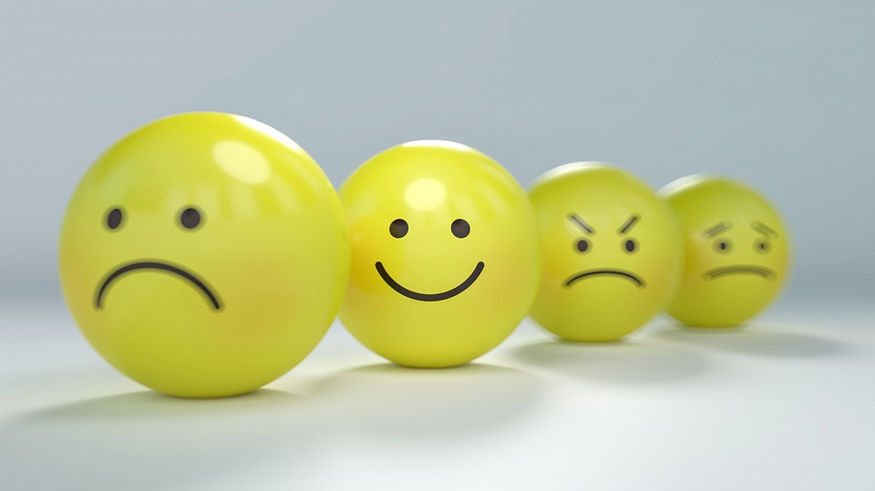
Lesson 2:
Good and not so good feelings

Slide 9

Ground rules
[Add your class rules here]
Notes:
Teacher Notes
Use this slide to display your class agreement / ground rules for PSHE education lessons. See Accompanying Teacher Guidance Notes (separate document).
At the beginning of the lesson, establish or reinforce existing ground rules – add or emphasise any ground rules that are especially relevant to this lesson.

Slide 10

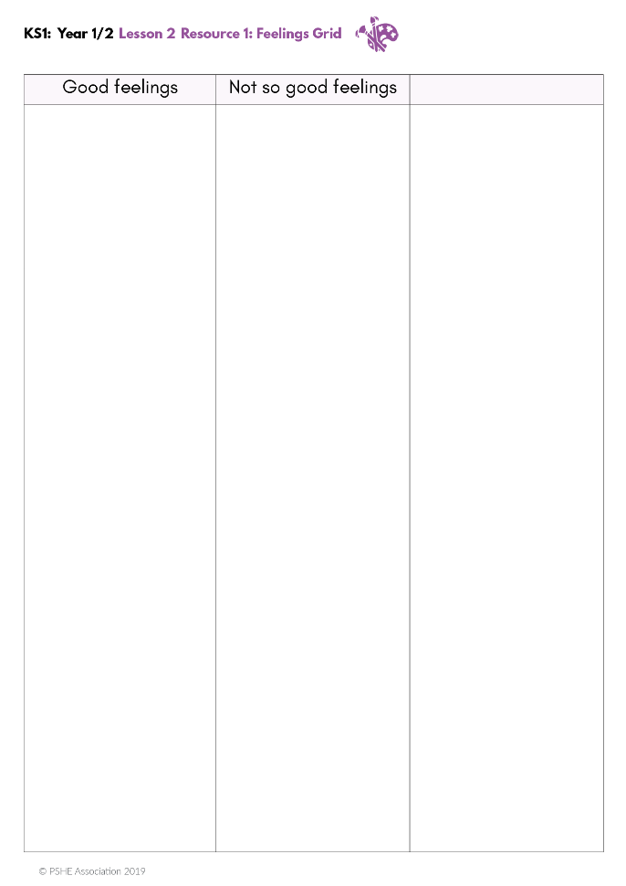
What’s our starting point?
Good and not so good feelings
Think of a feeling.
Decide if you think it is a good feeling or a not so good feeling and record this on the sheet.
Next, write or draw something that gives that good or not so good feeling.
Repeat for as many feelings as you can think of.
We’ll come back to the blank column later.
Notes:
Teacher Notes - Baseline assessment (10 mins)
Using Resource 1: Feelings grid, pupils think of as many feelings as they can, and write or draw the feeling under the heading they feel it fits best. Next, they should write or draw something that gives the good or not so good feeling. The blank column will be completed at the end of the lesson.
The purpose of this activity is to enable you to find out the pupils’ existing knowledge, understanding and attitudes associated with feelings and how they can change. Pupils should work individually. Whilst they are working, do not prompt them in any way. When complete, ensure pupils write their name at the top of their paper. Collect in and check pupil responses, noting any responses and any misconceptions that need addressing through the lesson

Slide 11
      We are learning:
      that feelings change and that not everyone experiences the same feeling in the same situation.
      We will be able to:
  identify feelings that are good and not so good
  recognise that people feel differently about things and situations
  talk about what can change our feelings
  suggest things that can help us to feel better
Notes:
Teacher Notes – Learning objective and outcomes
Introduce the learning objectives and outcomes, explaining that this lesson will explore good and not so good feelings.

Slide 12


Maz’s feelings
Are there any other feelings that you want to add to Maz’s list?
Do you think this is a good or not so good feeling?
Are there any that you are unsure of?
Notes:
Teacher Notes – Maz’s feeling (5 mins)
Display the Everyday Feelings list from the last session and add any new feelings to the list. Ask pupils to decide if each of the feelings is a good or not so good feeling and draw or display a ‘happy’ face or a ‘sad’ face next to each of the feelings. Draw a question mark by any feelings that pupils are unsure how to classify.
Display the Everyday Feelings list on the working wall for use again in the next lesson.

Slide 13
How does Maz feel about…?
Listen to some of the things that Maz might do while he’s visiting earth.
Think about how these things might make Maz feel.
Look at the words displayed around the room and stand by the word that you think describes how Maz feels.
Feelings
Notes:
Teacher notes – How does Maz feel about? 10 mins
Pin up the feelings words from Resource 2a: Display words individually in different areas around the room – use feelings picture cards for those pupils who may require support - and ask pupils to put themselves in the role of Maz. Read out the first scenario from Resource 2b: Everyday situations – teacher list. Pupils decide which of the displayed words best represents how they think Maz might feel, and stand next to that word. Repeat for remaining scenarios.
Ask:
Does everyone agree on how Maz feels?
Does everyone feel the same?
Think about how someone else might feel in this situation?
Would they feel the same as Maz?
Why might they feel different?

Slide 14
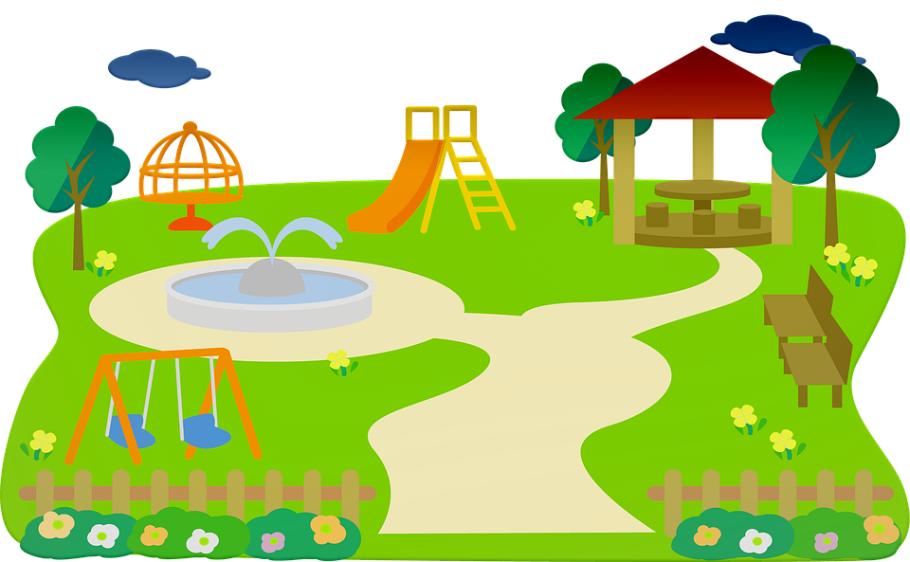


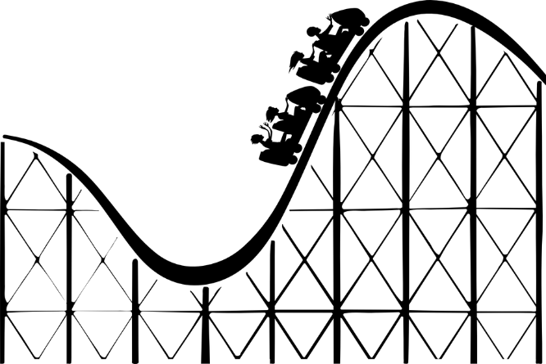
My feelings
Look at the sheet My feelings frame.
Think about how each situation might make you feel.
Decide if it is a good or not so good feeling.
If your not sure, put a tick in the ‘unsure’ box.
Notes:
Teacher notes – My Feelings (10 mins)
This is a personal reflection activity where pupils think about how they feel about certain everyday things and situations.
Using Resource 3a: My feelings frame, pupils identify if the situation gives them a good or not so good feeling and write their feeling in the box. Share their responses with one other person of their choice and compare their feelings about different things. Discuss as a class and ask questions to elicit the understanding that not everyone will feel the same. Ask: does everyone like sweets/ the sun/ pop music? Is everybody scared of the dark/spiders?
Support:
Pupils respond on Resource 3a with a happy, sad, or not sure emoji to show their responses. Display a list of feelings words that they can match to the emoji faces.
Challenge:
Using Resource 3b: My feelings frame (challenge), continue as above but ask pupils to identify their own situations in addition to those on the sheet.

Slide 15
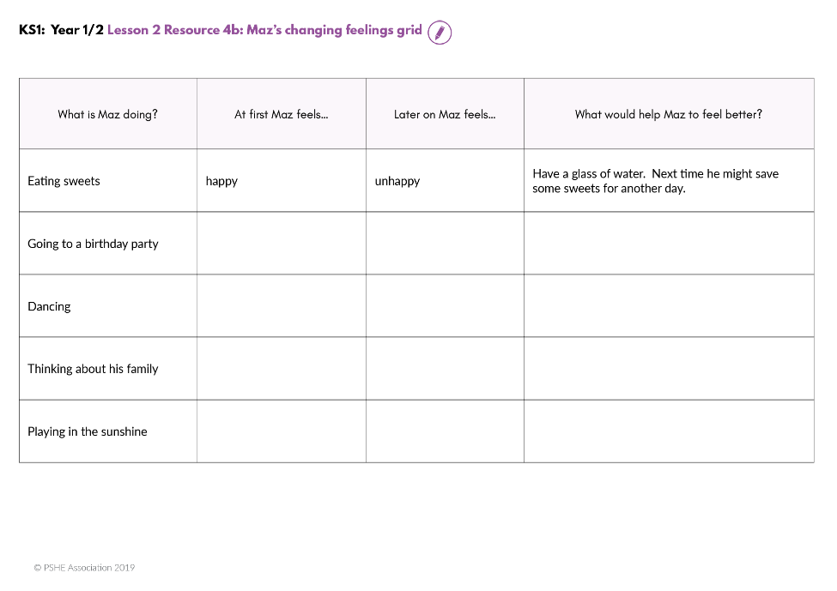
Feelings can change
Listen to some stories about Maz.
Using Maz’s Changing Feelings grid, write or say feelings words which show how Maz’s feelings change.
For example:
Eating sweets:
At first Maz feels ‘happy’
Later on her feels ‘unhappy’
*Make suggestions for what he could do to feel better.
Notes:
Teacher notes –Feelings can change? 15 mins
Explain that all feelings come and go, even happy and good feelings can sometimes change to not so happy and good feelings.
Read aloud the scenarios from Resource 4a: Maz’s feelings – teacher cards. Using resource 4b: Maz’s changing feelings grid, pupils work in pairs, to record or say feelings words which show how Maz’s feelings change. For example: Eating sweets – At first Maz feels…happy; later on he feels unhappy. Display feelings vocabulary lists for support. Next, pupils make suggestions for what he could do to feel better. For example: have a glass of water and next time save some sweets for another day.
Teaching point: Note that these are things that we can all do when something is bothering us, or when we are having not so good feelings.
Next, pupils verbally suggest ways that they could help Maz to feel better. If necessary, support pupils with suggestions such as: listen to him, share a toy with him, play with him or help him to find an adult to talk to.

Slide 16

Reflecting and signposting
Talk about some of the things that we can do the help us feel better.
2. Write a class postcard to Maz and include some of the ideas you have for how Maz can feel better.
3. Who or what can help Maz to feel better?
Notes:
Teacher Notes – Reflecting on and Signposting support 5 mins
Ask pupils to discuss some of the things that we can do to help us feel better when we’re feeling not so good. Display a large postcard, addressed to Maz and write down some of the ideas the pupils have for what Maz could do to help himself feel better when feeling not so good.
Are there any strategies for Maz that they could also use to help themselves to feel good? Discuss where at home and at school they can go to for support with their feelings.

Slide 17


Where are we now?
Go back to the ‘What’s our starting point?’ activity
Write or draw anything new that you have learned.
Fill in the blank column with ideas for what can make someone feel good again.
Notes:
Teacher Notes – End-point assessment (5 mins)
Return to the baseline assessment activity sheets. Pupils should annotate with any new learning, and complete the blank column with ideas for what can make them feel good.

Slide 18

More activities
Interview a grown-up at school.
Choose three things from Resource 2b and ask if it makes them feel good, or not so good, and what healthy things might they do to help themselves feel better.
Notes:
Teacher Notes – Extension activities
These activities can be included if you have additional time in the lesson or afterwards, to challenge pupils who need to be stretched or for pupils who demonstrate a particular interest in this topic.

