Slide 1



Ensure you read the guidance before teaching the lesson
Teacher
slide
Drug and alcohol education
KS1
Year 1 / 2 Lesson 2
Keeping healthy: medicines
© PSHE Association 2020

Slide 2

Using this PowerPoint
Teacher
slide
The slides in this presentation are divided into two sections:
Teacher slides (purple) – provide key information regarding lesson preparation
Pupil slides (white) – provide a visual focus point for pupils during the lesson and delivery notes for teachers about the activities. Click ‘notes’ to view these.
Ensure that you select ‘Use Presenter View’ under the ‘Slide Show’ tab – this will allow you to preview the teaching notes on your monitor while the main presentation is displayed on a screen/smartboard.
© PSHE Association 2020

Slide 3



Challenge and support
Teacher
slide
The lesson includes suggestions for challenge and support activities, to help you differentiate appropriately for your class.
Challenge activities deepen and extend the learning for those who need more challenge or who finish the activity quickly.
Support activities are adapted to be more accessible for those who need it.
Look for the logo on the pupil slides. See delivery notes for details of the activities.
Support
Challenge
© PSHE Association 2020

Slide 4
Context
Teacher
slide
This is the second of a series of three lessons for key stage 1 pupils introducing age-appropriate drug and alcohol education. This lesson focuses on medicines; what they look like, how they are used and why people use them. It explores how medicines are used to treat illness in the short and the long term as well as how some medicines can help protect people from becoming ill in the future. Pupils consider the role of other people in helping them and others stay healthy and well, manage or recover from illness.
Neither this, nor any of the other lessons, is designed to be taught in isolation, but should always form part of a planned, developmental PSHE education programme.
© PSHE Association 2020

Slide 5
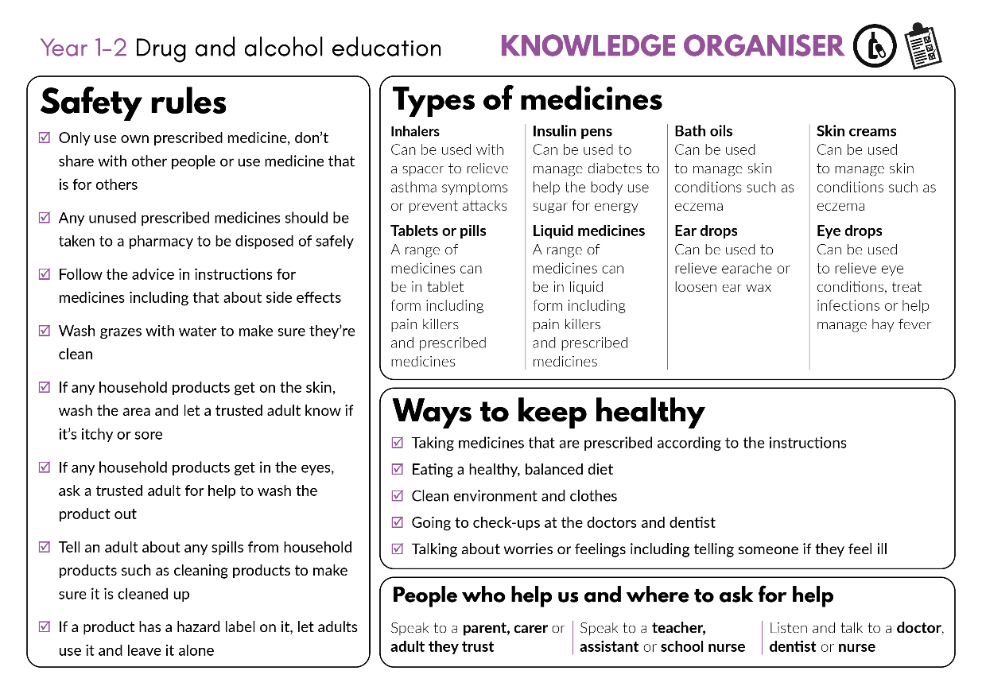


Developing subject knowledge
Teacher
slide
Key information on content related to these lessons can be found in the Year 1-2 Knowledge Organiser.
Advice on safe practice, dispelling common misconceptions, visitors to the classroom and other important information can be found in Teacher Guidance: Drug and alcohol education
Data sources to inform your planning can be found within our document that outlines the approach of these lessons Evidence Review: Effective drug and alcohol education, along with advice regarding how to talk to young people about addiction, dependency and problematic substance use.
© PSHE Association 2020

Slide 6



Teacher
slide
      Learning objective
To learn about medicines, and the people who help them to stay healthy
      Learning outcomes
Pupils will be able to:
  identify what can make people feel better if not feeling well
  explain that medicines come in different forms and are used in different ways
  recognise that some medicines, such as vaccinations, can help prevent illness and disease and that some people need to take medicines every day to help them to stay healthy
  identify who helps people to stay healthy and what they do
© PSHE Association 2020

Slide 7




Teacher
slide
Preparing to teach
      Climate for learning
Make sure you have read the accompanying teacher guidance notes before teaching this lesson for guidance on establishing ground rules, the limits of confidentiality, communication and handling questions effectively.
      Resources required
Box or envelope for anonymous questions
Resource 1: Feel better scenarios [1 set per pair]
Resource 1a. support: Feel better scenarios [1 set per pupil or pair requiring support]
Resource 1b. challenge: Feel better scenarios [1 set per pupil or pair requiring additional challenge]
Resource 2: Medicines cards [1 set per class]
Resource 3. Different medicines chart [1 per pair]
Resource 4: Medicines case studies [1 set per class]
Resource 5. support: People who help us with health cards [1 set per pupil or small group requiring support]
Optional:
Persona doll or puppet
Collection of empty and washed medicine and household product bottles, containers and packets
      Duration
      This has been designed to be taught as a sixty minute PSHE education lesson
60
      Further guidance
      Members of the PSHE Association can access our website for further guidance www.pshe-association.org.uk
© PSHE Association 2020

Slide 8
Teacher
slide
Lesson summary
Activity | Description | Timing
1. Baseline assessment | To be completed before the lesson. Individually or as a whole class, make a mind-map about what they already know about medicines. | 10-15 MINS
2. Introduction | Re-introduce or reinforce ground rules. Introduce the lesson with a short explanation about medicines. | 5-10 MINS
3. Feel better scenarios | Pupils read scenarios and suggest what will help the characters to feel better | 15 MINS
4. Different medicines hunt | Pairs of pupils describe different types of medicine, what it looks like, how it is used, where on the body and why | 10 MINS
5. Keeping healthy case study | Pupils explore a case study about someone who needs to use medicine every day to stay healthy | 10 MINS
6. Give me 5 | Pupils think of people who help them stay healthy and well and what they do | 5 MINS
7. Plenary/signposting support | Pupils name one thing that can help someone feel better. Explain the importance of only using medicines with the guidance of a trusted adult and telling them if they feel unwell | 5-10 MINS
8. End-point assessment | Pupils add to their baseline assessment activity, medicines mind-map, to demonstrate their new learning about medicines | 5-10 MINS
© PSHE Association 2020

Slide 9

Lesson 2
Keeping healthy: medicines

Slide 10

Medicines mind map
What do we know about medicines?
Notes:
Teacher Notes - Baseline assessment (10-15 mins) This activity should be completed before the lesson.
This allows time to look through the pupils’ work and gain a sense of their current understanding and experiences. Before setting this activity, ensure that ground rules for PSHE education lessons have been developed and shared with the class.
Pupils draw/write an individual response or make a whole class brainstorm or mind map, responding to the question ‘What do we know about medicines?’.

Slide 11

Ground rules
[Add your class rules here]
Notes:
Teacher Notes
Use this slide to display your class agreement / ground rules for PSHE education lessons. See Accompanying Teacher Guidance Notes (separate document).
Remind pupils - ‘although in this lesson we will be thinking about all different kinds of medicines and when people use them, we are not going to name people we know, if we want to share a story about someone using a medicine, we will say “someone I know…” rather than use their name.’

Slide 12
We are learning about medicines, and the people who help us to stay healthy
      We will be able to:
  say what can make people feel better if not feeling well
  explain that medicines come in different forms
  recognise that some medicines help prevent illness and that some people need to take medicines every day
  identify who helps people to stay healthy and what they do
Notes:
Teacher Notes – Learning objective and outcomes
Introduce the learning outcomes - these are a simplified, more pupil-friendly version of the outcomes on slide 6 (teacher slide).

Slide 13
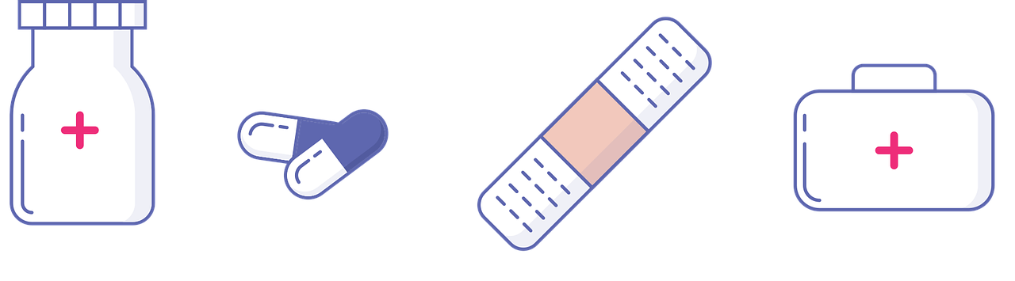
Different types of medicines
Some medicines help someone to recover (get better) from illness or injuries, such as antiseptic cream on a graze.
Some medicines protect the body, such as vaccinations which protect people against diseases, sun cream protecting the skin from burning, or mosquito spray protecting against bites.
Some medicines help people keep healthy and well and may need to be used every day or over a long period of time.
Notes:
Teacher notes Introduction (5-10 mins)
Explain that in this lesson pupils will be learning about some of the medicines and people that help us to stay healthy and well. Explain there are all different types of medicines which are used in different ways and for lots of different reasons:
some medicines help someone to recover (get better) from illness or injuries, such as antiseptic cream on a graze;
some medicines protect the body, such as sun cream protecting the skin from burning, or mosquito spray protecting against bites, or vaccinations which protect people against diseases (vaccinations might include injections or drops to swallow)
some medicines help people keep healthy and well and may need to be used every day or over a long period of time

Slide 14
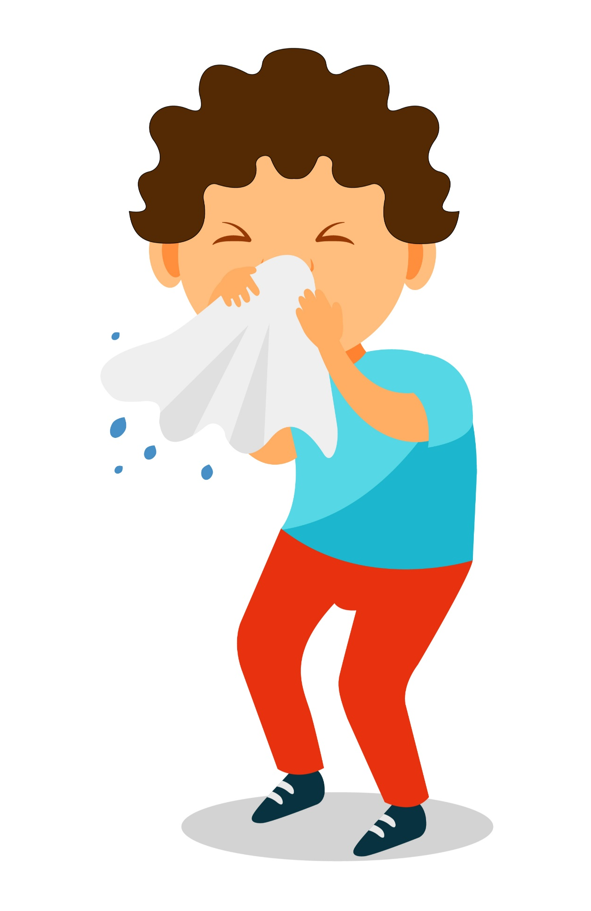
Feel better scenarios
Think about a time you felt poorly and what helped you to feel better.
Now with your partner, read the Feel better scenarios. What might help the characters feel better and get well?
Notes:
Teacher notes – Feel better scenarios (15 mins)
Pupils think about a time when they felt poorly and what helped them to feel better. Pupils do not need to share, just reflect for themselves.
Introduce a character and explain that they are not feeling well. You might want to use a persona doll or puppet. Pupils discuss what might help them to feel better.
Pupils work in pairs, to read Resource 1. Feel better scenarios and suggest what might help the characters to feel better and get well.
Support: Resource 1a. Feel better scenarios - support. Pupils match up the symptoms to the remedies/things that might help them feel better.
Challenge: Resource 1b. Feel better scenarios - challenge. Pupils organise responses into things that go into / onto bodies and add other ideas
Take feedback from the class. Draw out that medicines can be used to treat an illness or injury, but that other things such as hugs or having a hot drink can also help someone feel better.

Slide 15
Did you think of…
antiseptic cream
nasal spray
ear drops
tissues
plasters
hugs
resting
watching TV
cuddling a teddy
eating soup
drinking water
rubbing where it hurts
Notes:
Take feedback from the class. Draw out that medicines can be used to treat an illness or injury, but that other things such as hugs or having a hot drink can also help someone feel better.
Pupils may identify:
Medical products such as: antiseptic cream, ear drops, nasal spray, tissues, plasters
Soothing items or activities such as: cuddling a teddy, hugs, resting, watching TV, sleeping, drinking water, eating soup, rubbing the injury

Slide 16

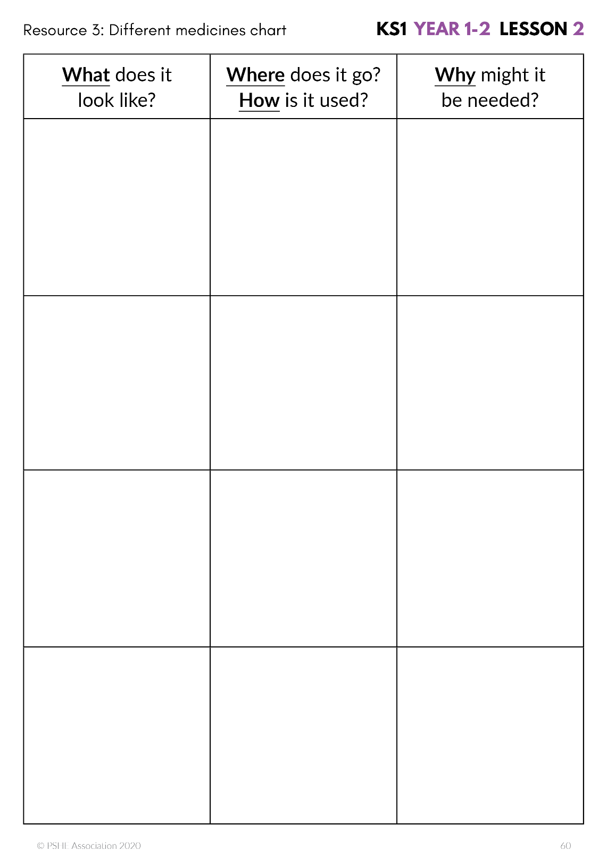

Different medicines hunt
Think about a time you were given a medicine.
What did it look like?
Did it go into or onto the body?
How did it help?
With your partner, hunt for the Medicines cards. When you have found four, fill in the Different medicines chart.
Notes:
Teacher Notes - Different medicines hunt (15 mins)
If pupils cannot remember a time they were given medicine, they can think about someone they know, such as a younger brother or sister. Pupils do not need to share, just reflect for themselves.
Explain that medicines look different (come in many different forms); are used in different ways, and that it is important they are used correctly.
Display Resource 2. Medicines cards around the classroom. In pairs, pupils hunt around the classroom for the cards, find four different types of medicine and complete the Resource 3. Different medicines chart showing what the medicine looks like, where it might be used on the body, how it is used and why it might be needed.
Bring the class back to together and discuss the different forms that medicines come in (e.g. drops, tablets, lozenges, liquids, creams) and explain that each medicine has a specific and individual use; they are all needed for different parts of the body and to relieve different ailments or illnesses.
Teacher’s note: Empty, washed bottles, and containers and empty medicine packets can also be used for the medicines hunt, if preferred.

Slide 17

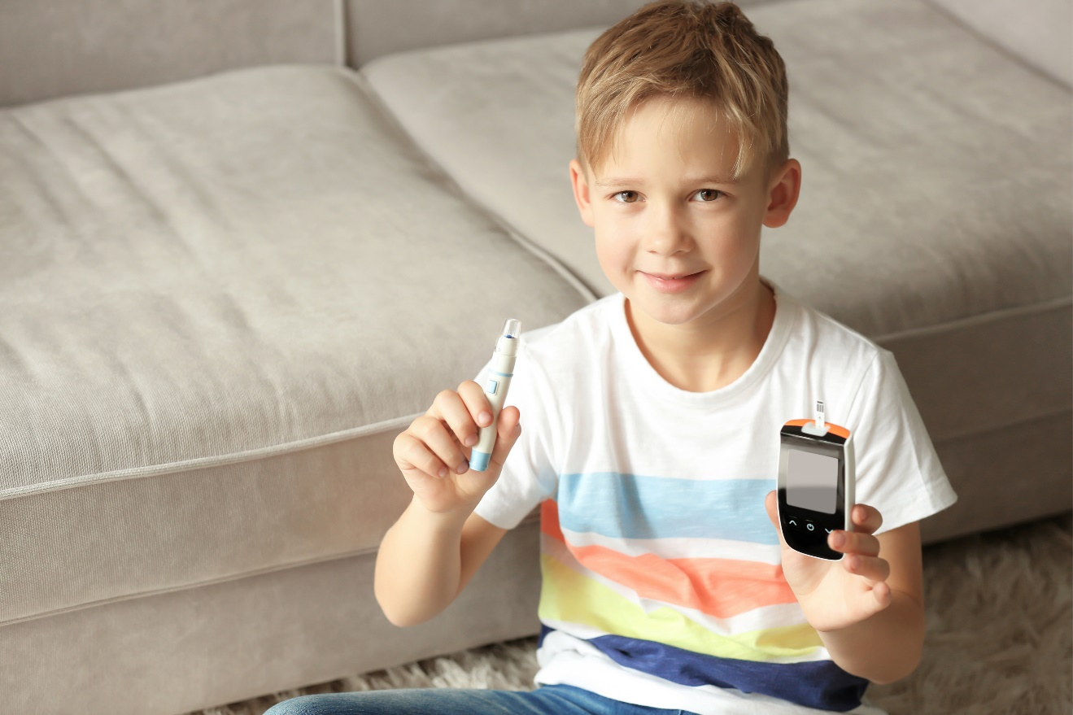
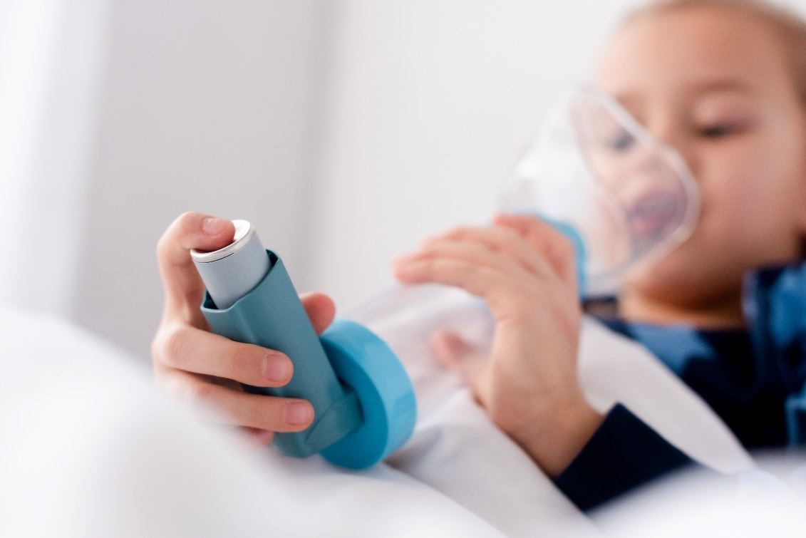
Keeping healthy case study
Listen to the case study.
Think about the questions and share your ideas.
Talk about the type of medicines used and how they help the person.
Notes:
Teacher Notes – Keeping healthy case study (10 mins)
Explain that some medicines help to keep illnesses under control and are needed to help the person stay healthy – so that they can do all the things everyone else can do.
Choose one or some of the medicines case studies to read to the class (Resource 4. Medicines case studies) and encourage the pupils to discuss the questions before sharing their ideas. Pupils can work as a whole class or in small groups.
Talk about the type of medicines used and how they help the person. Conclude that some people take medicines to recover from illness quickly and some need to take medicines every day or regularly in order to help keep healthy and well over a longer period of time.
Teacher’s note: You might prefer to read an information book on a similar theme. Be aware that the pupils or members of their families may be living with a health condition. In most instances, it is best to select a case study that is not being experienced by a pupil in the class.

Slide 18

3
Give me 5
4
2
Think of 5 people who help others to stay healthy and well.
Talk about their role and what they do.
1
5
Notes:
Teacher Notes – Give me 5 (5 mins)
In pairs or small groups, pupils think of at least five people who help others to stay healthy and well, discuss their roles and the kinds of things they do.
Support: Use Resource 5. People who help us with health cards to identify the roles of the people and label their job title and what they do.
Challenge: Think of 10 different people – ‘give me 10’
People might include: Parent/carer; doctor, pharmacist, nurse, paramedic, teacher, teaching assistant, midday assistant, dentist, counsellor, nutritionist, cleaner.
What they do might include: provide healthy food to eat, clean their clothes, keep the house/school clean, check-ups, listen to them, give them medicine.

Slide 19

Reflecting and getting support
Share one thing that can help someone feel better if they are unwell.
Remember: if you feel unwell, talk to an adult you trust – at home or at school.
Only a trusted adult should give medicine.
Notes:
Teacher Notes – Reflecting and getting support (5-10 mins)
Each pupil shares one thing that can help someone feel better if they are unwell.
Remind the pupils that if they feel unwell it is important that they talk to an adult they trust – at home or school; and that only a trusted adult should give them medicines. Young children should not take medicines without an adult helping them. If they are unsure about taking or using medicines of any kind, they should speak to their trusted adults first.

Slide 20

What has been learnt?
Now go back to your mind-map.
Is there anything you would like to change?
Is there anything you would like to add?
Use a different colour pencil to add your ideas.
Notes:
Teacher Notes – End-point assessment (5-10 mins)
Pupils return to their baseline assessment activity, medicines mind-map. Using a different colour pencil or pen they add to the mind-map to demonstrate their new learning about medicines.

Slide 21

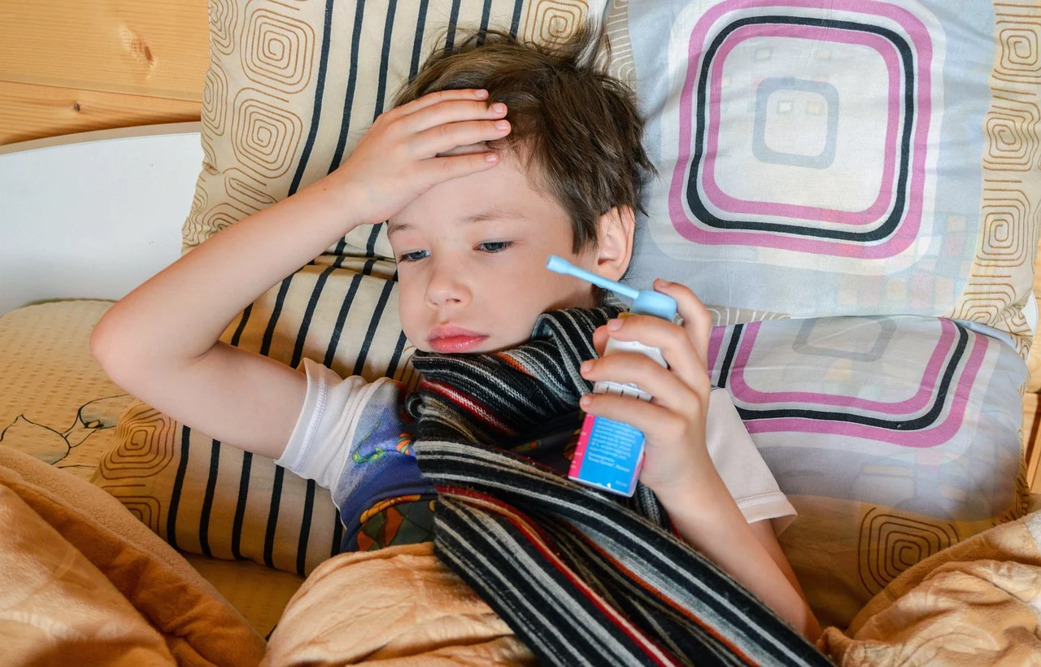
More activities
Write a story or create a storyboard about a character who isn’t feeling well.
Include:
What they do to feel better
Who helps them
Notes:
Teacher Notes – Extension activity
Pupils write a story or create a storyboard about a character who isn’t feeling well and what they do to feel better. They write about who helped them and what they did.

