Slide 1

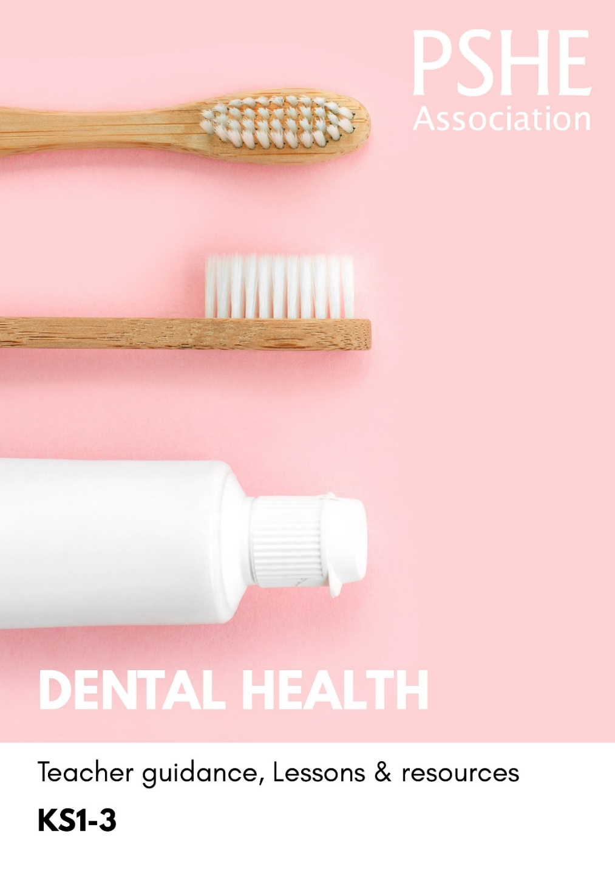
Teacher
slide
Ensure you read the guidance before teaching the lesson
Dental Health, KS2
Maintaining dental health

Slide 2
Teacher
slide
Using this PowerPoint
The slides in this presentation are divided into two sections:
Teacher slides (purple) — provide key information regarding lesson preparation
Pupil slides (white) — provide a visual focus point for pupils during the lesson and delivery notes for teachers about the activities. Click ‘notes’ to view these.
Ensure that you select ‘Use Presenter View’ under the ‘Slide Show’ tab — this will allow you to preview the teaching notes on your monitor while the main presentation is displayed on a screen/smartboard.

Slide 3



Teacher
slide
Challenge and support
The lesson includes suggestions for challenge and support activities, to help you differentiate appropriately for your class.
Challenge activities deepen and extend the learning for those who need more challenge or who finish the activity quickly.
Support activities are adapted to be more accessible for those who need it.
Look for the logo on the student slides. See delivery notes for details of the activities.
Support
Challenge

Slide 4
Teacher
slide
Context
There is an accompanying lesson for key stage 1, in which pupils learn about teeth-friendly food and drink, keeping teeth clean and people who can help with dental health; and for key stage 3, which encourages independence in maintaining dental health and accessing dental health services.
This key stage 2 supports pupils to reflect on everyday actions that can affect their teeth and the importance of good oral hygiene practises such as flossing and regular visits to the dentist.
This lesson is best used within the context of a unit of work on healthy, balanced lifestyles.

Slide 5
Developing subject knowledge
Teacher
slide
Children aged 7 years and over should brush their teeth twice a day using toothpaste containing between 1350-1500ppm fluoride.
Children aged 7 years and over should aim to brush last thing at night and at least on 1 other occasion in the day.
Children should be encouraged to spit out after brushing rather than rinsing with water, so that the fluoride remains on the teeth.
It is recommended that water and plain milk are drunk during the school day.
After eating, a period of demineralisation starts to damage the tooth surface. It is important to limit the amount of demineralisation time after eating and increasing the amount of remineralisation time. For this reason it is recommended that high sugar items, such as fruit juices and smoothies, only be consumed once a day, and with a meal (150 ml).
Children aged 7 years and over should visit their dentist for a regular check-up (every 6 months).
Notes:
More information can be found in the guidance notes that accompany this resource.

Slide 6



Teacher
slide
      Learning objective
To learn about the importance of dental health routines
      Learning outcomes
Pupils will be able to:
identify how everyday actions affect dental health
describe ways to maintain good dental health
explain common risks to dental health and how to manage them

Slide 7




Teacher
slide
Preparing to teach
      Climate for learning
Make sure you have read the accompanying teacher guidance notes before teaching this lesson
for guidance on establishing ground rules, the limits of confidentiality, communication and handling
questions effectively.
    Resources required
Box or envelope for anonymous questions
Paper and pencils (including coloured pencils)
Resource 1: Everyday actions
Resource 2: Dental Health facts
Resource 3: Dental dilemmas
Resource 3a: Dental dilemmas teacher guidance
      Duration
      This has been designed to be taught as a sixty minute PSHE education lesson
      Further guidance
      Members of the Association can access our website for further guidance
      www.pshe-association.org.uk
60

Slide 8

Ground rules
[Add your class rules here]
Notes:
Teacher Notes
Use this slide to display your class agreement / ground rules for PSHE education lessons. See Accompanying Teacher Guidance Notes (separate document).

Slide 9



Graffiti wall
Write your ideas about keeping teeth healthy by answering the questions on the graffiti walls around the classroom.
Notes:
Teacher Notes – Baseline – Graffiti wall (10 mins)
Ask pupils to write on three graffiti walls, demonstrating their prior understanding of dental health using the following headings:
What can help to keep teeth healthy?
What might damage teeth?
Why is dental health important? (Explain to pupils that ‘dental’ refers to ‘teeth’)
As this is a baseline assessment, it is important to use neutral, non-guiding language and avoid giving any further information until the activity has been completed.
Use the insights from this and the next activity to gauge students’ current understanding to adapt teaching throughout the lesson.

Slide 10
  We are learning about the importance of dental health routines
      We will be able to:
identify how everyday actions affect dental health
describe ways to maintain good dental health
explain common risks to dental health and how to manage them
Notes:
Teacher Notes - Learning objectives and outcomes
Introduce the learning objectives and outcomes, explain that today’s lesson will explore the importance dental health

Slide 11
Key word match-up
Enamel
ways to keep teeth clean
Plaque
tiny holes in the tooth caused by a
build-up of plaque
Cavity
hard, outer layer of the tooth
soft, sticky film that builds up on teeth and contains bacteria
Oral hygiene
Notes:
Teacher Notes – Key word match-up (5 mins)
Complete the match up with pupils
Enamel: hard, outer layer of the tooth
Plaque: soft, sticky film that builds up on teeth and contains bacteria
Cavity: tiny holes in the tooth caused by a build-up of plaque
Oral hygiene: ways to keep teeth clean

Slide 12
Key word match-up ANSWERS
Enamel: hard, outer layer of the tooth
Plaque: soft, sticky film that builds up on teeth and contains bacteria
Cavity: tiny holes in the tooth caused by a build-up of plaque
Oral hygiene: ways to keep teeth clean
Notes:
Teacher notes-key words-ANSWERS
To consolidate the meaning of ‘oral hygiene’, ask pupils to name oral hygiene practises on the graffiti wall which support dental health e.g. brushing teeth twice a day, flossing

Slide 13
Everyday Actions
Sort the Everyday actions cards into the categories “positive actions”, “negative actions” and “not sure/depends”
Which actions are most harmful to teeth?
Which actions are most helpful in keeping teeth healthy?
Notes:
Teacher Notes (10 MIN) Everyday Actions
Give each group a set of Resource 1: Everyday Actions and ask them to sort the cards into piles of ‘positive actions’, ‘negative actions’ and ‘not sure/depends’
Support: Give pupils a reduced number of cards from Resource 1: Everyday Actions and ask them to sort these
Challenge: Pupils rank the actions using Resource 2: Action continuum (A3 size), by deciding which are harmful to teeth and which help to keep teeth healthy

Slide 14
Dental health facts
Match the dental health facts to the everyday actions
Dos and Don’ts
Now create a list of Dos and Don’ts for maintaining good oral hygiene
Example:
Dos Brush teeth for 2 minutes – to keep them clean and get rid of plaque
Don’ts Rinse with water after brushing – it washes away the fluoride in the toothpaste
Notes:
Teacher Notes (15 MIN) Dos and Don’ts
In their groups, give pupils a set of Resource 3: Dental Health facts, and ask them to match the facts to the everyday actions from the previous activity. Then ask pupils to compile a ‘dos and don’ts’ list on maintaining oral hygiene, ensuring they justify their choices with a dental health fact
Support: Give pupils a reduced number of cards that match those from the previous activity (Resource 1: Everyday Actions)
Challenge: Pupils adjust their continuum based on their findings

Slide 15
Dental dilemmas
1. What actions might affect the character’s dental health?
2. What information might help the character in this situation?
3. Who can help them with the dilemma?
Notes:
Teacher Notes (15 MIN) Dental dilemma scenarios
Give pupils one scenario per group and ask them to consider how the dilemma could be solved by responding to the questions

Slide 16
Sam
Lea
If not treated by a dentist, Sam’s toothache could get worse and cause more serious issues.
Sam should reduce the amount of sweets they are eating because the sugar is causing harm to their teeth.
So that the situation can be resolved quickly, Sam could talk to a parent or trusted adult so that they can make an appointment with the dentist.
If Lea’s sister doesn’t brush her teeth, it could cause plaque to build up.
Lea could tell her sister about the importance of brushing teeth twice a day.
Lea could brush her teeth each day at the same times as her sister or help her create a brushing routine poster or chart to remind her. In addition, Lea should let a parent or carer know what is happening, so that they can help with a brushing routine.
Notes:
Use these slides to take feedback from each group and to summarise key learning

Slide 17
Bailey
Jesse
Bailey shouldn’t worry too much, it is normal for teeth to fall out at different times and it happens to children at different stages.
Bailey could also let a parent or carer know about his worries so that they can talk them through.
Using mouthwash and chewing gum can help to prevent plaque from building up.
But, as long as Jesse is following a good oral hygiene routine e.g. brushing twice a day for 2 minutes and eating foods lower in sugar, then chewing gum and mouthwash are extras rather than necessities.

Slide 18
Yasmin
Mohammed
Fruit juice is a drink high in sugar (14.7g in one small glass).
Yasmin should ensure she is drinking the recommended daily limit of 150ml (small glass) of fruit juice a day.
Yasmin could also let a parent or carer know about the sugar content of juice.
It could help Mohammed to talk to a parent, carer or trusted adult about how he is feeling.
Mohammed’s parent could let the dentist know he is feeling nervous so that they can take him through the appointment slowly, and reassure him about what to expect.

Slide 19

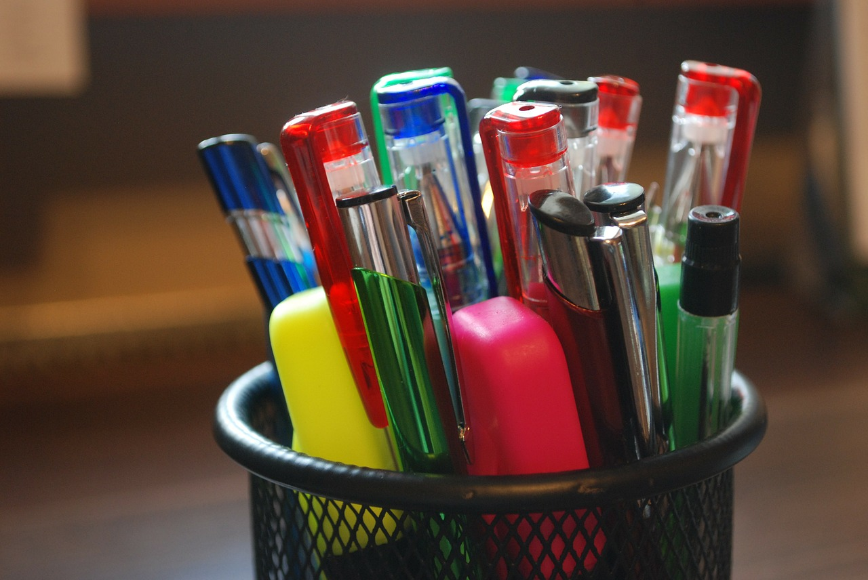
What has been learnt?
Looking at the graffiti walls you completed at the start of the lesson. Using a different colour pen, add new information about what you have learned about dental health.
Notes:
Teacher Notes (5 MIN) Endpoint assessment
Ask pupils to revisit the graffiti walls and add new ideas based on their learning in the lesson. For new (or original) ideas, ask pupils to justify their choices where possible e.g. spit out toothpaste rather than rinse with water – fluoride stays on the teeth for longer

Slide 20

More activities
Dental health leaflet for parents
Create a leaflet for parents about maintaining their child’s dental health
The leaflet could feature:
information on sugar intake
the importance of teeth brushing
avoiding harmful actions such as smoking
Notes:
Teacher Notes
This activity can be used to extend the learning, either in lessons or as home learning.

