Slide 1



Ensure you read the guidance before teaching the lesson
Teacher
slide
Drug and alcohol education
KS1
Year 1 / 2 Lesson 3:
Keeping safe: medicines and household products
© PSHE Association 2020

Slide 2

Using this PowerPoint
Teacher
slide
The slides in this presentation are divided into two sections:
Teacher slides (purple) – provide key information regarding lesson preparation
Pupil slides (white) – provide a visual focus point for pupils during the lesson and delivery notes for teachers about the activities. Click ‘notes’ to view these.
Ensure that you select ‘Use Presenter View’ under the ‘Slide Show’ tab – this will allow you to preview the teaching notes on your monitor while the main presentation is displayed on a screen/smartboard.
© PSHE Association 2020

Slide 3

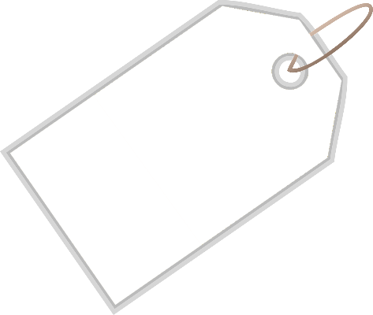

Challenge and support
Teacher
slide
The lesson includes suggestions for challenge and support activities, to help you differentiate appropriately for your class.
Challenge activities deepen and extend the learning for those who need more challenge or who finish the activity quickly.
Support activities are adapted to be more accessible for those who need it.
Look for the logo on the pupil slides. See delivery notes for details of the activities.
Support
Challenge
© PSHE Association 2020

Slide 4
Context
Teacher
slide
This is the third lesson in a set of three for key stage 1 pupils about managing risks in relation to household products and medicines. It focuses on safety rules at home and in familiar environments. Pupils identify risk in different situations and what to do to keep themselves and others safe. Pupils also explore how to manage when feeling pressure to do something that looks like fun but might be harmful to theirs, or others’, bodies.
Neither this, nor any of the other lessons, is designed to be taught in isolation, but should always form part of a planned, developmental PSHE education programme.
© PSHE Association 2020

Slide 5
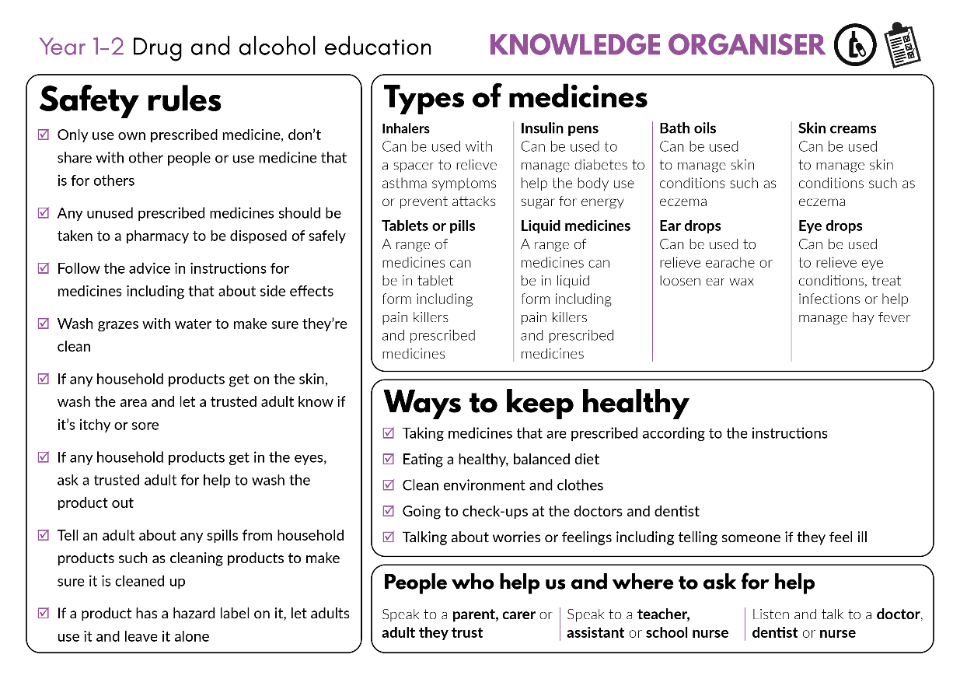


Developing subject knowledge
Teacher
slide
Key information on content related to these lessons can be found in the Year 1-2 Knowledge Organiser.
Advice on safe practice, dispelling common misconceptions, visitors to the classroom and other important information can be found in Teacher Guidance: Drug and alcohol education
Data sources to inform your planning can be found within our document that outlines the approach of these lessons Evidence Review: Effective drug and alcohol education, along with advice regarding how to talk to young people about addiction, dependency and problematic substance use
© PSHE Association 2020

Slide 6



Teacher
slide
      Learning objective
To learn about the rules for keeping safe around medicines and other household products
      Learning outcomes
Pupils will be able to:
  state safety rules for the use of medicines and other household products
  recognise risk in situations related to medicines and household products, including when there is pressure to do something which is unsafe or may cause someone to be unwell
  identify what to do next in a situation that may involve risk
  identify when asking for adult permission is required (in relation to medicines and household products)

Slide 7




Teacher
slide
Preparing to teach
      Climate for learning
Make sure you have read the accompanying teacher guidance notes before teaching this lesson for guidance on establishing ground rules, the limits of confidentiality, communication and handling questions effectively.
      Resources required
Box or envelope for anonymous questions
Collection of empty and washed medicine and household product bottles, containers and packets or selected pictures from Lesson 1: Resource 1. Picture cards [1 set per class]
Resource 1: Safety rules quiz cards [1 per class or small group]
Resource 2: Risk cards [1 set per group]
Resource 2a. support: Action cards [1 set of per pupil or small group]
Resource 3: Pressure cards [1set per class]
      Duration
      This has been designed to be taught as a sixty minute PSHE education lesson
      Further guidance
      Members of the PSHE Association can access our website for further guidance www.pshe-association.org.uk
60
© PSHE Association 2020

Slide 8
Teacher
slide
Lesson summary
Activity | Description | Timing
1. Introduction | Remind pupils of ground rules. Pupils view different household products pictures or empty packaging and think about how these are used at home and school | 5 MINS
2. Baseline assessment | In pairs, pupils discuss safety rules involving the use of household products and medicines | 5 MINS
3. Safety rules quiz | As a class or in small groups, pupils decide whether a safety rule is true, false or whether it depends on the situation | 10 MINS
4. Safety rules scenario | Pupils read scenarios where safety rules might be broken, identify the risk and suggest what the character should do next | 15 MINS
5. What if? | Pupils discuss scenarios in the light of additional pressure characters may feel from themselves or others | 15 MINS
6. Signposting support | Discuss when someone should ask for help and who to ask | 5 MINS
7. Plenary/End-point assessment | Pupils pair up and share their learning on safety rules, then meet with another pair, share and compare | 5 MINS
© PSHE Association 2020

Slide 9
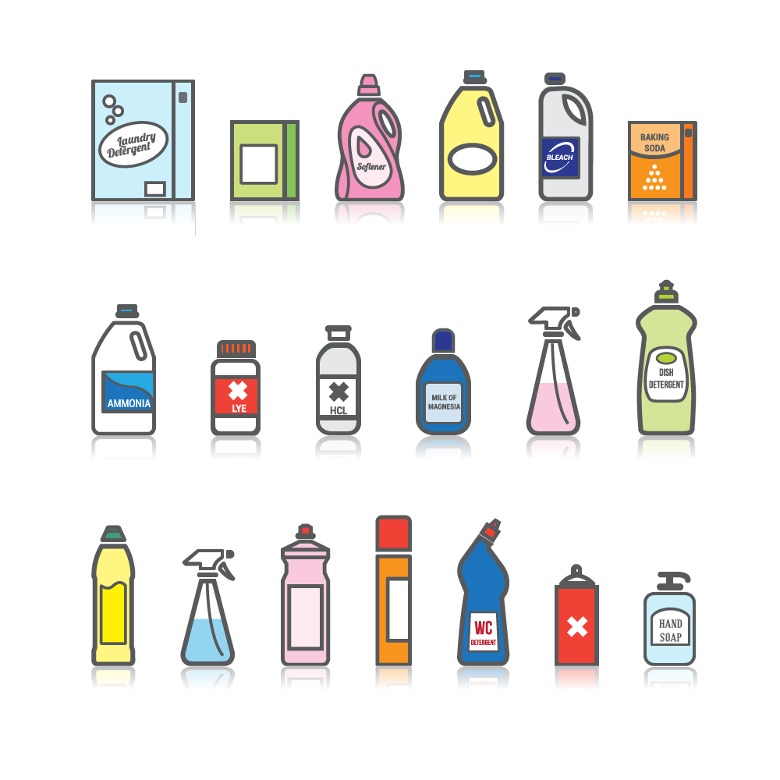

Lesson 3
Keeping safe: medicines and household products

Slide 10

Ground rules
[Add your class rules here]
Notes:
Teacher Notes
Use this slide to display your class agreement / ground rules for PSHE education lessons. See Accompanying Teacher Guidance Notes (separate document).
Remind pupils of the ground rules for PSHE lessons and highlight any particular to the lesson, such as ‘if anything comes up in this lesson that makes me worried about your safety at home or school, I will need to tell another teacher, to make sure you stay safe in the future, or if you are worried about something you can let me know but writing a note and putting it in the talk-to-the-teacher note-box.’

Slide 11
We are learning about the rules for keeping safe around medicines and other household products
      We will be able to:
  state safety rules for medicines and household products
  recognise risky situations with medicines and household products
  say what to do next in a risky situation
  identify when to ask for adult permission
Notes:
Teacher Notes – Learning objective and outcomes
Introduce the learning outcomes - these are a simplified, more pupil-friendly version of the outcomes on slide 6 (teacher slide).

Slide 12
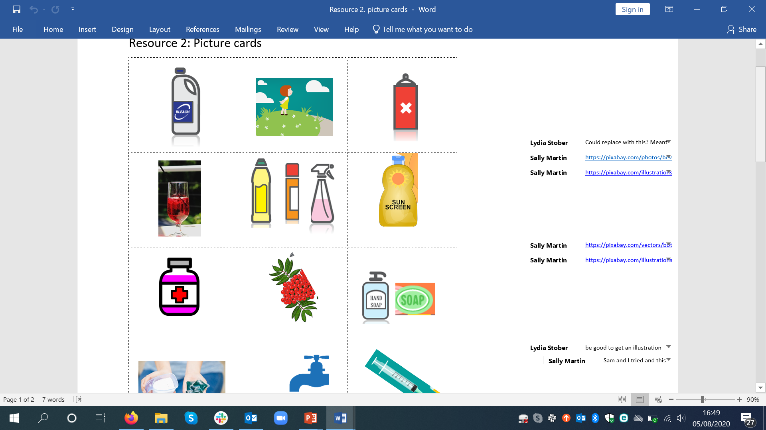
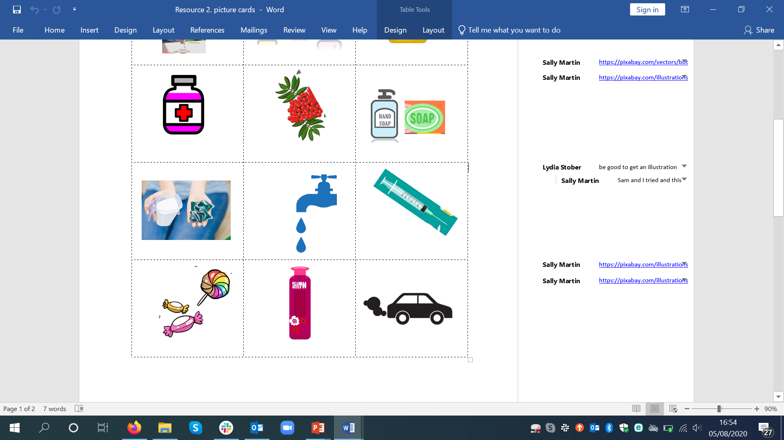
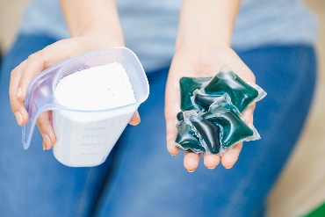
Medicines and household products
Items like these are often found in our homes and at school.
What are they?
What are they used for?
Who might use them?
Where are they kept?
Notes:
Teacher Notes – Introduction (5 min)
Display empty, washed packaging from household products, including cleaning products and medicines or use pictures from Lesson 1 - Resource 2. Picture cards.
Ask pupils to discuss the questions displayed on the slide.

Slide 13
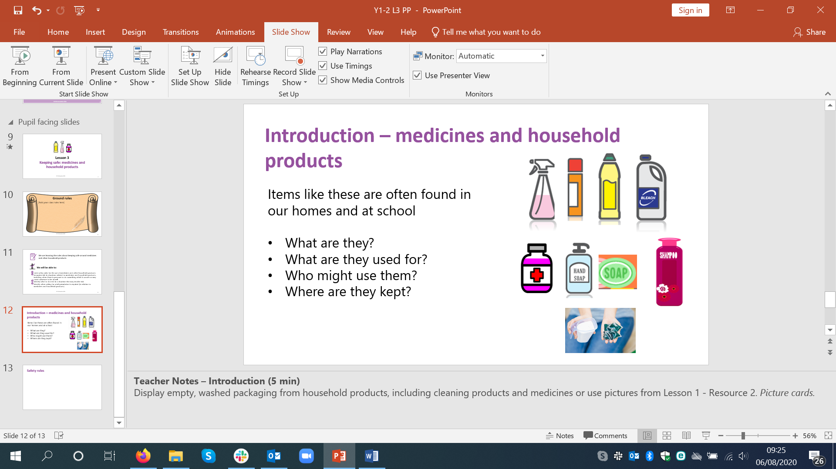
What’s our starting point?
Talk to your partner.
Are there any safety rules about using these products?
What are the safety rules?
Notes:
Teacher Notes – Baseline assessment (5 min)
Ask the pupils to discuss the questions in pairs, then share their ideas with the class.
Use their responses to gain a sense of what they already know and think.
Pupil responses might include:
Be careful not to spill any – if any gets spilt clean it up immediately; don’t put it in your mouth; don’t put onto skin; if it goes in your eyes wash straight away and don’t rub them; don’t use it if it is not yours, check how much to use; check if you are allowed to use it; only an adult should use it or give it to you.

Slide 14


Safety rules quiz
Listen to the safety rules.
Decide whether the rule is:
True
False
It depends
?
Notes:
Teacher Notes – Safety rules quiz (10 mins)
Display the safety rules from Resource 1: Safety rules quiz cards reading each one aloud in turn. Pupils discuss and decide whether each safety rule is – true / false / depends. Categorise the safety rule under one of the headings. This activity can be carried out with the teacher leading the whole class or with pupils working in small groups.
If the pupils suggest ‘it depends’, discuss this rule in more detail, encouraging them to explain their thinking or give an example of when the safety rule might ‘depend’.

Slide 15



Safety rules quiz answers
?
1. Children should not use medicines without an adult helping.
IT DEPENDS
2. Medicines and cleaning products must be kept out of reach of children.
TRUE
3. If someone is ill any medicine will help them.
FALSE
4. It is important to use (or take) the amount instructed on the bottle or packet.
TRUE
Notes:
Teacher Notes – Safety rules answers
If the pupils suggest ‘it depends’, discuss this rule in more detail, encouraging them to explain their thinking or give an example of when the safety rule might ‘depend’.

Slide 16
Safety rules quiz answers
5. If you see a syringe you should pick it up and put it in the bin.
FALSE
6. All medicines should be taken twice a day.
FALSE
7. Always read the instructions before using a medicine or household product.
TRUE
8. Medicines last forever.
FALSE

Slide 17
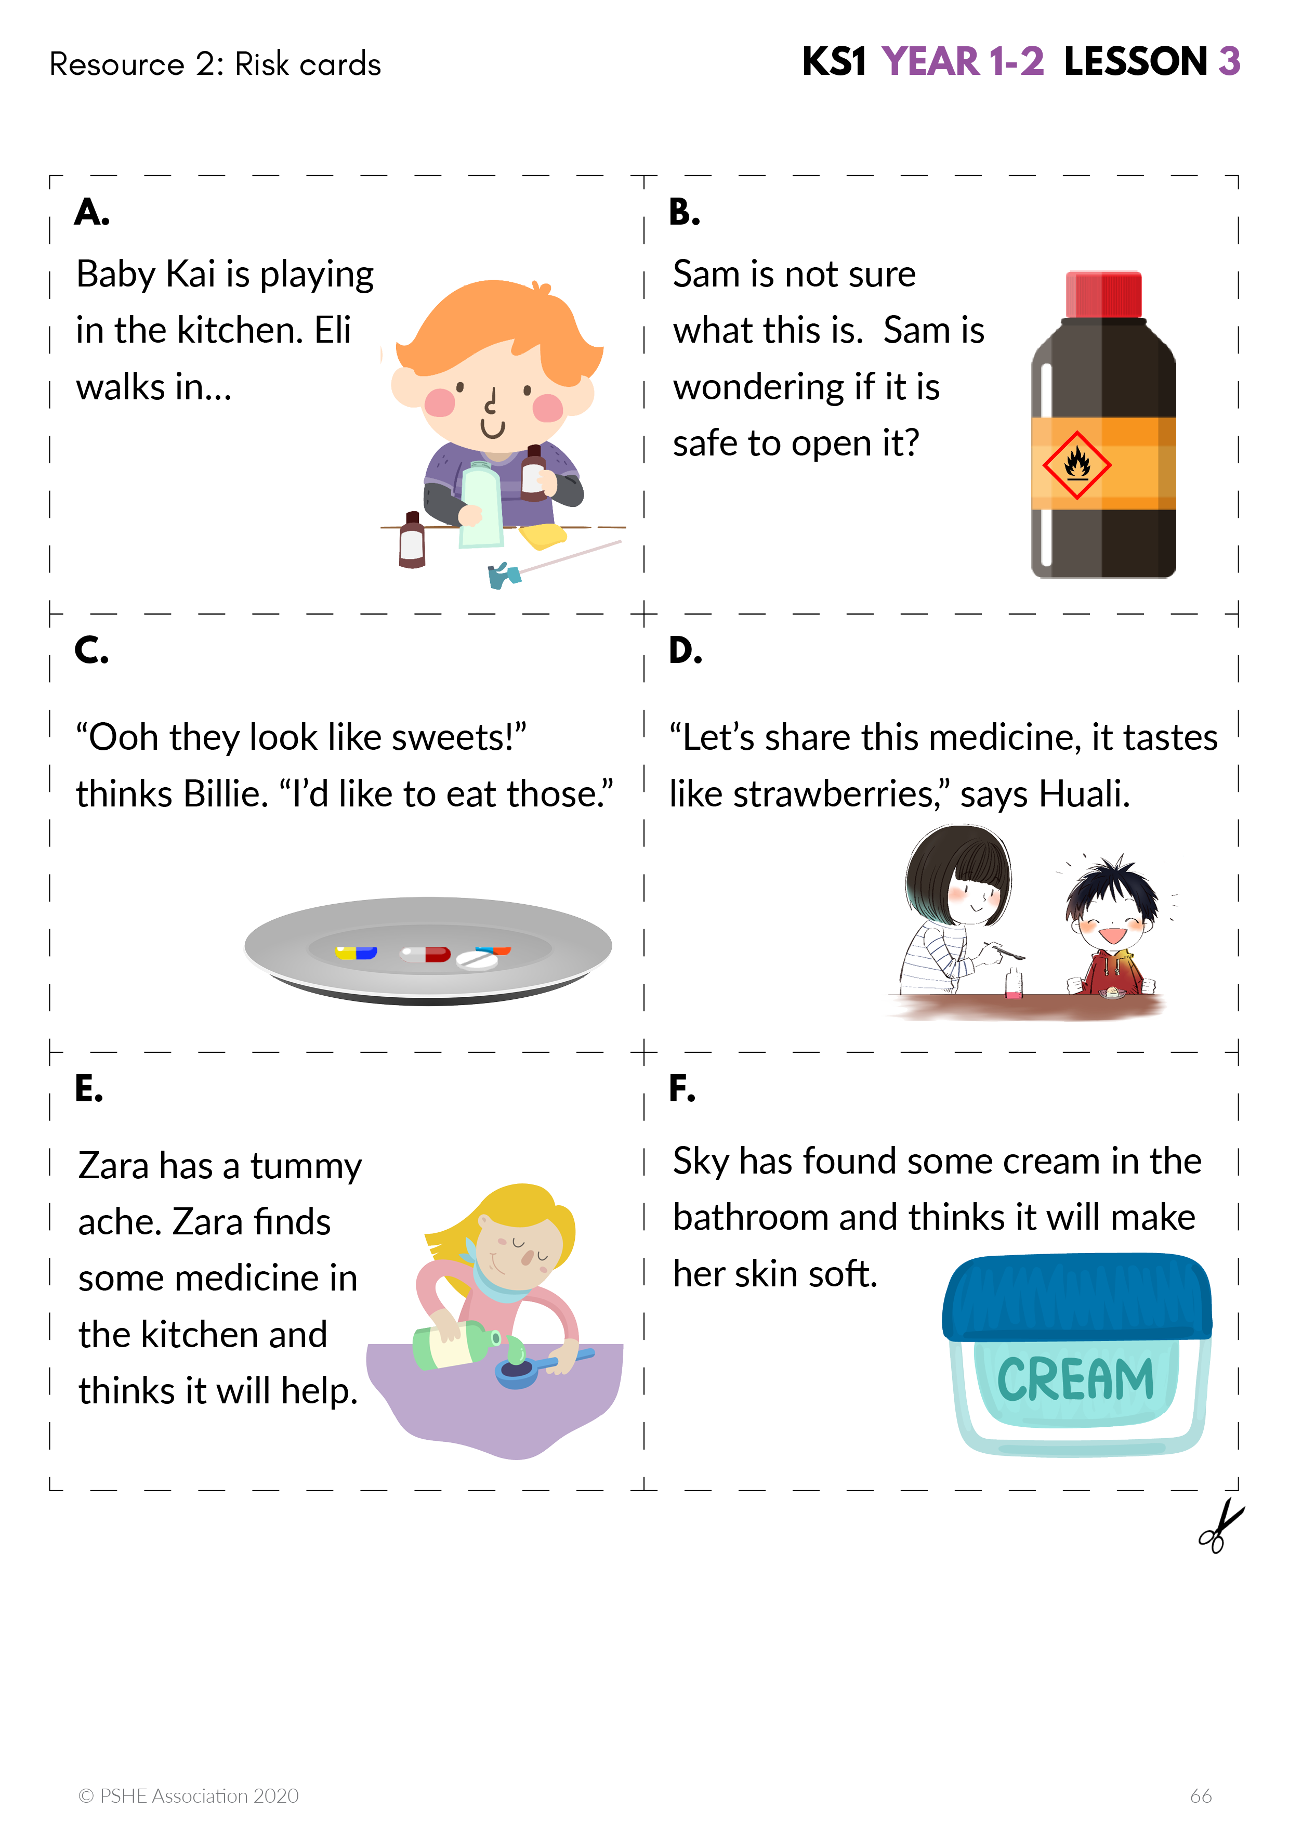
Safety rules scenarios
Read the Risk cards with your group.
Then talk about:
Why is it unsafe?
What could the character/s do to help prevent a danger?
Notes:
Teacher Notes – Safety rules scenarios (15 mins)
In groups, pupils are given simple sentence cards with pictures (Resource 2. Risk cards). Pupils discuss what the risk or danger might be in the scenario.
Why is it unsafe? What could the character/s do to help prevent a danger?
Support: Pupils are given a scenario from Resource 2. Risk cards and Resource 2a. Action cards. They look at the action cards and organise them into things the character should do and things the character shouldn’t do in the situation.
Challenge: Pupils complete the activity and then write a safety rule to match each scenario.

Slide 18
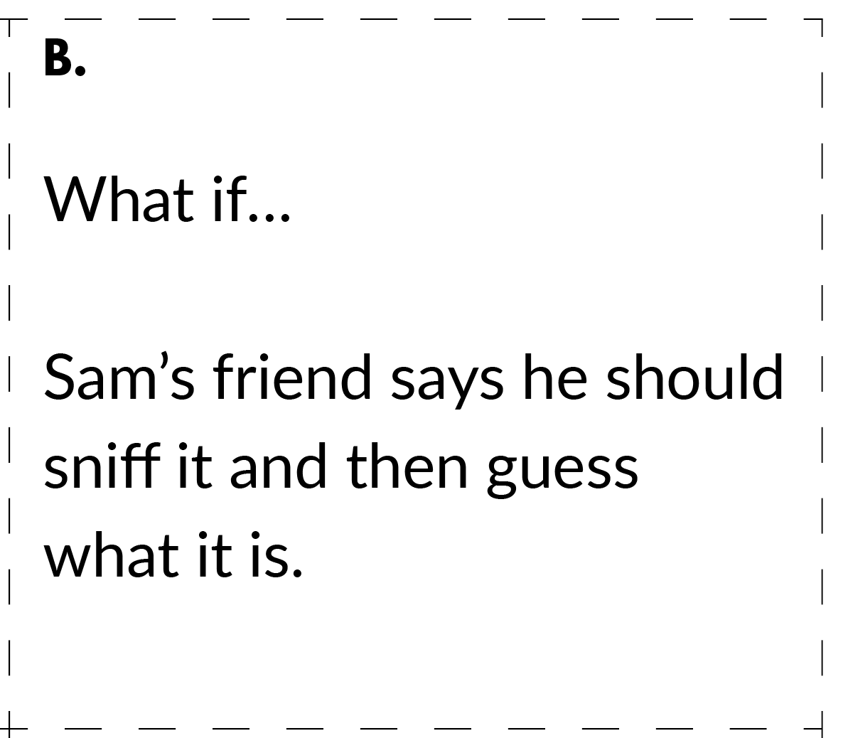
What if…?
Listen to the matching Risk card and ‘What if…’ scenario.
How might the character feel with the added pressure?
Would it make it easier or harder to keep safe?
How should they handle the situation to help prevent (or stop) an accident from occurring?
Notes:
Teachers Notes – What if…? (15 mins)
Choose some of the scenarios from activity 2: safety rule scenarios – see Resource 2. Risk cards. Find the matching ‘What if…?’ statement on Resource 3. Pressure cards. Read aloud the scenario on the risk card and then the corresponding pressure statement. Invite pupils to role play the character and how to manage the situation positively. Then, with the class discuss the questions
To ensure role play is managed sensitively, choose pupils who feel confident to role play and be sure to provide a signal or countdown for pupils stepping ‘into role’ and another for coming ‘out of role’.

Slide 19

Getting support
Remember to tell a trusted adult if an accident happens, or if you think one is going to happen.
Talk to a trusted adult at home or at school if you are not sure about touching a household product or medicine.
Notes:
Teacher notes – Signposting support (5 mins)
Discuss the importance of telling an adult if there is a likelihood of an accident and that if an accident has happened, the importance of getting help quickly. If there is an emergency and no adults are available, they should phone 999. If there is something they are not sure about, such as whether to touch a household product or medicine, they should not be persuaded to do it, but should always seek help from a trusted adult at home or school first.

Slide 20


What has been learnt?
Talk to your partner about the safety rules in the lesson.
Now, meet with another pair and share your ideas.
Are there any safety rules you have learnt that you didn’t know before?
?
Notes:
Teacher Notes – End-point assessment (5 mins)
Pairs of pupils think about the safety rules they have learned during the lesson, then meet with another pair, share and compare ideas.
Ask pupils: Are there any they have learned that they didn’t know before?

Slide 21


More activities
Make a list of safety rules about household products and medicines for a display.
Notes:
Teacher Notes – Extension activity
Pupils make a class list of safety rules about household products and medicines for display.

