Slide 1


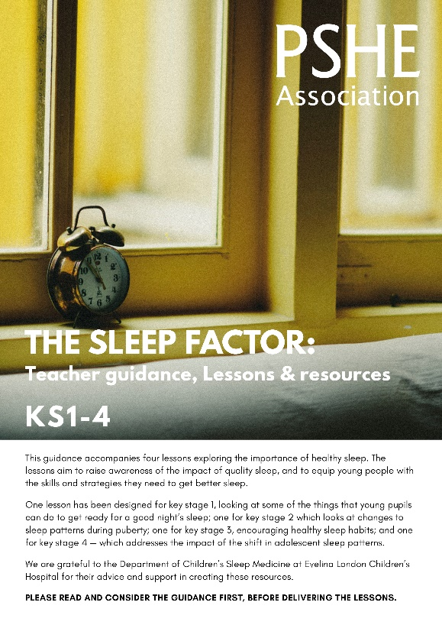
Teacher
slide
Ensure you read the guidance before teaching the lesson
The Sleep Factor
KS3
Healthy sleep

Slide 2

Teacher
slide
Using this PowerPoint
The slides in this presentation are divided into two sections:
Teacher slides (purple) – provide key information regarding lesson preparation
Pupil slides (white) – provide a visual focus point for pupils during the lesson and delivery notes for teachers about the activities. Click ‘notes’ to view these.
Ensure that you select ‘Use Presenter View’ under the ‘Slide Show’ tab – this will allow you to preview the teaching notes on your monitor while the main presentation is displayed on a screen/smartboard.
© PSHE Association 2018

Slide 3



Teacher
slide
Challenge and support
The lesson includes suggestions for challenge and support activities, to help you differentiate appropriately for your class.
Challenge activities deepen and extend the learning for those who need more challenge or who finish the activity quickly.
Support activities are adapted to be more accessible for those who need it.
Look for the logo on the student slides. See delivery notes for details of the activities.
Support
Challenge
© PSHE Association 2018

Slide 4
Teacher
slide
Context
There is an accompanying lesson for Key Stage 1, which explores good sleep habits, key stage 2, which explores the impact of puberty on changing sleep patterns; and for key stage 4, which reinforces the importance of sleep for wellbeing and personal effectiveness.
This lesson explores the importance of good quality sleep — particularly during a time of transition between primary and secondary school, when routines, schedules and pressures are likely to change.
This lesson is best used within the context of a unit of work on healthy, balanced lifestyles, or during sessions on transition.

Slide 5
Developing subject knowledge
Teacher
slide
Teenagers need approximately 9 hours of sleep per night.
Many are averaging approximately 7 hours.
After puberty, the internal clock of an adolescent undergoes a biological shift of up to 2 hours later.
The time that teenagers naturally wake up also shifts by up to 2 hours later.
Teenagers will benefit from a regular sleep schedule.
The time before bed (at least 60 minutes) should allow for winding down and must avoid screen use (e.g. TV, phones, tablets etc.).
Teenagers should avoid caffeinated or high-sugar products such as fizzy drinks, tea or coffee and sweets.
Spending time outdoors every day (especially in the morning) can
be beneficial to sleep.
Notes:
More information can be found in the guidance notes that accompany this resource.

Slide 6



Teacher
slide
      Learning objective
To learn about healthy sleep
      Learning outcomes
Students will be able to:
explain the impact of sleep on health and wellbeing
describe healthy sleep patterns and identify factors which can reduce sleep quality
describe a range of strategies for ensuring appropriate sleep patterns
© PSHE Association 2018

Slide 7




Teacher
slide
Preparing to teach
      Climate for learning
Make sure you have read the accompanying teacher guidance notes before teaching this lesson —
for guidance on establishing ground rules, the limits of confidentiality, communication and handling
questions effectively.
    Resources required
Box or envelope for anonymous questions
Blank postcards
Resource 1a: Sleep quiz
Resource 1b: Teacher answers
Resource 2: Sleep benefits
Resource 3: Sleep scenarios
      Duration
      This has been designed to be taught as a sixty minute PSHE education lesson
      Further guidance
      Members of the Association can access our website for further guidance
      www.pshe-association.org.uk
60
© PSHE Association 2018

Slide 8
Teacher
slide
Lesson summary
Activity | Description | Timing
Introduction | Introduce or revisit ground rules | 5 MINS
2. Baseline assessment | Students complete a true or false quiz about healthy sleep | 15 MINS
3. Diamond 9 | Students evaluate the importance of nine benefits of sleep | 10 MINS
4. Sleep strategies | Students work in groups to suggest a range of strategies to promote good quality sleep | 10 MINS
5. Sleep scenarios | In four groups, students review case studies of poor sleep and make recommendations to each character | 15 MINS
6. Endpoint assessment | Students complete an exit card highlighting key things they have learnt about sleep | 5 MINS
© PSHE Association 2018

Slide 9

Z
Z
Z
Z
Healthy sleep
© PSHE Association 2018

Slide 10

Ground rules
[Add your class rules here]
© PSHE Association 2018
Notes:
Teacher Notes
Use this slide to display your class agreement / ground rules for PSHE education lessons. See Accompanying Teacher Guidance Notes (separate document).

Slide 11

  We are learning about healthy sleeping habits
      We will be able to:
  explain the impact of sleep on health and wellbeing
  describe healthy sleep patterns and identify factors which can reduce sleep quality
  describe a range of strategies for ensuring appropriate sleep patterns
© PSHE Association 2018
Notes:
Teacher Notes - Learning objectives and outcomes
Introduce the learning objectives and outcomes, explain that today’s lesson is about healthy sleep habits and will explore both the importance of, and habits to help achieve, healthy sleep, particularly during teenage years.

Slide 12
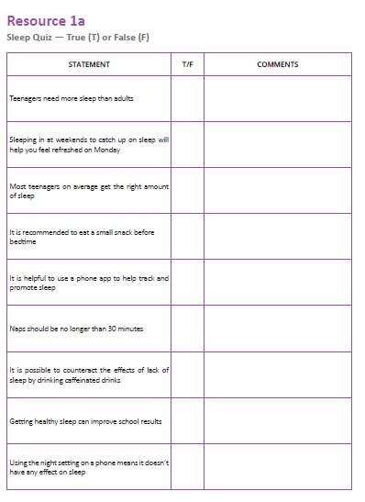


Z
Z
Sleep quiz
Z
Look at each statement and decide if it is true or false.
If you think its false, write what you think the truth might be in the comment box next to the statement.
True
False
© PSHE Association 2018
Notes:
Teacher Notes - Baseline activity (15 mins)
Hand out Resource 1a: Sleep quiz and ask students to complete the quiz, indicating ‘T’ for True and ‘F’ for False. In the final column, students should add what they think is the truth for any statement that they have identified as false.

Slide 13


Quiz answers
Teenagers need more sleep than adults
Sleeping in at weekends to catch up on sleep will help you feel refreshed on Monday
Most teenagers on average get the right amount of sleep
It is recommended to eat a small snack before bedtime
It is helpful to use a phone app to help track and promote sleep
True
False
False
True
False
© PSHE Association 2018
Notes:
Teacher Notes
Take class feedback (this could be through holding up true/false cards, class vote or standing on different sides of the room to represent true/false/not sure). Use Resource 1b to challenge misconceptions and provide additional information.

Slide 14
Quiz answers
Naps should be no longer than 30 minutes
It is possible to counteract the effects of lack of sleep by drinking caffeinated drinks
Getting healthy sleep can improve school results
Using the night setting on a phone means it doesn’t have any effect on sleep
True
False
True
False

Slide 15


Sleep benefits
Most important
What are the benefits of sleep?
Sort the cards into a diamond 9 showing the most important benefits of sleep.
Put the most important benefit at the top, then the next two most important benefits, down to the least important.
Less important
© PSHE Association 2018
Notes:
Teacher Notes (10 MIN) Diamond 9
Give each pair/small group a set of Resource 2: Sleep benefits. Ask students to form a diamond 9 with the cards, showing the benefits they think are the most important at the top, down to those they think have less of an impact (1, 22, 333, 44, 5), recognising that there are no absolute right or wrong answers. During feedback, each group could be encouraged to share the card they chose as ‘most important’.
Support: Hand students 5 cards and ask them to create a small diamond with fewer benefits (1, 222, 3)
Challenge: Ask students to prioritise the cards in two different orders; firstly, thinking about a young person’s priorities during exam time and then again during the summer holidays. Have any priorities changed?

Slide 16

Sleep strategies
What techniques or strategies could someone use to get better sleep?
Tip: you could do this by making a list of Do’s and Don’ts that someone could use to promote good quality sleep.
© PSHE Association 2018
Notes:
Teacher Notes (10 MIN) Sleep strategies
Ask students to continue working in their groups to generate a list of any habits or strategies that they think a person could use to promote good quality sleep. They could formulate this as a Dos and Don’ts list.
Take feedback from the class, referring back to the initial baseline T/F answer sheet.
Support: Some groups may need prompting through questioning (which could be displayed or discussed):
• What should the bedroom environment be like for good sleep?
• What activities should be avoided before sleep?
• What routines might make someone feel calm, relaxed and ready for sleep?
• What could someone do if they were struggling to fall asleep?

Slide 17




Sleep scenarios
1. What habits might be preventing your character from getting good quality sleep?
2. What might be the consequences for your character if they don’t get good quality sleep?
3. What could your character do differently to help them get better quality sleep?
© PSHE Association 2018
Notes:
Teacher Notes (15 MIN) Sleep scenarios
In four (or eight) different groups, give each a different character from Resource 3: Sleep scenarios. Ask them to read through the scenario and identify the things in the questions in the slide.
Challenge: Look back at the benefits of sleep from the Diamond 9 activity — which benefits would be most helpful to persuade the character to get better sleep?

Slide 18
Klaudia
Benji
Klaudia needs to review her schedule as she is currently only getting 7 hours’ sleep.
She is eating and exercising very late.
She should think about how to prioritise or reorganise her schedule so that she is able to get better sleep.
Benji has very erratic sleep patterns.
He should reduce his use of caffeine drinks (especially in the afternoon).
He should try to avoid napping and sleeping in at the weekends.
Instead he needs to establish a more consistent routine.
Notes:
Use these slides to take feedback from each group and to summarise key learning

Slide 19
Ryan
Shaznay
Ryan needs to focus on reducing his stress.
He could organise his school bag in the evening before bed.
He should try to do something relaxing and calming before bed.
This will mean he is better able to function (and feel less stressed) the next day.
Shaznay may be more affected by her phone than she thinks.
Regular disturbances during the night and looking at backlights before sleep lead to poorer quality sleep overall.
She should remove her phone from her bedroom at night and make sure it is turned off.

Slide 20


What has been learnt?
Complete the following three sentences on your exit card:
Three things that help promote good sleep are…
Two benefits of good quality sleep are…
One question I still have about sleep / today’s lesson is…
Hand in your exit card as you leave the room
© PSHE Association 2018
Notes:
Teacher Notes (5 MIN) Endpoint assessment
Ask students to complete an exit card to hand in on their way out of the room (either on blank postcards or paper) summarising what they have learnt during the lesson.
NB: If asking students to write questions about a topic, particularly as part of a plenary activity, it is vital that these are returned to and answered in subsequent lessons.
Display ‘Further support ‘slide on next page as students are working.

Slide 21

Further support
If you’re worried about your sleep, you can always speak to your parent or carer, or a teacher in school for more advice and support.
The ChildLine website has advice about sleep for young people:
www.childline.org.uk
Phone: 0800 1111
NHS Direct (Tel: 111) can be called for non-urgent medical issues or for further information.
© PSHE Association 2018
Notes:
Teacher Notes
During the assessment activity, display a range of support services for people who are concerned about the issues related to sleep and ensuring a balanced lifestyle. These should include people in school (such as the tutor, head of year or school nurse).

Slide 22


More activities
Healthy sleep into action
Healthy sleep campaign
Reflect on one thing you think you could change about your evening routine to promote better sleep.
Create an advertising campaign to promote healthy sleep.
This could include …
A poster or flyer to raise awareness
A tagline or slogan
A logo
An information
leaflet
© PSHE Association 2018
Notes:
Teacher Notes
These activities can be used to extend the learning, either in lessons or as home learning.

