Slide 1


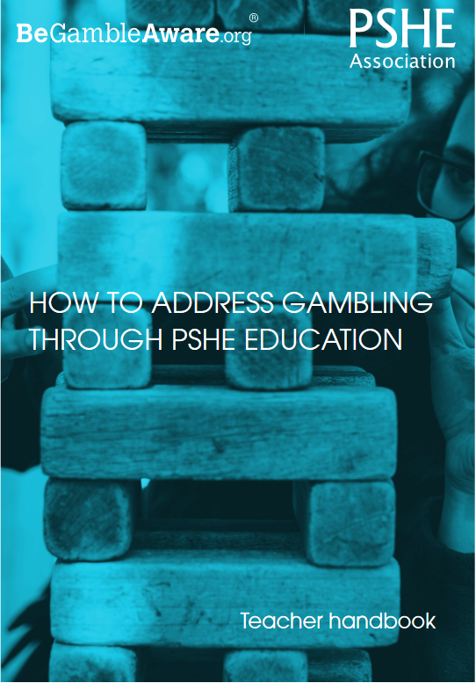
Teacher
slide
Chancing It!
Exploring risk in
relation to gambling
KS2 – Year 5/6
Ensure you read the guidance before teaching the lesson
© PSHE Association & Gamble Aware, 2020

Slide 2
Teacher
slide
Using this PowerPoint
The slides in this presentation are divided into two sections:
Teacher slides (blue) – provide key information regarding lesson preparation
Pupil slides (white) – provide a visual focus point for pupils during the lesson and delivery notes for teachers about the activities. Click ‘notes’ to view these.
Ensure that you select ‘Use Presenter View’ under the ‘Slide Show’ tab – this will allow you to preview the teaching notes on your monitor while the main presentation is displayed on a screen/smartboard.

Slide 3
Teacher
slide
Context
This lesson is designed to support pupils in key stage 2 to consider risk in relation to gambling and is intended to build on prior learning exploring the nature of risk and risk assessment.
This lesson is not designed to be taught in isolation and should form part of a planned, developmental programme for PSHE education. Timings provided are approximate – teachers are expected to adapt delivery according to the needs of their pupils.
Young people are increasingly exposed to gambling and gambling-related activity, including through gaming, advertising, social media, betting shops, arcades and casinos. It is important that even at a younger age, pupils build the skills to navigate a world (both offline and online) where gambling is prevalent and start to develop a nuanced understanding of risky gambling behaviours and the impact of problem gambling on people’s health and wellbeing.

Slide 4
Teacher
slide
      Learning objective
To learn about risk in relation to gambling
      Learning outcomes
Pupils will be able to:
explain risk in relation to gambling
identify how winning and losing can affect a person’s feelings and what makes someone want to take the risk
describe what can influence someone to gamble or feel pressure to do so
recognise who to ask for help if concerned about gambling or the pressure to do something like gambling

Slide 5
Teacher
slide
Preparing to teach
Climate for learning
Make sure you have read the accompanying teacher guidance notes before teaching this lesson – for guidance on establishing ground rules, the limits of
confidentiality, communication and handling questions effectively.
Resources required
Box/envelope for anonymous questions
Flip chart paper and marker pens
Resource 1: Gambling draw and write
Resource 2: Chance cards
      Duration
      This has been designed to be taught as a sixty minute PSHE education lesson
60

Slide 6
Teacher
slide
Lesson summary
Activity | Description | Timing
1. Baseline assessment | Before the lesson, pupils complete a draw and write activity and ask an anonymous question | 20 MINS
2. Introduction | Explain what is meant by gambling | 5 MINS
3. Dilemma discussion | Pupils discuss a gambling and respond to questions in relation to the dilemma | 15 MINS
4. Analysing influences | Pupils discuss what might influence a person to gamble and what makes them more likely to win or lose | 10 MINS
5. Pupil questions | Pupils respond to some of the questions they had before the lesson, provide additional input | 10 MINS
6. Plenary | Signpost appropriate support. Pupils provide phone advice to the character from the dilemma about how to manage the scenario | 15 MINS
7. Extension activity | Pupils add further advice imagining the character wins or loses the money in the scenario

Slide 7
Chancing It!
Exploring risks
related to gambling

Slide 8

Ground rules
[Add your class rules here]
Notes:
Teacher Notes
Use this slide to display your class agreement / ground rules for PSHE education lessons. See Accompanying Teacher Guidance Notes (separate document).

Slide 9

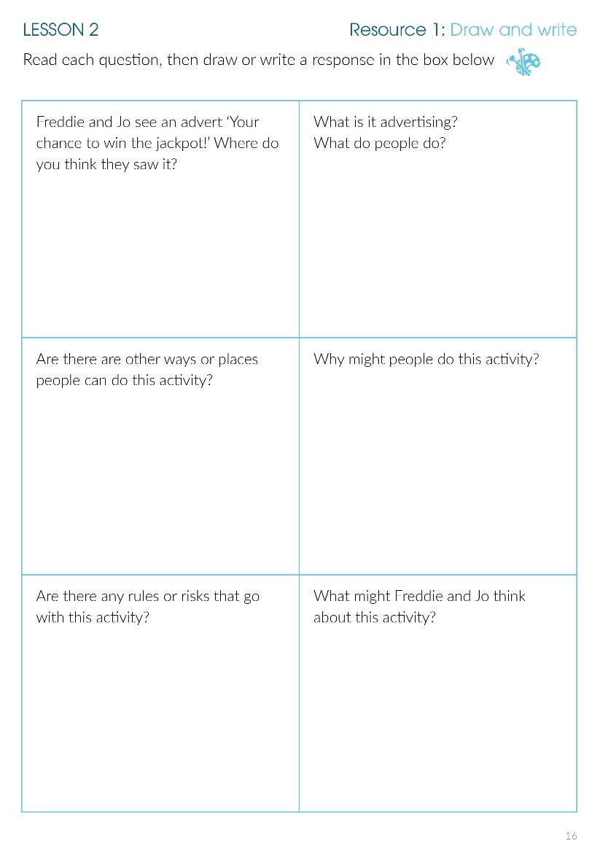
What’s our starting point?
Draw and write:
Draw or write a response in each box on the sheet… write your name at the top of the sheet.
Notes:
Teacher Notes - Baseline assessment (20 mins)
Before teaching this lesson, it is important to be aware of pupils’ prior knowledge of, and attitudes towards gambling. Pupils should complete the activity: Resource 1: Draw and write before the lesson. Following the draw and write activity, provide an anonymous questions box – pupils write down a question they have and post it in the box.
Allow time to consider their responses and assess current understanding. This can help you decide which age-group this lesson is most suitable for, prepare for questions and concerns pupils might raise in the lesson and get a sense of the type of responses you might expect from the lesson activities. Prepare responses to pupils’ questions to revisit in the lesson – choose age-appropriate questions and answers that are suitable to be explored in the classroom. (See PSHE Association teacher guidance – teaching about mental health and emotional wellbeing - handling questions).

Slide 10

      We are learning about gambling and risk
      We will be able to:
  explain risk in relation to gambling
  identify how winning and losing makes someone feel and what makes them want to take the risk
  describe what can influence someone to gamble or feel pressure to do so
  recognise who to ask for help if concerned about gambling or the pressure to do something like gambling
Notes:
Teacher Notes – Learning objective and outcomes
Introduce the learning objectives and outcomes

Slide 11
What is gambling?
Gambling is a risk where money (or something else of value) is swapped in the hope of winning something better (e.g. more money). Participants have no idea if they will win or lose.
Notes:
Teacher Notes – Dilemma discussion (20 mins)
Explain what is meant by gambling – use the explanation on the slide to help.
Explain that gambling is an activity meant for adults, but that sometimes even adults can find it difficult to manage the risks and feel they can easily lose control. Many adults choose not to gamble at all (because they think it is not worth it and it can cause bad feelings; for some people it is against their values or religious beliefs).
Discuss other words or phrases that relate to or mean the same as gambling but that may be more familiar to the pupils, such as: placing a bet, betting

Slide 12


Drew’s dilemma
Drew is thinking about playing a game. Drew has £5. There are ten boxes: nine contain £0 and one contains £50. Drew can choose to keep the £5 or gamble (swap, bet, play) the £5 for one box. Drew can choose which box but has no way of knowing what is in any box.
Notes:
Teacher Notes – Dilemma discussion (20 mins)
Working in small groups, pupils consider the scenario and respond to the questions below. Pupils can record their ideas on a piece of flipchart paper.
How is Drew feeling about making this decision?
What makes this game risky?
If Drew lost, how would Drew feel?
What might influence Drew to take the risk?
Support: Pupils can use drawings to respond to the questions.
Challenge: Pupils respond to an additional question: What if Drew could not afford to lose the money? Would this affect Drew’s decision whether to gamble? (For example, imagine Drew needs the £5 to buy their mum a birthday present).

Slide 13

Influences
Read the card…
Will this mean Drew is more likely to gamble or not gamble?
Will this mean Drew is more likely to win or lose?
Notes:
Teacher Notes – Analysing influences (15 mins)
Provide each group with cards from Resource 2: Chance cards. This activity could be delivered as carousel (passing the cards around the groups, giving each group a short while to discuss the information, before moving on to the next one) or by displaying them in the classroom and doing a ‘walk around’ activity.
Ask the pupils to answer two questions about the information on the cards:
Will this mean Drew is more likely to gamble or not gamble?
Will this mean Drew is more likely to win or lose?
Take feedback.
Draw some conclusions, such as:
Adverts or pop-ups are often designed to try and ‘hook’ people into gambling or to keep them trying over and over again; people can be persuaded or tricked into thinking it is easy to win; pressure can come from inside ourselves or from other people; gambling can become a habit – people get hooked on the idea they will win at some point; that it will make them feel better if they are not feeling good (although evidence shows it is more likely to make people feel bad more than it helps them to feel good). Sometimes people believe that ‘thinking positive thoughts’ or ‘luck’ can help them win, but gambling is based on chance there is (usually) no way of telling whether someone will win or lose.

Slide 14

Question Time
Can you give answers to your classmates’ questions?
Notes:
Teacher Notes – Pupils’ question time (10 mins)
Display questions about gambling (asked previously by the pupils). Pupils come up with responses to the questions themselves, help and guide their responses as appropriate.

Slide 15

Remember…
Sometimes people can be tempted to gamble things they cannot afford to lose or can feel like they have to gamble (it can become a habit) and can cause them to worry or feel bad.
The National Gambling Helpline for help, support and advice about gambling:
www.begambleaware.org/NGTS.html
Phone: 0808 8020 133
If you are worried about someone and gambling, or you are not sure whether a game is encouraging you to gamble, talk to someone you know and trust - at home or school.
The ChildLine website also has advice about gambling for young people: www.childline.org.uk
Phone: 0800 1111
Notes:
Teacher Notes – Signposting support (5 mins)
Explain that sometimes people can become ‘hooked’ on gambling (addicted) or that people can be tempted to gamble money or things they cannot afford to lose or that it’s not always easy to tell if a game is encouraging gambling. If pupils are worried about something they have seen (or heard about) or about someone they know in relation to gambling, they can ask for help and advice at school (e.g. teacher) or out of school (e.g. parent) or through Childline - www.childline.org.uk Phone: 0800 1111. The National Gambling Helpline​ 0808 8020 133 provides free help support and advice 24 hours a day, seven days a week, and is completely anonymous.

Slide 16

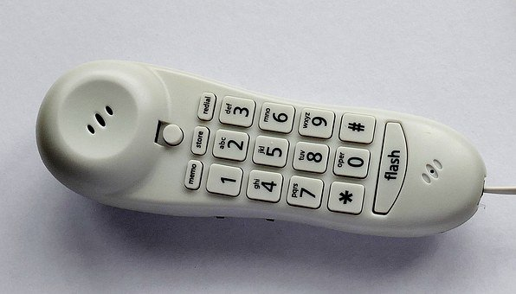
Where are we now?
Can you help advise Drew?
Imagine Drew has phoned to ask for advice, what would you say?
Notes:
Teacher Notes – End-point assessment (10 mins)
Pupils imagine themselves in the situation with Drew as ‘phone a friend’ – they provide advice for Drew and how best to manage the situation. Ask pupils to record a brief script of the phone advice they would give to Dev.

Slide 17

More activities
Phone a friend
Continue the phone conversation with Drew…
Imagine Drew gambled and won. What would you advise Drew does now… and in the future?
Imagine Drew gambled and lost. What would you advise Drew does now and in the future?
Notes:
Teacher Notes – Extension activities
Pupils add to their advice for Drew…

